Slide 1
Upfront IP access models in Sponsored research agreements
“Innovation to Impact” Discussion Series
August 25, 2021
Andrew Pollock
Interim Executive Director, Office of Technology Commercialization

Slide 2
Topics for Discussion
Why is IP so important in Sponsored Research Agreements?
New models to allow corporate sponsors access to resulting IP
What’s the process to offer these upfront options?
What happens after the SRA is signed?

Slide 3
We believe innovation from academic research can make a positive difference in the world. The Purpose of OTC is to help OU researchers transform ideas into tangible impact for the betterment of society.
The Mission of OTC is to provide the highest level of fiduciary expertise for the perfection, conveyance and commercialization of OU IP.
To be recognized as a driving force for OU’s economic impact through education, expertise and efficiency.
Purpose
Mission
Vision

Slide 4
Intellectual Property
What is Intellectual Property?
  Patents
    Most common in University
    Novel, Non-Obvious, Useful
    Please see “Publish and Patent without Perishing”
  Copyrights, Trademarks, Know-How
    Generally less expensive to Protect
    Lower Threshold to Meet
    Value more variable

Slide 5
IP Terms in Sponsored research
Historical Standard Terms:
  Background IP
    Ownership remains with cross license for use
  Project IP
    What each party creates they own
    Created jointly, owned jointly
    Rights to Project IP
      University grants Non-Commercial NERF
      Option to Commercially License

Slide 6
IP terms in sponsored research
Common Concerns from Industry:
  Who controls the outcomes:
    Often more familiar with Work Made for Hire
    Ownership vs. Access
      Issue is actually Access
      Ownership is limited by state asset law
      Access is governed by IRS Rev. Proc.
  Typically, able to reach resolution, however:
    Extends negotiation timeline
    Hard start to the partnership – IP Waiver
  Why is this so important?

Slide 7
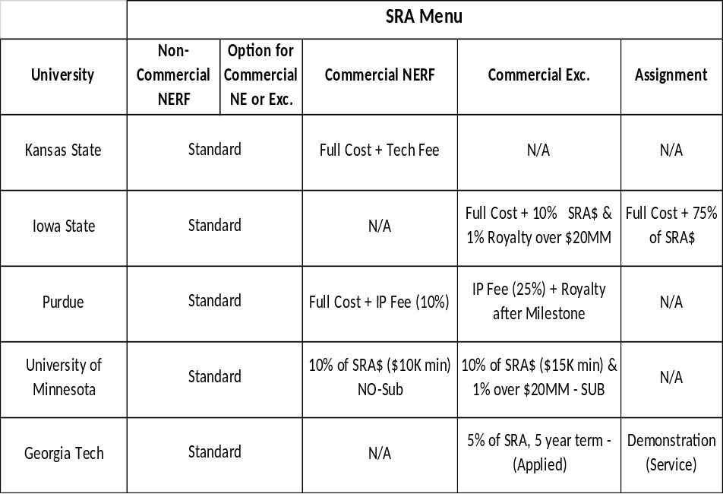
New models for access
IRS Rev. Proc. allows for a Safe Harbor amount of PBU
In 2016 began testing a “Kicker” model
Not the first to try this:

Slide 8
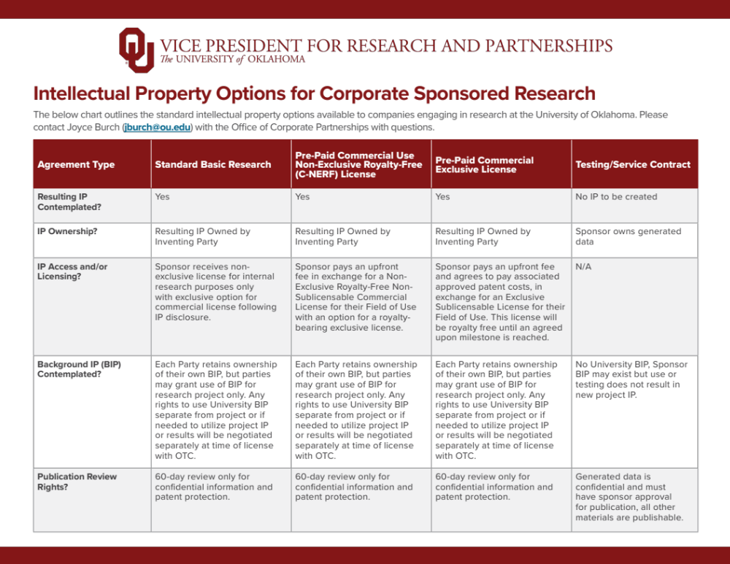

Slide 9
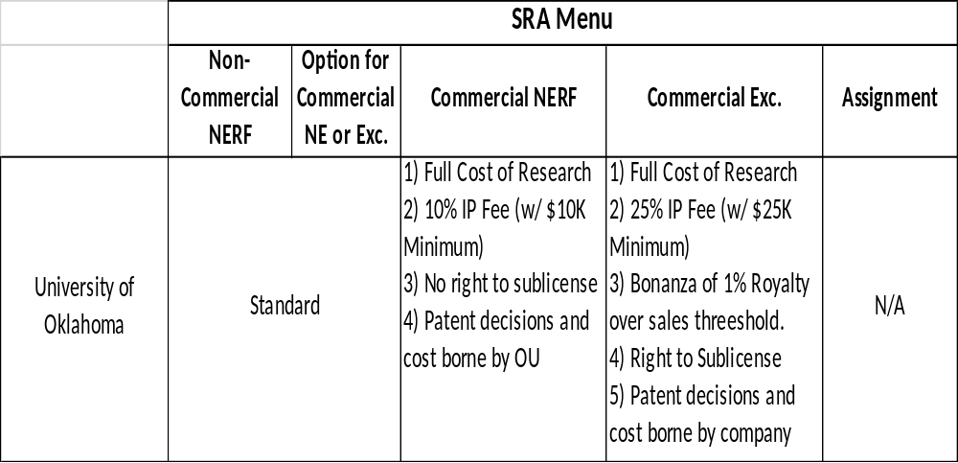
New Models for access
Terms:

Slide 10
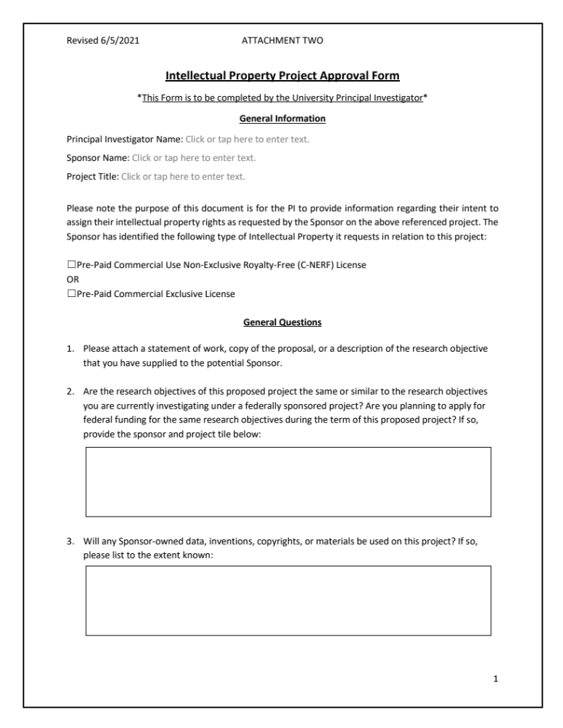
Process for New models
Focus should be on the research, but if they have IP questions refer to published flyer
Infosheet process does not change
At Award Negotiation 3 options will be presented
If company selects non-standard options, ORS will send IP Project Approval Form

Slide 11
New Models for access
Need to capture project information
Forwarded to financial services for PBU tracking

Slide 12
What happens next?
University will continue to Own IP
  Publication
  Freedom to conduct future research
Disclosures will need to be submitted if IP results
  OTC will officially report to sponsor
License will be executed for no additional consideration
  Needed for liability purposes
  Company still has option to convert to Exclusive for NERF option

