Slide 1



Constructing your future: Disability awareness
Lesson 4:
Elevator speech
About My Disability
Disability Awareness

Slide 2


Elevator speech
about my disability
Disability Awareness

Slide 3

Journal Prompt
How do you know what assignments or tasks you might need extra support for?
Disability Awareness

Slide 4
Objectives
Today you will:
  define elevator speech
  discuss how an elevator speech can help you talk to others about your disability
  write your own elevator speech
Disability AWareness

Slide 5

What is an elevator speech?
An elevator speech is a quick way to:
introduce yourself,
share one or two key things about yourself, and
make a connection with someone.
Think of it as a commercial about you!
Disability AWareness

Slide 6
What is an elevator speech?
You can use this to introduce yourself and quickly explain your disability and the accommodations you need to:
  teachers
  coaches
  managers
  bosses
  anyone else who might need to know about you and the supports you need!
Disability AWareness

Slide 7


Elevator Speech about my Disability
Who do you want to share information about your disability with?
Disability AWareness

Slide 8
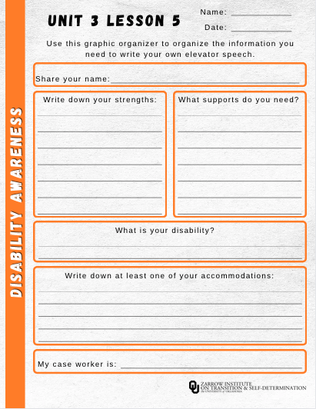

Follow along with this presentation on your graphic organizer!
Disability AWareness
Notes:
-This is your preference.
- Students can Google phrases like "athletes with disabilities" or "famous people with disabilities".
You can put the links for these sights in your LMS or Google classroom site.
- https://www.google.com/
- https://www.understood.org/
The websites on the slide are hyperlinked.

Slide 9

NAMe
Disability AWareness
First things first!
Introducing yourself and share your name.

Slide 10

Strengths
Now, share some of your strengths!
They can be things
you are good at or
positive characteristics you possess!
Disability AWareness

Slide 11

supports
What do you need help with?
What kind of supports do you need?
Explain how the person you’re talking to can help you be successful!
Disability AWareness

Slide 12


Disability
Disability AWareness
What is your disability?
Use this part of your speech to share what your disability is.

Slide 13

Accommodations
Disability AWareness
What accommodations
do you need to be successful?
Use this part of your speech to share them.

Slide 14

Case Manager
Who is your case manager?
That’s the person who coordinates your IEP and your services. Share their name!
Disability AWareness

Slide 15
Put it all Together!
Use Worksheet 3.5 to put together an elevator speech script that you can use when you tell other people about your disability.
Disability AWareness

Slide 16

Extension Activity
Practice your elevator speech with a partner!
Disability AWareness

