Slide 1



Constructing your future: Disability awareness
Lesson 2:
Disability Awareness
Disability Awareness

Slide 2

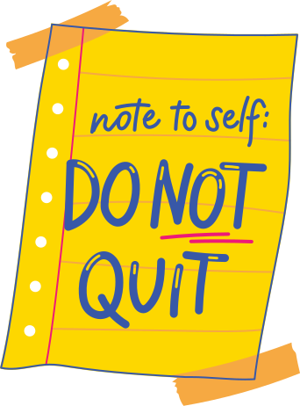
Disability awareness
Disability Awareness

Slide 3
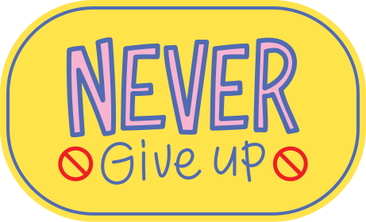
Journal Prompt
Why is it important to know about our disabilities?
Disability Awareness

Slide 4
Objectives
Today, you will:
  define disability awareness
  discuss common disabilities and their characteristics
  identify your own disability and describe how it impacts you
Disability AWareness

Slide 5
Disability Awareness
Disability awareness means understanding and
being knowledgeable
about disabilities,
including our own.
Disability AWareness

Slide 6
Disability Awareness
Why is disability awareness important?
When we understand our disability, we can identify our strengths and use persistence to overcome limitations.
Disability AWareness

Slide 7


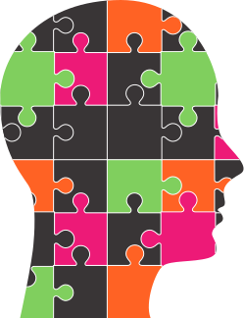
Extraordinary Discovery!
Researchers and your biggest supporters agree:
Disabilities are just one puzzle piece of your identity--just a fraction of the incredible person you are!
We all have qualities, talents, strengths, interests, and aspirations that shape our identity.
Disability AWareness

Slide 8
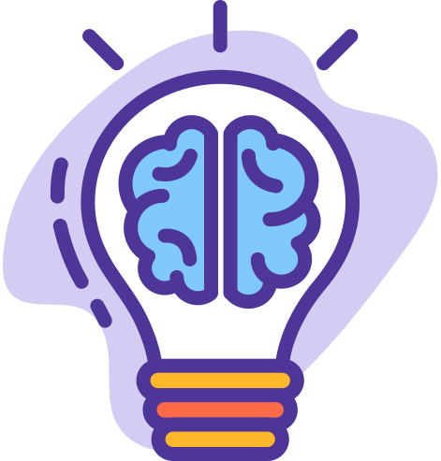

What do disabilities look like?
Common disabilities and their characteristics.
ADHD
Speech/Language Impairment
Hearing Impairment
  hyperfocus
  inattention
  impulsivity
  executive functioning challenges
  creativity
  high energy levels
  social challenges
  strong non-verbal skills
  receptive language challenges
  creativity
  verbal language challenges
  social challenges
  reduced or lost hearing
  strong visual and nonverbal communication
  improved visual ability
  communication barriers
  social challenges
Disability AWareness
Learning Disability
Autism
  strong visual-spatial skills
  creativity
  processing speed
  memory difficulties
  perseverance
  resiliency
  attention to details
  social challenges
  sensory sensitivities
  special interests or expertise
  visual thinking
  preference for routine

Slide 9


Disability Awareness
What do you know about your disability?
Disability AWareness

Slide 10
Disability Awareness
How can your disability impact your daily life and learning?
Disability AWareness

Slide 11


Disability Research
Where can I find my disability category?
What if I have more than one disability category?
Disability AWareness
Notes:
Let students know that their disability category can be found in their IEP paperwork. Also, it can be found in the full evaluation.
If a student has more than one disability, advise them to select their primary disability.

Slide 12
Let's explore our Disabilities
On worksheet 3.2, you will:
Disability AWareness
Explore your disability category
Identify common characteristics of your disability.
Describe how you disability impacts you.

