Slide 1



Constructing your future: Disability awareness
Lesson 1:
What are disabilities?
Disability Awareness

Slide 2


What are disabilities?
Disability Awareness

Slide 3

Journal Prompt
Why is it important to learn about disabilities?
Disability Awareness

Slide 4
Objectives
Today, you will:
  define disability
  discuss how disability, strengths and limitations, and persistence are connected
  research a famous person with a disability and report your findings
Disability AWareness

Slide 5
What are disabilities?
When you hear the word disability,
what comes to mind?
Disability AWareness

Slide 6
What are disabilities?
Disabilities affect a person's body, senses, or ability to do things.
They might make some tasks more difficult or require special accommodations.
Disability AWareness

Slide 7
What are disabilities?
Disabilities can be different for each person.
They can affect how someone moves, sees, hears, learns, or communicates.
Disability AWareness

Slide 8
What are disabilities?
Remember:
Having a disability doesn't mean that someone is less capable or less valuable--people with disabilities can do amazing things and contribute to the world in amazing ways!
Disability AWareness

Slide 9
Who has disabilities?
Anyone can have a disability!
Disabilities can affect people of any age, gender, race, culture, and nationality.
Disability AWareness

Slide 10
Who has disabilities?
Disabilities can be present from birth or happen later in life due to illness, injury, or other reasons.
Disability AWareness

Slide 11
Who has disabilities?
Disabilities don't define a person or limit their ability to be successful.
Disability AWareness

Slide 12


Disability and Perseverance
How can disabilities
affect people?
Disability AWareness

Slide 13
Disability and Perseverance
How can understanding and being aware of disabilities help develop persistence?
Disability AWareness

Slide 14
Disability and strengths & limitations
How can disability awareness help us focus on our strengths rather than our limitations?
Disability AWareness

Slide 15


Famous People with Disabilities
Disability AWareness

Slide 16
Famous People with Disabilities
Do you know anyone famous who has a disability?
How did that person turn their limitations into strengths?
Disability AWareness

Slide 17

Famous People with Disabilities
Billie
Eilish
Frida
Kahlo
Tammy
Duckworth
Disability Awareness
Muhammad
Ali
Louis
Braille
Solange Knowles

Slide 18
Famous People with Disabilities
Billie Eilish has Tourette Syndrome which causes her to have tics or repetitive and uncontrolled movements.
Polio caused damage to Frida Kahlo's right leg & foot, and her spine & pelvis were damaged in a car accident.
Tammy Duckworth lost both legs and the mobility in her right arm after her helicopter crashed in Iraq.
Disability Awareness
Muhammad Ali had dyslexia his whole life and was diagnosed with Parkinson's when he was 42.
Solange Knowles has ADHD and dysautonomia that affect her ability to complete tasks and regulate her nervous system.
Louis Braille lost his vision when he was 3 years old after he was injured in an accident.

Slide 19
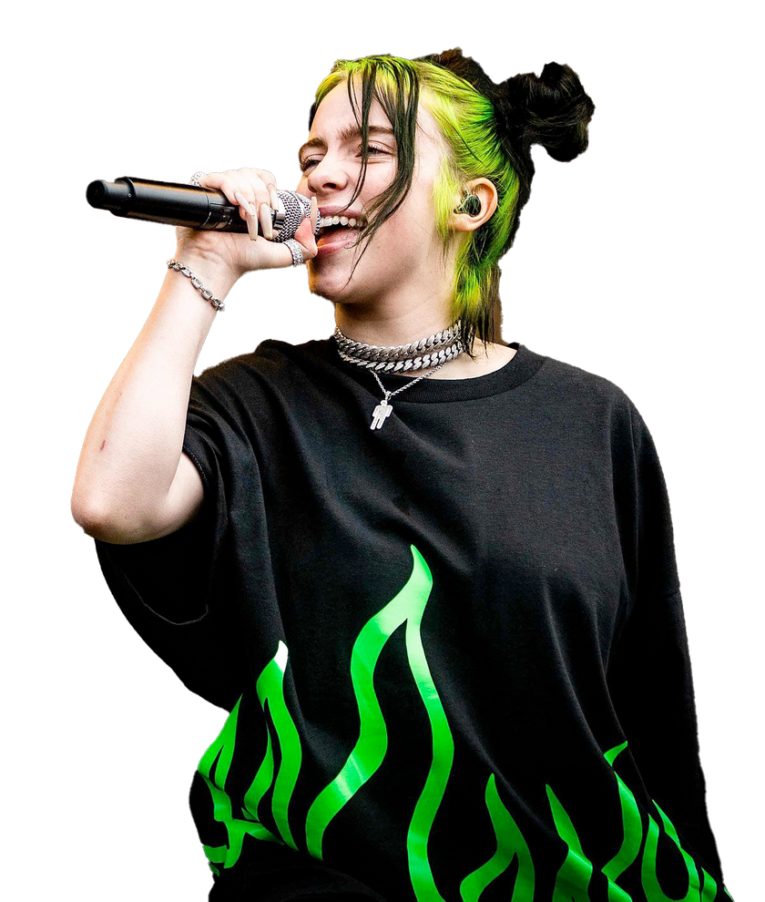
Billie Eilish
Billie Eilish has Tourette Syndrome which causes her to have tics (involuntary sounds and movements). She said her tics are exhausting and sometimes people laugh when she tics because they think she's trying to be funny. She likes to talk about Tourette Syndrome because it's very interesting and feels like it's a part of who she is which makes her confident in herself.
Disability awareness

Slide 20
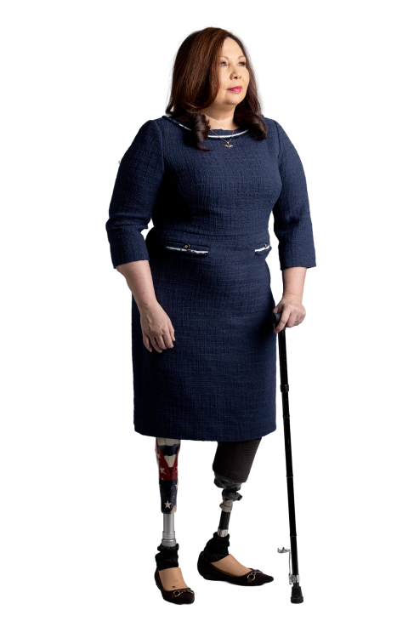
Tammy Duckworth
Tammy Duckworth was a helicopter pilot who lost both of her legs and the ability to move her right arm when her helicopter was shot down in Iraq. She ran for Congress to serve her fellow troops because she didn't want to let them down. She is the first Thai woman to be elected to Congress, the first woman to give birth while serving as a Senator, and the first female Senator to use a wheelchair. She educates others on accessibility and fights for rights of individuals with disabilities.
disability awareness

Slide 21
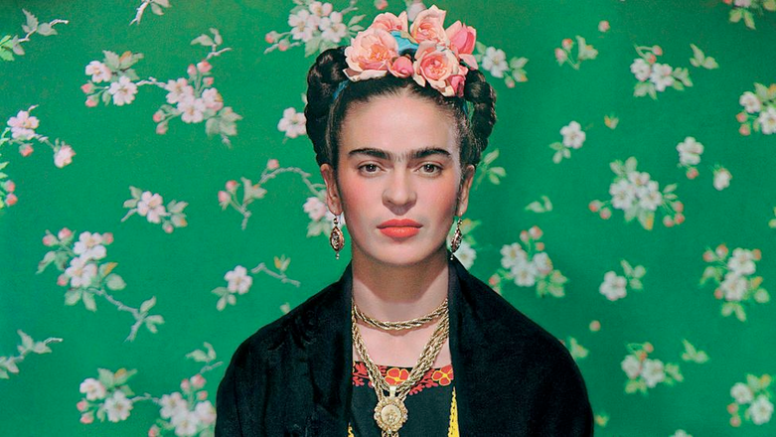
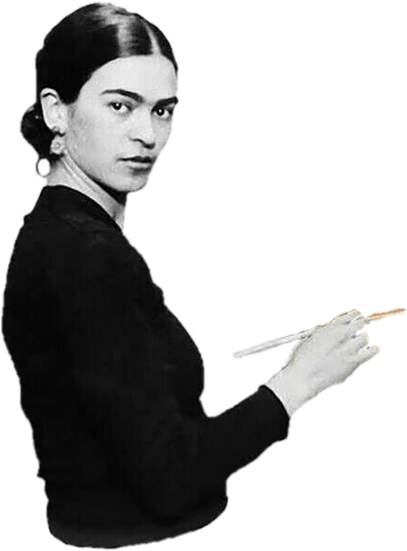
Frida Kahlo
Frida Kahlo had multiple disabilities from polio and a car accident which caused a lot of pain and made it hard for her to get around. She began painting while she recovered from the car accident, and she turned her disabilities into art. She never let her disability prevent her from painting--she even created a special easel that let her paint in bed!
Disability awareness

Slide 22
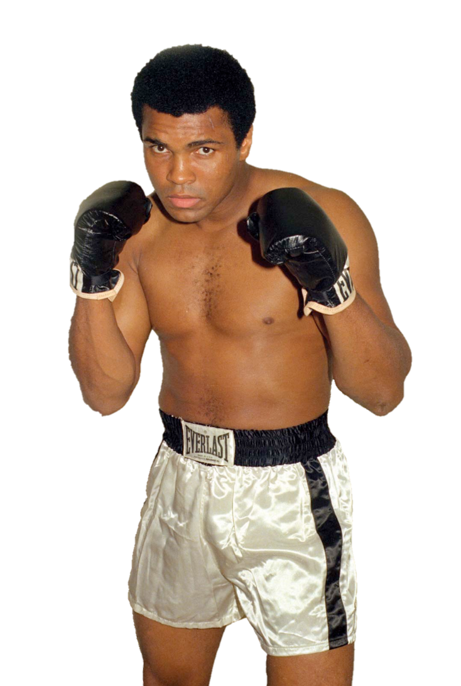
Muhammad Ali
Muhammad Ali was a champion boxer. He said many of his high school teachers thought he was dumb because he could barely read--he didn't know he had dyslexia until he was older! He wanted to help others who struggled to read, so he created the series Go the Distance. He also fought for racial and social justice. One of his famous sayings is, "If my mind can conceive it, and I can believe it--then I can achieve it."
Disability awareness

Slide 23
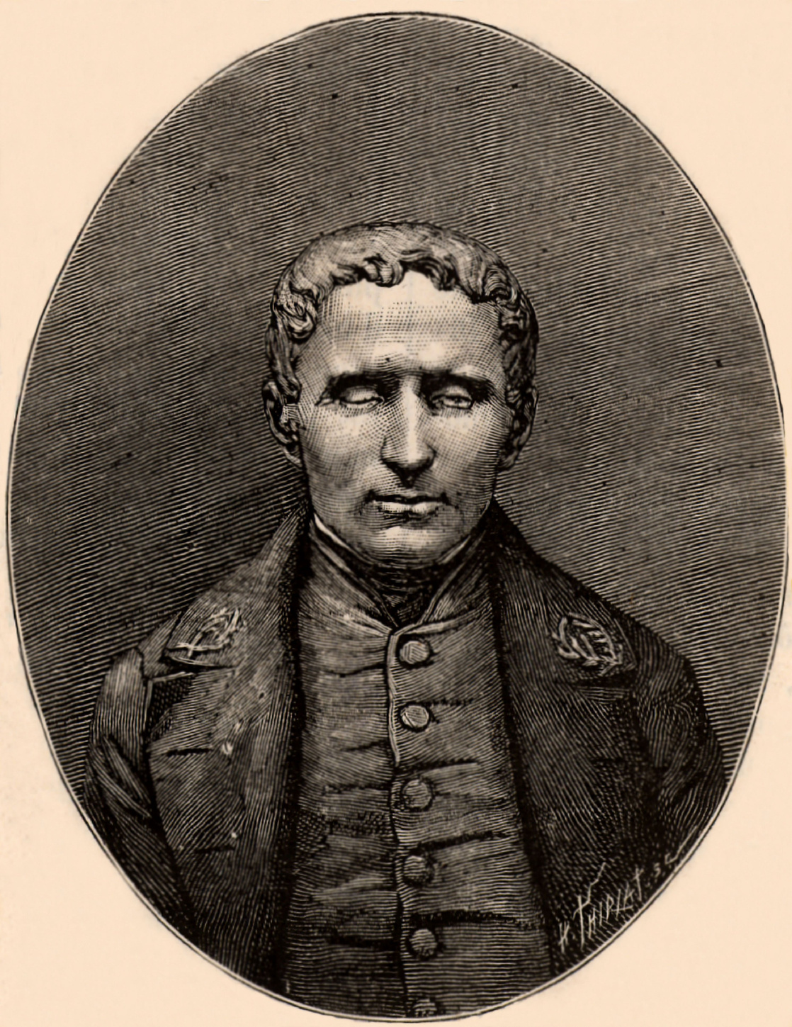
Louis Braille
Louis Braille was born in France in 1809 and became blind after he was injured in an accident when he was 3 years old. When he grew up, he revived a scholarship for playing the organ and was able to attend The Royal Institute for Blind Youth. Later, he taught there and created the simplified Braille Code used by people with visual impairments today.
Disability awareness
Notes:
https://www.loc.gov/nls/braille-audio-reading-materials/lists-nls-produced-books-topic-genre/listings-on-narrow-topics-minibibliographies/louis-braille-1809-1852/

Slide 24
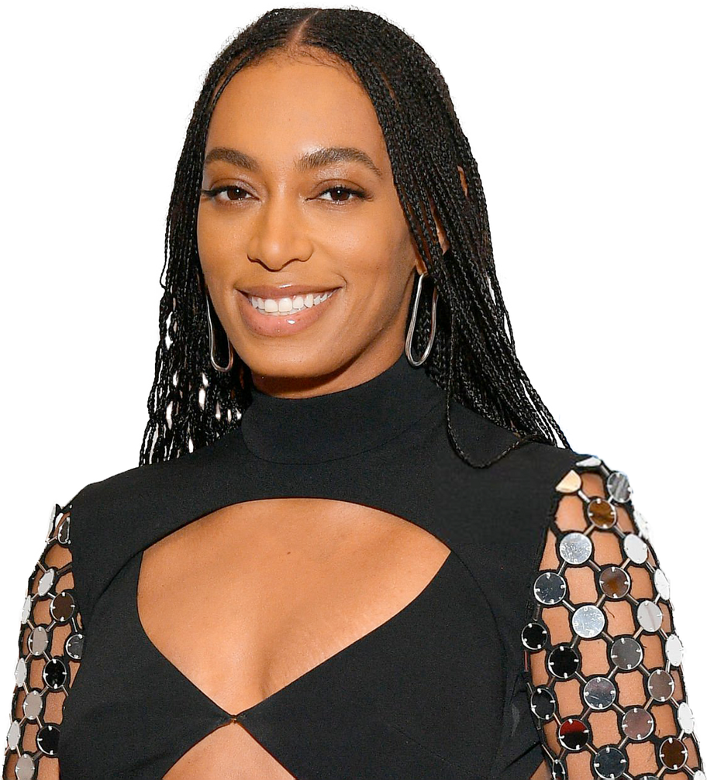
Solange Knowles
Solange Knowles is a singer, songwriter, and actress. She also has ADHD and likes to teach people about her disability. ADHD causes her to have disorganized speech, memory loss, hyperactivity, and trouble finishing things. She has also been diagnosed with dysautonomia, an autonomic nervous system disorder. This can affect things your body does automatically such as breathing, heart rate, blood pressure, digestion and more.
Disability awareness

Slide 25
Websites that can help your search
google.com
understood.org
respectability.com
Disability AWareness
Notes:
-This is your preference.
- Students can Google phrases like "athletes with disabilities" or "famous people with disabilities".
You can put the links for these sights in your LMS or Google classroom site.
- https://www.google.com/
- https://www.understood.org/
The websites on the slide are hyperlinked.

Slide 26
Let's Discuss our Research
How do you think the world would be different if these people had not demonstrated characteristics of perseverance?
Disability AWareness

Slide 27

Famous person with
a disability
  Choose a famous person who has a disability to research.
  Use worksheet 3.1 to record what you find.
Disability AWareness

Slide 28
Extension Activity
  After finish your discovery brainstorming worksheet, create a presentation introducing your famous person.
  Use the headings from the worksheet and include a picture of your person.
Disability AWareness
Notes:
If you have time....
Teachers can build a slide deck on Canva, Powerpoint, or slides for students to use.
Include:
- Picture of famous person
- Headings from worksheet
Remind students to be creative and find images or their person hard at work.

