Slide 1
Student-Directed Transition Planning
Lesson 8
The Summary of Performance
By
Lorraine Sylvester, Lee L. Woods, and James E. Martin
University of Oklahoma
College of Education
Department of Educational Psychology
Zarrow Center for Learning Enrichment
Preparation of SDTP supported in part by funding provided by the U.S. Dept. of Education, Office of Special Education Programs, Award #: H324C040136
Copyright 2007 by University of Oklahoma
Permission is granted for the user to duplicate the student materials and PowerPoint files for educational purposes. If needed, permission is also granted for the user to modify the PowerPoint files and lesson materials to meet unique student needs.

Slide 2
The Summary of Performance
Putting it All Together
Image is the copyrighted property of JupiterImage and is used with permission under license

Slide 3
Your Future
You have gathered lots of information about what you and your family want for your future.
You have also learned about what it takes to transition from high school to adult life.
Image is the copyrighted property of JupiterImage and is used with permission under license
Notes:
Make circle words appear separately

Slide 4
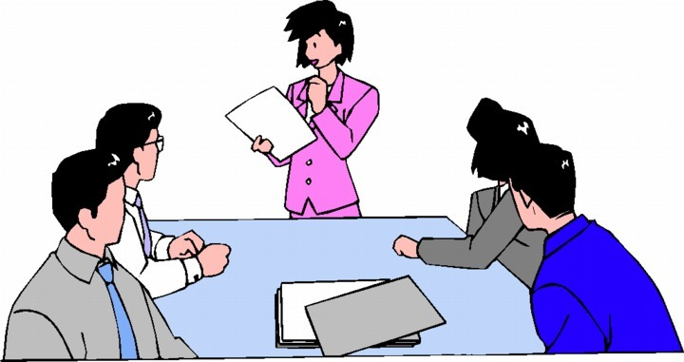
Transition IEP Meeting
You will soon have a meeting to discuss how you are doing in school and what you want to do with your life.
You can be an active participant, or even lead your meeting.
Who knows this stuff better than you?
Image is the copyrighted property of JupiterImage and is used with permission under license

Slide 5
The Meeting
Who will be there?
Mostly people you know. A family member, your teachers, an administrator.
There may be someone there you don’t know yet but they are all there for you.
Image is the copyrighted property of JupiterImage and is used with permission under license

Slide 6
The Meeting
What will we talk about?
You
How you are doing in school
Goals for the next year and your future
What you have learned in these lessons
Your strengths, needs, interests, and accommodations
Image is the copyrighted property of JupiterImage and is used with permission under license

Slide 7
Summary of Performance
Exit document
Tells information about you and your disability
Lists assessments and accommodations
States your transition goals
Image is the copyrighted property of JupiterImage and is used with permission under license

Slide 8
Summary of Performance
Background Information
Section 1 = Goals for after graduation
Section 2 = What you think about your disability
Section 3 = What your school thinks about your disability
Section 4 = Documentation of disability and assessments

Slide 9
The Meeting
What if I’m uncomfortable talking?
Do the best you can.
You will have a script to help you and to make sure that everything is covered.
Some students may need to share their script with a family member.
Image is the copyrighted property of JupiterImage and is used with permission under license

Slide 10
Script?
Information gathered from the lessons
You report information in the Summary of Performance
Helps you remember what to say
Helps make sure the important stuff is covered
Image is the copyrighted property of JupiterImage and is used with permission under license

Slide 11
Writing Your Script
You probably know some of the information in this section.
Your teacher can help you fill in the parts you don’t know.

Slide 12
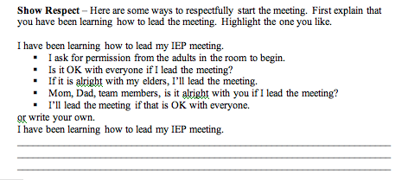
Writing Your Script
You are the youngest member of your IEP team.
You can show respect by asking for permission to lead the meeting.
With the team’s permission, I’ll lead now.

Slide 13
Writing Your Script
This section will help you bring the meeting to order
You will write in the purpose
Why are we meeting?
talk about
my IEP, review my goals and progress for the past year, and
make a plan for the next year.

Slide 14
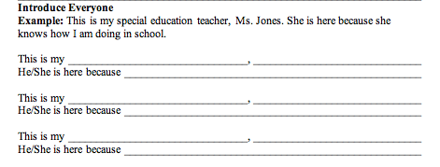
Writing Your Script
In this section you will write the names of all your IEP team members.
Briefly tell why they are on your team.

Slide 15
Writing Your Script
In the next section you will be writing your transition goals
You get this information from the inner circles of your input circles

Slide 16
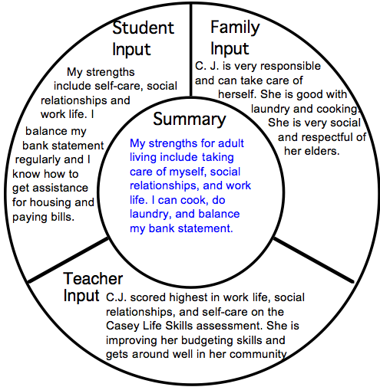
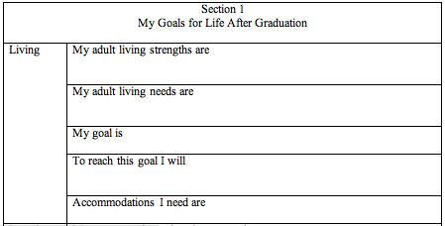
Writing Your Script
The information that goes into the strengths sections comes from the summary circles in the input circles

Slide 17
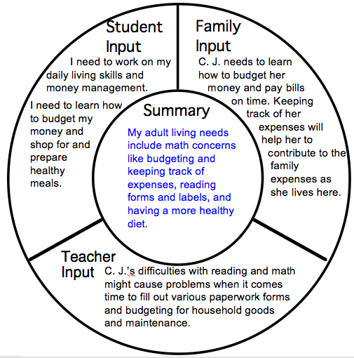
Writing Your Script
The information that goes into the needs sections comes from the summary circles in the input circles

Slide 18
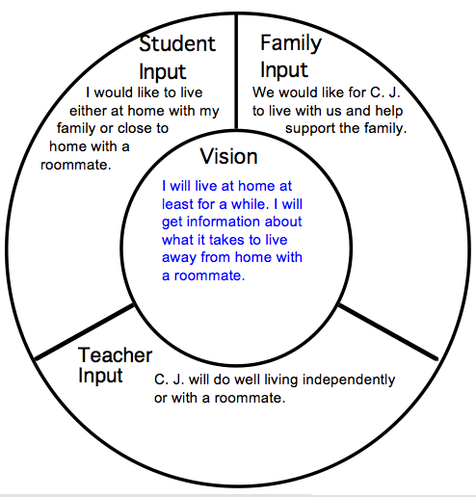
Writing Your Script
The information that goes into the goals sections comes from the vision circles in the input circles

Slide 19
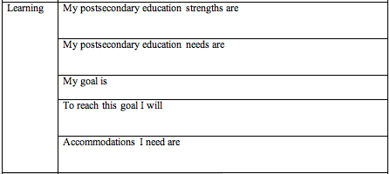
Writing Your Script
This section tells what you will do in the next year to help reach your vision.
to graduate from nursing school
visit 3 nursing schools in the area

Slide 20
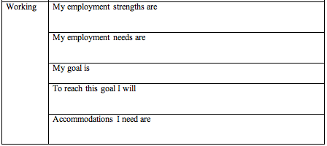
Writing Your Script
to be a welder
This section tells what accommodations you will need to succeed.
take classes at vo-tech
extra time on tests

Slide 21
Writing Your Script

Slide 22
Writing Your Script

Slide 23
Writing Your Script

Slide 24
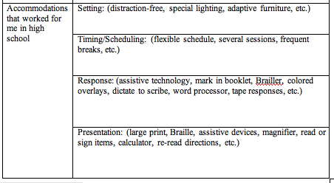
Writing Your Script
Quiet place, small group
Extra time for tests and assignments
This information comes from the Awareness lesson activities.

Slide 25
Your Script
Take your script home and talk to your family about it. Talk about what will happen at your meeting

Slide 26
Summary of Performance
Your teacher fills out sections 3 and 4 of the Summary of Performance.
Your teacher will go over these sections with you before your meeting.

Slide 27
