Slide 1
Famous People With Disabilities
ME!
Unit 6: Increasing My Self-Awareness
ME! Lessons for Teaching Self-Awareness and Self-Advocacy – Updated 9/14
© 2015 Board of Regents of The University of Oklahoma

Slide 2
Does having a disability mean you can’t be successful?
Your disability only limits you if you
let it! Let’s meet some successful people!

Slide 3
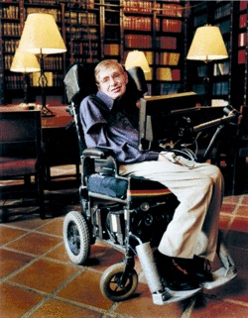
Dr. Stephen Hawking
Dr. Hawking is considered one of the world’s foremost experts on “Black Holes”, and is professor of mathematics at Cambridge University. He is the author of several books on the nature of the universe.

Slide 4
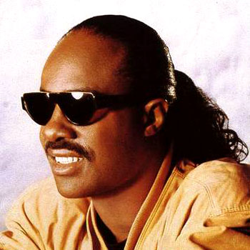
Stevie Wonder
Stevie Wonder is a famous singer, record producer, songwriter, and musician. Wonder lost all vision shortly after he was born but it did not stop him from pursuing his dream. By the age of 12, Wonder had already signed his first recording deal with Motown Records.

Slide 5
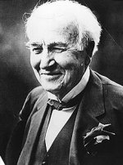
Thomas Edison
A famous inventor and scientist who patented over 1000 inventions. As a child Edison struggled with math and had difficulty with speech. At age 12 he was thrown out of school for being “dumb”. During his adult years, after becoming well-known Edison said, "Genius is one percent inspiration and 99 percent perspiration."
Notes:
Picture of famous people with disabilities. Collage ADD powerpoint

Slide 6
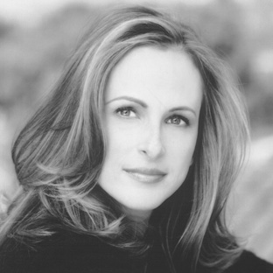
Marlee Matlin
Matlin is a well-known actress. She won an Academy Award at age 21 for her performance in the movie Children of a Lesser God. Matlin has been deaf since she was 18 months old.

Slide 7
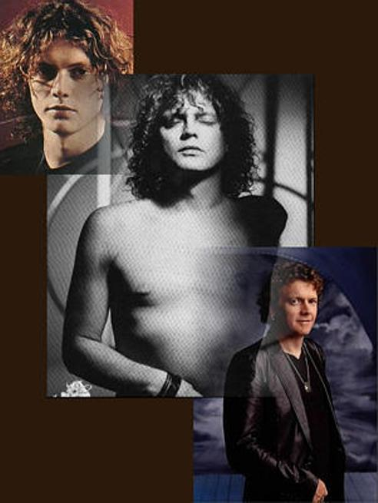
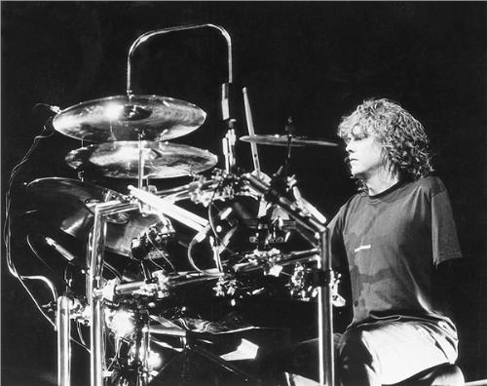
Rick Allen
Rick Allen has played the drums since he was a child and became a drummer for Def Leppard at age 15. As an adult, Rick lost his left arm in a car accident but continued to play. Rick once said "If I couldn't play drums it would have destroyed me. If you're thrown in the deep end you swim, and that's basically what I did. I had to do it and with the rest of the band behind me and the encouragement I got from people from all over the world, I knew that I was going to play." Over the years Rick became known as The Thunder God because of his tremendous drumming talent.

Slide 8
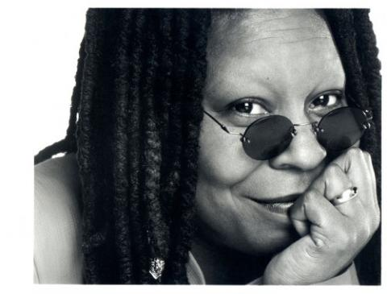
Whoopi Goldberg
An award-winning actress, comedian, singer, and talk show host. Whoopi struggled in school and as an adult learned she has dyslexia.
Notes:
Picture of famous people with disabilities. Collage ADD powerpoint

Slide 9
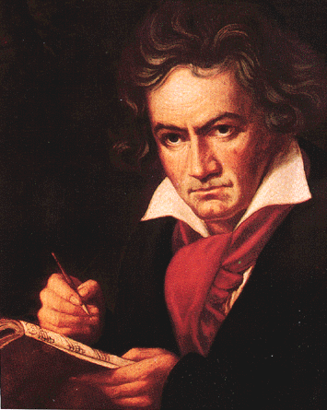
Ludwig van Beethoven
Beethoven is one of the most influential and well-known composers of all times. At age 26, Beethoven began to lose his hearing and eventually became deaf. Beethoven continued his work as a composer after his hearing loss and gave numerous musical performances up until the year before his death.
Notes:
Lane, William (2006). Beethoven: The Immortal. Retrieved May. 6, 2010, from http://lucare.com/immortal.

Slide 10
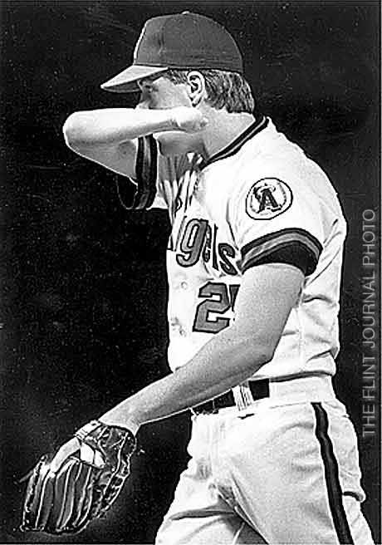
Jim Abbott
Jim Abbott is a major league baseball pitcher who has played for the California Angels, Milwaukee Brewers, Chicago White Sox, and New York Yankees. Abbott was born with only one hand.
Notes:
http://www.jimabbott.info/biography.html

Slide 11
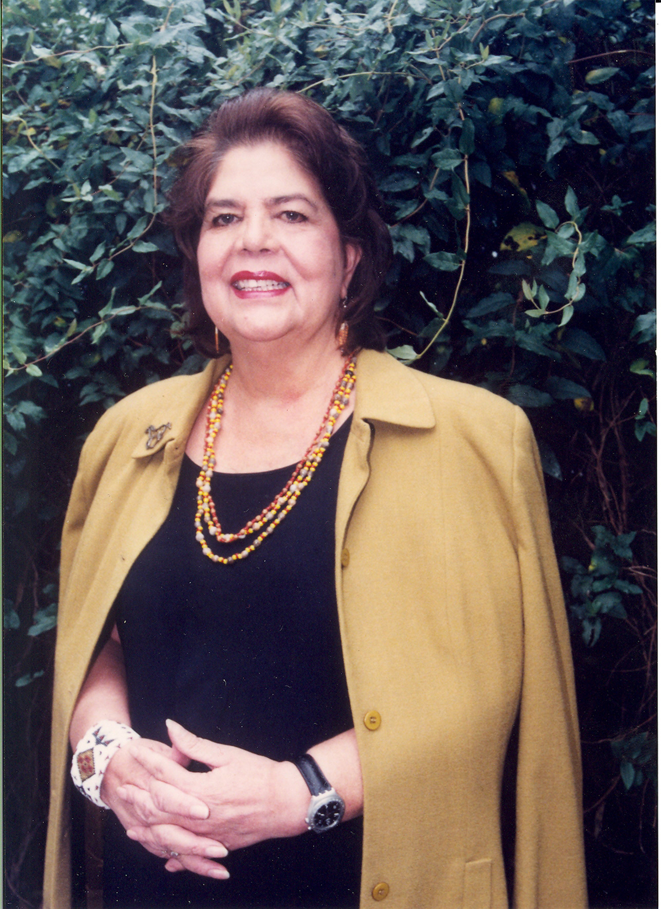
Wilma Mankiller
Chief of the Cherokee Nation and author of numerous books. During her mid thirties, Mankiller was diagnosed with muscular dystrophy. After her diagnosis, Mankiller continued working and in 1985 became the first female Chief of the Cherokee Nation, a tribe based in Tahlequah, Oklahoma with over 220,000 members.

Slide 12
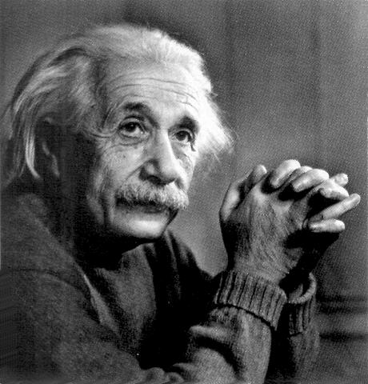
Einstein was a well known theoretical physicist, author and philosopher who became one of the most influential scientists of all time. He did not talk until age four and did not learn to read until he was nine. His teachers considered him mentally slow, unsociable and a dreamer. He failed the entrance examinations to college and had to study for an additional year before passing the exams.
Albert Einstein

Slide 13
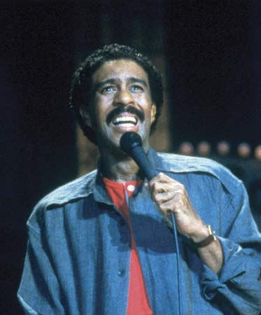
Richard Pryor
Pryor is a successful comedian, actor, writer and producer who has multiple sclerosis. MS is an autoimmune disease that affects a person’s brain and spinal cord causing him/her to lose muscle control, vision, and balance.

Slide 14
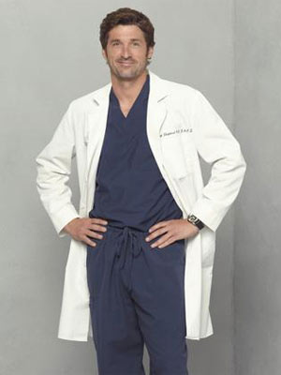
Patrick Dempsey
Dempsey is a well-known actor that was diagnosed with dyslexia at age 12. Dempsey once said "I think it's made me who I am today. It's given me a perspective of you have to keep working. I have never given up."
Notes:
Patrick Dempsey
Dyslexia

Slide 15
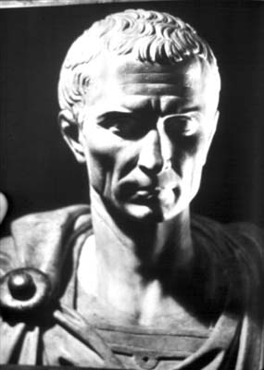
Julius Caesar
One of Ancient Rome’s most famous figures, Caesar was a general and statesman. He was the first commander of the Roman army to invade England. Caesar had epilepsy which is also known as seizure disorder.

Slide 16
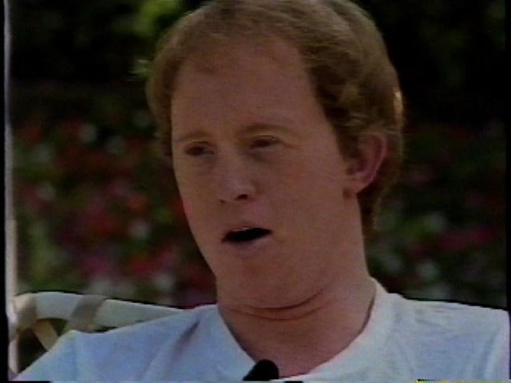
Christopher Burke
Burke is an actor and musician. He is most well known for his role as Corky in a television series (Life Goes On), and as a guest on other TV shows, he also tours with his band, and is the National Down Syndrome Society’s goodwill ambassador. Burke was born with Down Syndrome.
Notes:
Picture of famous people with disabilities. Collage ADD powerpoint

Slide 17
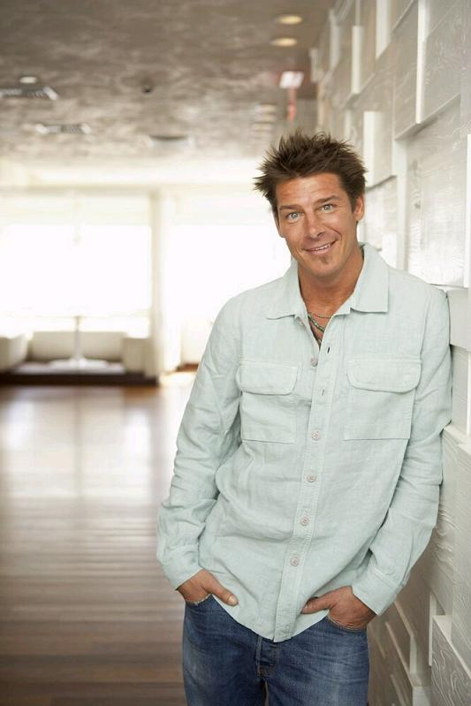
Ty Pennington
Known best for his role as carpenter and television host for Extreme Makeover: Home Edition, Ty has also published two books and worked as a model. At an early age, Ty was diagnosed with ADHD.

Slide 18
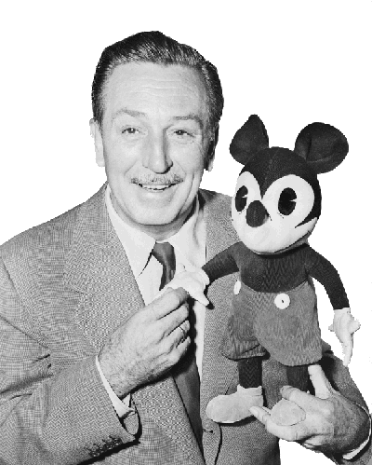
Walt Disney
Disney struggled in school
and had a learning disability. He went on to become a successful movie producer, director, screen writer, animator, and theme park developer. He founded one of the largest media and entertainment corporations
in the world.
Notes:
Picture of famous people with disabilities. Collage ADD powerpoint

Slide 19
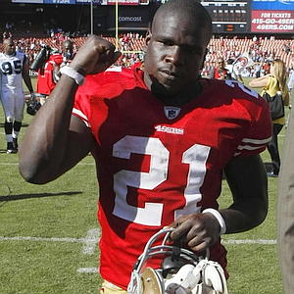
Frank Gore
Football running back for San Francisco 49ers. Gore was in special education because of a learning disability that affected his math and comprehension. His learning disability made school difficult and almost kept him out of college, despite being one of the most highly regarded high school football players in 2000. He eventually had a successful college career and went on to the NFL.
Notes:
Picture of famous people with disabilities. Collage ADD powerpoint

Slide 20
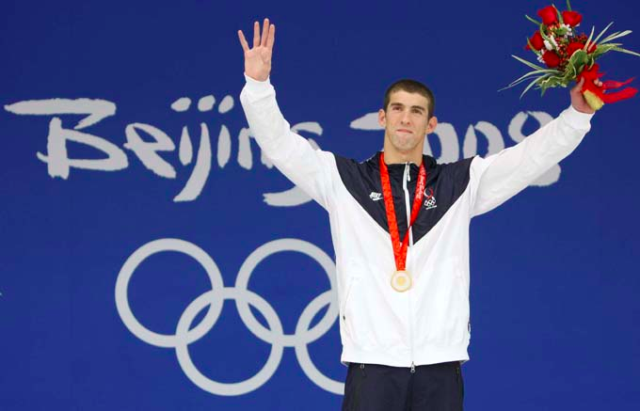
Michael Phelps
Michael Phelps is a well-known American swimmer who holds many titles and records including the record for most medals won at a single Olympics. During elementary school, Michael was diagnosed as having ADHD.

Slide 21
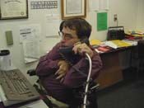
Chuck Roberts
Chuck Roberts was the first person with multiple disabilities to graduate from Norman High. Chuck went on, despite opinions of professionals, to earn his bachelor's in special education from the University of Oklahoma. He is an active member of his community and is professionally involved in a variety of disabilities advocacy areas in Oklahoma and nationally.
Notes:
Picture of famous people with disabilities. Collage ADD powerpoint

Slide 22
Did you know?
These are all types of disabilities that can affect people including how they learn.
Students with these types of disabilities may get help learning through special education.
These famous people are only a few of the people who did not let their disability stop them.

Slide 23
All of these people became successful with help
from other people…friends, family, teachers, others.
This process is called…
ADVOCACY
Advocacy means active verbal support for a cause or a
position; speaking up or acting in favor of something.
You advocate for yourself and for others.
Others advocate for you too.

