Slide 1
A Brief History of Disability
Unit 2: Learning About Special Education
ME!
ME! Lessons for Teaching Self-Awareness and Self-Advocacy – Updated 9/14
© 2015 Board of Regents of The University of Oklahoma

Slide 2
Disability in the U.S.
Nations largest minority group
49.7 million people in the U. S. age 5 and over have a disability
  1 in 5 Americans have a disability (19%)
  5.2 million were between the ages of 5 and 20
  30.6 million were between the ages of 21 and 64
  14.0 million were 65 and over.
The 2000 U.S. Census
Notes:
The 2000 U.S. Census shows us that 49.7 million people in the U. S. age 5 and over have a disability -- nearly 1 in 5 U.S. residents, or 19 percent.
･5.2 million were between the ages of 5 and 20. This was 8 percent of people in this age group.
･･30.6 million were between the ages of 21 and 64. Fifty-seven percent of them were employed.
･･14.0 million were 65 and over. Those with disabilities comprised 42 percent of people in this age group.
It is not just a matter of being PC it isa a matter of respect!

Slide 3
How many people in the United States have a disability?
    1 in 5 people
    1 in 10 people
    1 in 50 people
    1 in 100 people
1 in 5 people
Notes:
The 2000 U.S. Census shows us that 49.7 million people in the U. S. age 5 and over have a disability -- nearly 1 in 5 U.S. residents, or 19 percent.
･5.2 million were between the ages of 5 and 20. This was 8 percent of people in this age group.
･･30.6 million were between the ages of 21 and 64. Fifty-seven percent of them were employed.
･･14.0 million were 65 and over. Those with disabilities comprised 42 percent of people in this age group.

Slide 4

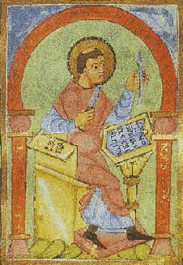
Balbrus Balaesus the Stutterer

Slide 5
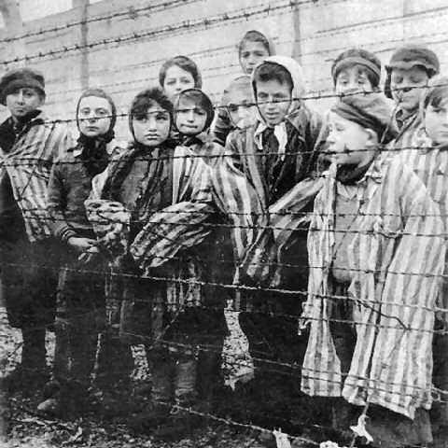
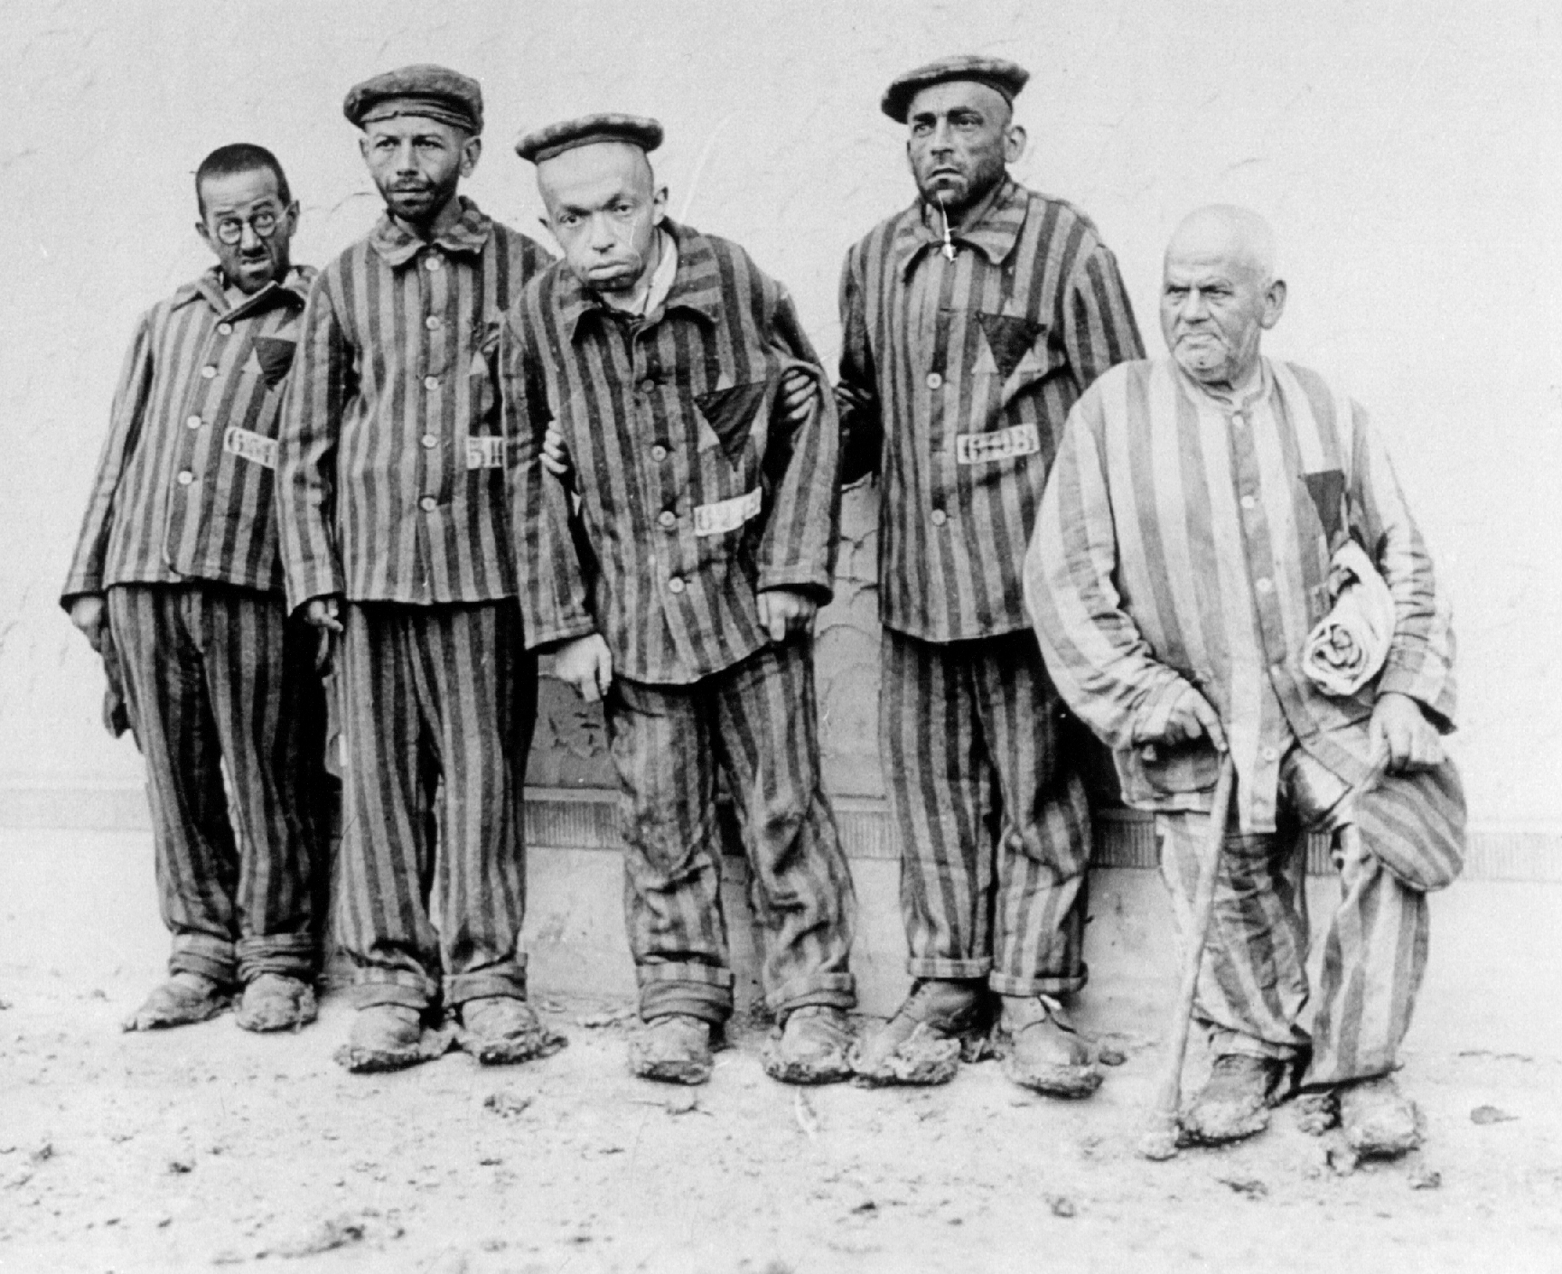
Holocaust in Germany
During the Holocaust Jewish people were sent to concentration camps. Did you know that people with disabilities were also sent to concentration camps?

Slide 6
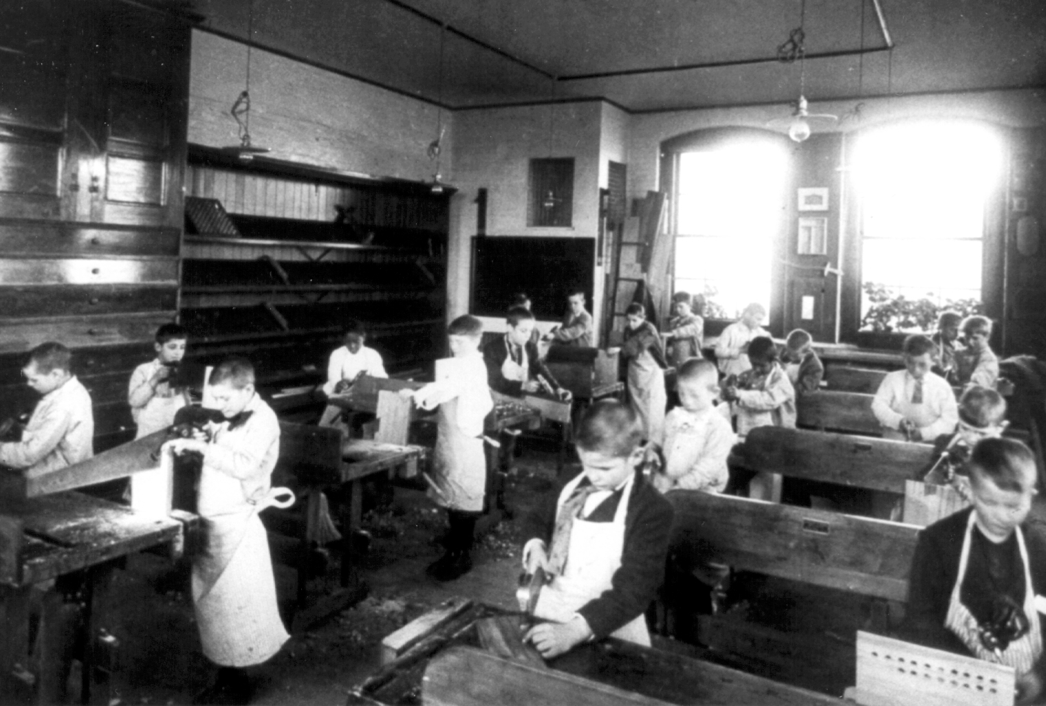
Many families would send children with disabilities to special schools. The students often lived at the school and rarely saw their families or the public.
Notes:
http://www.hss.state.ak.us/gcdse/history/HTML_Content_Main.htm

Slide 7
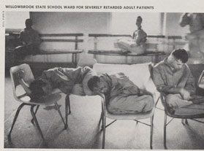
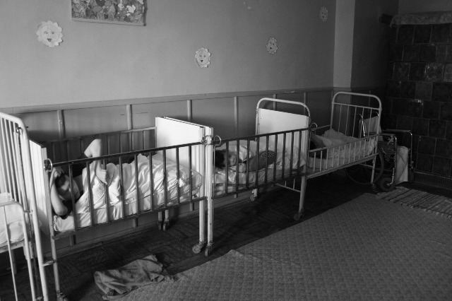
Children and adults with disabilities were often sent to live in institutions and hospitals where they had little or no contact with the public.
Notes:
http://www.museumofdisability.org/newyork_timeline_1980s.asp

Slide 8
Barriers, Low Expectations, and Prejudice
People with disabilities often experience barriers, low expectations and prejudice.
People without disabilities are often unaware of the daily challenges people with disabilities face.
Sometimes people choose not to acknowledge the barriers that exist for people with disabilities.
Take a couple of minutes to think of examples of barriers, low expectations and prejudice a person with a disability might experience.

Slide 9
Barriers, Low Expectations, and Prejudice
Low Expectations
Barriers
Jobs
Education
Social Relationships
Transportation
Travel
Restaurants
Shopping
Technology
Gyms
Sporting Events
Suitable housing

Slide 10

Over the years there have been many improvements in the way people with disabilities are treated.
Why do you think these changes occurred?
Victor
Notes:
In the late 1700’s, a boy named Victor was found wandering around in the woods in France. He was about 12 years old when he was found. It is believed that Victor had been alone in the woods for at least 7 years. A man named Itard took the boy home and taught him how to read, write and live around people. Some people say this was the first time in history that an “IEP” was used. Itard wrote out goals and objectives based on Victors needs. Many people have studied the information Itard wrote about Victor and believe that if Victor were alive today he would be diagnosed with Autism.

Slide 11

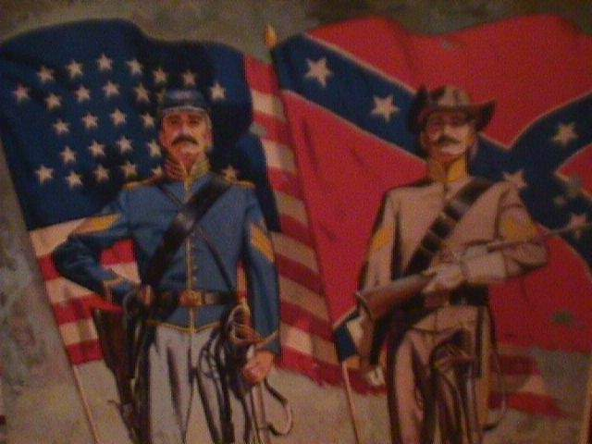
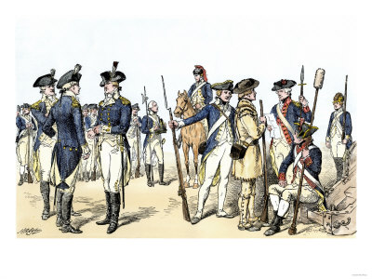


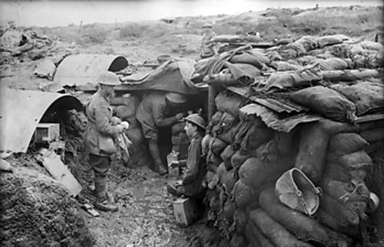
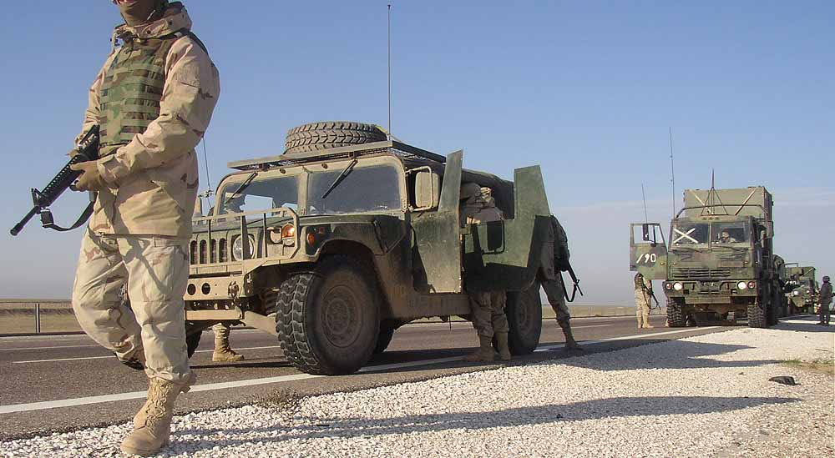
World War II
(1939-1945)
The Civil War (1861-1865)
War
The Revolutionary War
(1775-1783)
The Vietnam War
(1957-1975)
The Gulf War
(1990-1991)
World War I (1914-1920)
The current wars
in Iraq and Afghanistan
Notes:
War has also been a reoccurring event in history which has forced society to reevaluate how disabilities are viewed. Several examples of this include: The Revolutionary War (1775-1783), The Civil War (1861-1865), WW I (1914-1920), WWII (1939-1945), The Vietnam War (1957-1975) and more recently, The Gulf War (1990-1991) and the current wars in Iraq and Afghanistan

Slide 12
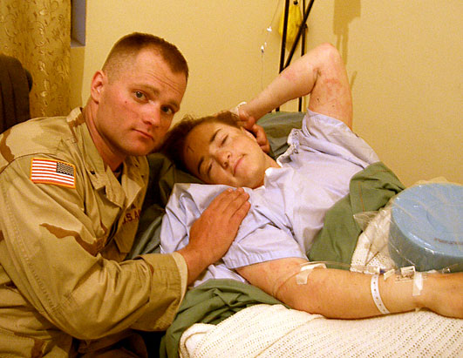
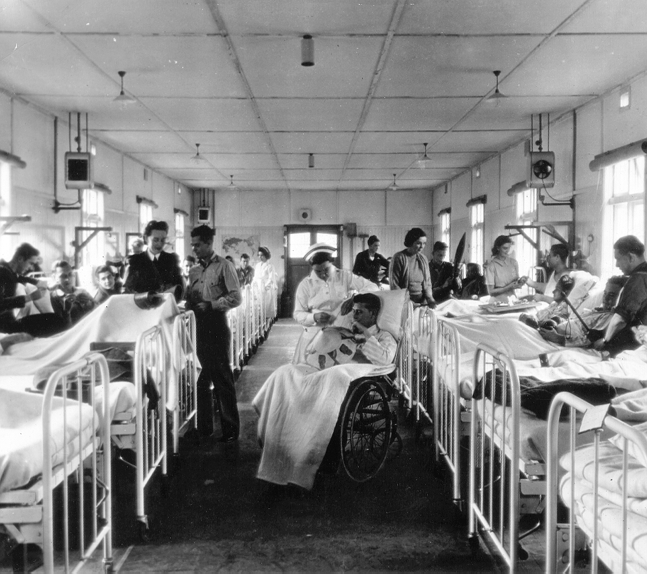
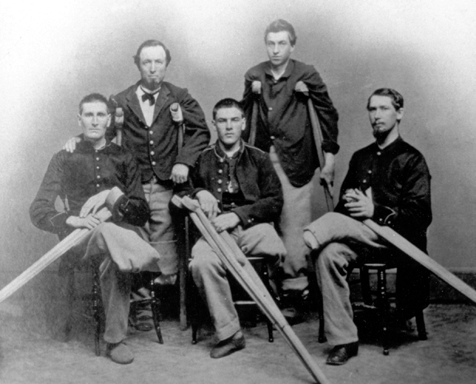
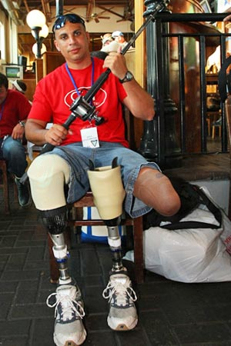
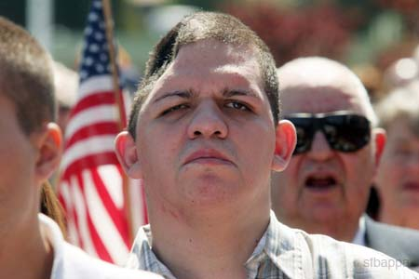
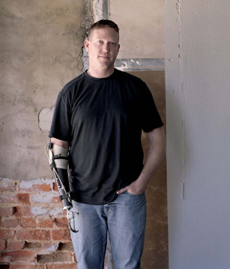
What did all of these wars have in common?
Notes:
One thing all of these wars have in common is that many veterans returned home with disabilities from their injuries. Many people began to change their attitude toward people with disabilities because they now had friends and/or family who returned home from war with a disability.

Slide 13
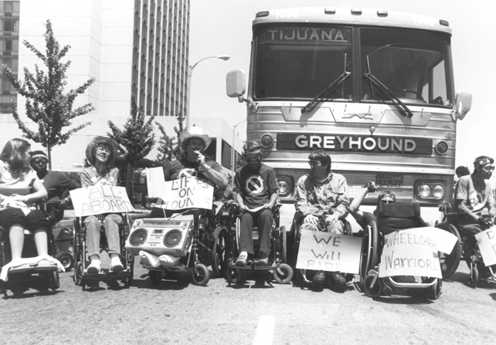
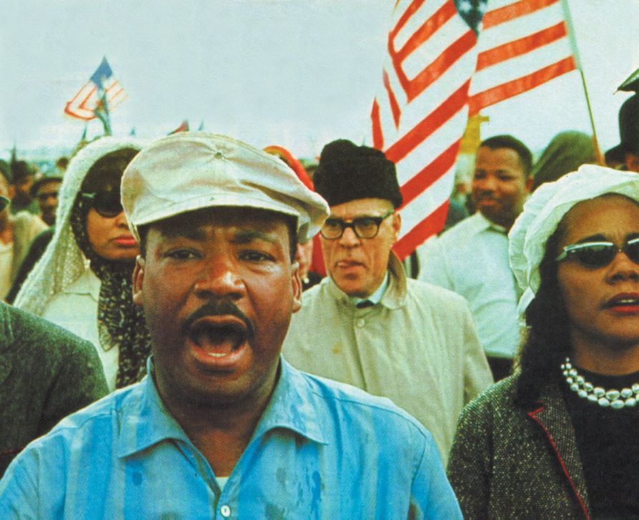
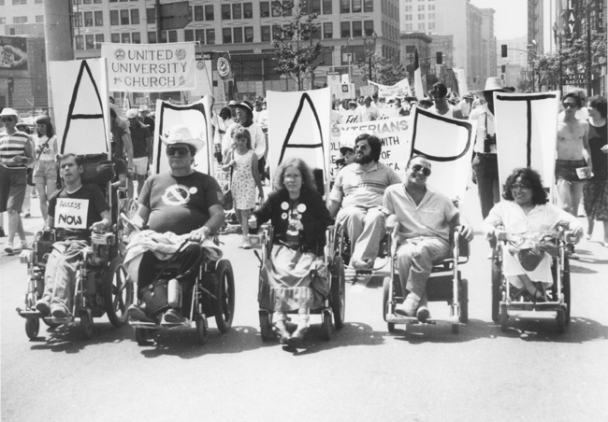
Civil Rights Movement
The Civil Rights movement in the 1960’s also changed the way many people felt about people with disabilities. This was a time when minority groups, including Native Americans, Black Americans, and people with disabilities strongly advocated for equal rights.
Notes:
http://www.hss.state.ak.us/gcdse/history/HTML_Content_Main.htm

Slide 14
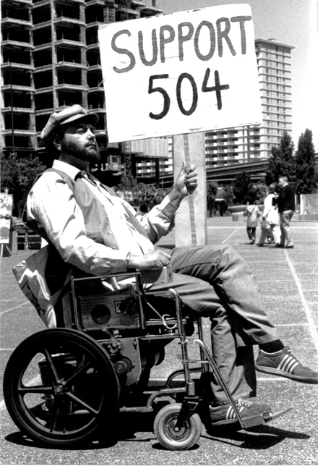
Civil Rights Movement
  Laws that resulted from the Civil Rights Movement
  1975 – The Education for All Handicapped Children
    Individuals with Disabilities Education Act (IDEA)
  Americans with Disabilities Act (ADA)
  Rehabilitation Act of Section 504
Notes:
In the 1970’s the first law in history to protect the civil rights of people with disabilities was passed. In 1975, The Education for All handicapped Children Act was passed. The purpose of this law was to make education available to students with disabilities. This law is now known as IDEA.
Since the 70’s, other important legislation has been passed that has helped improve the lives of people with disabilities. Legislation that has impacted education includes:
Individuals with Disabilities Education Act
Americans with Disabilities Act
Rehabilitation Act Section 504
We will learn about each of these laws in unit 4.

Slide 15
Worksheet 2-1: History of Disability
Complete section 2 and section 3 of your worksheet.

