Slide 1


Social Skills
Bell Ringers

Slide 2




Why are social skills important?
  improve communication skills
  help create individual goals
  improve school climate
  increase graduation rates
  result in better employment outcomes

Slide 3




Section 1:
self-concept
Draw a picture or write a sentence to define
self-concept.
Self-concept is how we perceive (or think about) our behaviors, abilities, and unique characteristics.
What does
self-concept
mean?

Slide 4




self-concept
What do you like about yourself?
List at least 3 things.
Draw a self-portrait.

Slide 5



self-concept
What are you proud of?
List at least 3 things.
Write 3 words to describe yourself.

Slide 6
Section 2:
self-Esteem
Draw a picture or write a sentence to define
self-esteem.
Self-concept is your overall sense of personal value and self-worth.
What does
self-esteem
mean?

Slide 7


self-Esteem
Link to video

Slide 8

self-esteem
I am good at
Complete the following sentences.
I care about
When I look in the mirror, I see
The best thing about me is
I love learning about

Slide 9


self-Esteem
What are some of your dreams?
List at least 2 of them.
What are you good at? List at least 3 things.

Slide 10
self-esteem
What short-term goals do you have? List three here.
Short-Term Goals
Short-term goals are goals you want to reach soon--today, this week, this month, or even this year.

Slide 11
self-esteem
What long-term goals do you have? List three here.
Long-Term Goals
Long-term goals are goals you want to reach in the future--like after you graduate high school.

Slide 12

education
self-esteem
family
Values
freedom
What do you value most? Rank these values
from 1 to 8.
1 is the least important, and 8 is the most important.
friends
loyalty
money
respect
responsibility

Slide 13
Section 3:
Friendship
Draw a picture or write a sentence to define
friendship.
Self-concept is a relationship between people who enjoy each other’s company.
What does
friendship
mean?

Slide 14
Friendship
Link to video

Slide 15
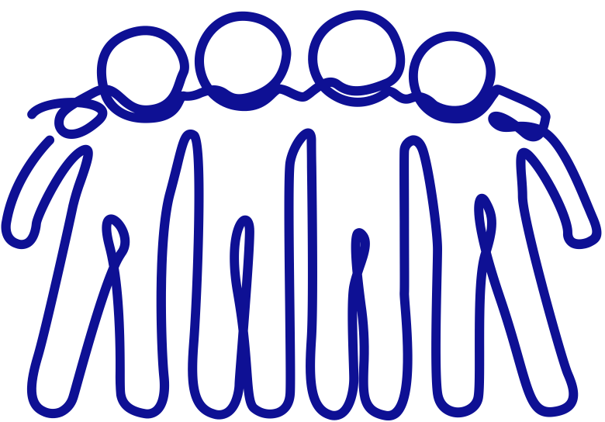
Friendship
List at least 3 qualities of someone who is a great friend.
Think about what makes someone a good friend.

Slide 16
Friendship
What do you look for in a friend? What qualities are important?
Think about what makes someone a good friend.

Slide 17
Friendship
What do you enjoy doing with your friends?
List at least 3 things.
Think about what makes someone a good friend.

Slide 18
Section 4:
Consequences
Draw a picture or write a sentence to define
consequence.
A consequence is a result or effect of an action or condition.
What does
consequence
mean?

Slide 19
Consequences
Link to video

Slide 20

Consequences
What are some consequences for posting offensive or inappropriate content on social media?
List at least 4 things.
Think about all the social media apps you are currently using or have used before.

Slide 21
Consequences
I forgot to set my alarm last night.
Now, I’m late for work.
Let’s think about consequences. Read the scenarios and identify potential consequences.
Consequences
I stopped at the gas station to get breakfast.
Now, I’m late for class.
I did not leave on time.
Now, I’m late for my doctor’s appointment.
Consequences
Consequences

Slide 22
Section 5:
Feelings
Draw a picture or write a sentence to define
feelings.
Feelings are the expression of emotion or sensitivity.
What do
feelings
mean?

Slide 23
Feelings
Link to video

Slide 24
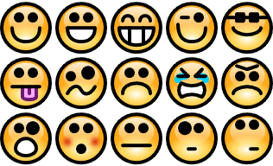
feelings
I felt
What feelings have you felt recently? Why did you have those feelings?
because
I felt
because
List at least 3 feelings you’ve had recently and explain why you had each.
I felt
because

Slide 25
...your friend got sick and went to the hospital?
Feelings
Let’s think about feelings. Read the scenarios and identify any feelings you might have.
...you broke the screen on your new phone?
How would you feel if...
...you had to take the ACT today?
...spring break started tomorrow?

Slide 26
Feelings
When I see other people being successful, I feel
Complete the following sentences.
When I’m struggling, I ask
When I am successful, I feel..
for help.
When other people tell me “good job,” I feel
I want to be better at

Slide 27
Section 6:
Self-Awareness
Draw a picture or write a sentence to define
self-awareness.
Self-awareness means being aware of your own personality or individuality.
What does
self-awareness
mean?

Slide 28
Self-Awareness
Link to video

Slide 29
self-Awareness
How would you describe your work habits?
How would you describe your personality?
How would you describe your study skills?

Slide 30
Section 7:
Job Skills
Draw a picture or write a sentence to describe
job skills.
Job skills include communication, public speaking, teamwork, time management, leadership, flexibility, and personal skills.
What are
job skills?

Slide 31

job skills
What skills do you need when you’re working?
Think about all the jobs you’ve had.
This could be paid or unpaid jobs, volunteer work, or even chores you do at home.
What skills did you learn when you worked?

Slide 32

Why is it important to have good communication skills
and good listening skills at work?
Job Skills
What does it mean to be a good listener?
What does it mean to be a good communicator?

Slide 33
Section 8:
Teamwork
Draw a picture or write a sentence to define
teamwork.
Teamwork means a group of people coordinating, cooperating, and working together as a team for a common cause.
What does
teamwork
mean?

Slide 34
Teamwork
What would you do?
You and three classmates are working together on a group project. Two people want to make a video, but you want to create a PowerPoint. The other group member doesn’t care which one the group makes.
How can you create a plan that everyone can agree with?

Slide 35
Section 9:
Self-Control
Draw a picture or write a sentence to define
self-control.
Self-control means restraining (controlling) your impulses, emotions, and/or desires.
What does
self-control
mean?

Slide 36
Self-control
Link to video

Slide 37

Self-control
Describe how you felt after taking the 10 breaths?
  Sit still and don’t move.
  Close your eyes. You can do it!
  Take 10 deep breaths. Breathe in through your nose and out through your mouth. Only think about your breathing.
  Open your eyes.
How can this exercise help you control your feelings?

Slide 38
yell at someone
self-control
take a deep breath
Sometimes people or things can make us mad. We can’t always control what happens to us. However, we can control how we act. Put an X on the inappropriate ways to respond to a bad situation.
walk away
say bad things about someone
throw things
lie about what happened
hit someone or something
apologize
tell someone how you feel

Slide 39
We want students to become more independent and to have the skills that will help them be successful in postsecondary education, employment, and community living. However, it can be difficult to find easy and efficient ways to teach social skills. It was important for us to create a resource that will allow teachers to easily embed social skills instruction into their lessons.

Slide 40
References
McRae, J., & Noble, S. (2007). Social skills worksheets. https://education.mn.gov/MDE/sde/sped/cat/dhh/index.htm

