Slide 1
Early Transition Bell ringers
By Peighton Pratt M.Ed., Christy Jolliff M.Ed., & Melissa Wicker Ph.D.

Slide 2
All About Me
Taking Care of Myself
Understanding Money
Who I Want to Be
Would You Rather?
What Would You Do?
Relationships with Others
Links to Early Transition Bell Ringers Section Headers

Slide 3
Introduce your students to the bell ringer routine. Use the "I do, We do, You do" method and model how and when students are expected to complete bell ringers in your class. (Be sure to include clear expectations about the length and depth of response you expect from students.)
Display a slide with your desired prompt.
Instruct students to read the prompt and respond in a journal, on paper, or on an online document.
Inform students of the amount of time they have to complete the task and set a timer.
Monitor students and assist as needed.
Use a timer, visuals, or verbal cues to alert students when time is up.
Invite students to share their thoughts in whole or small group discussions.
After each session, reflect on student engagement, depth of discussion, and routine effectiveness to determine what adjustments need to be made to the process.
Early
Transition
Bell Ringers Instructions

Slide 4
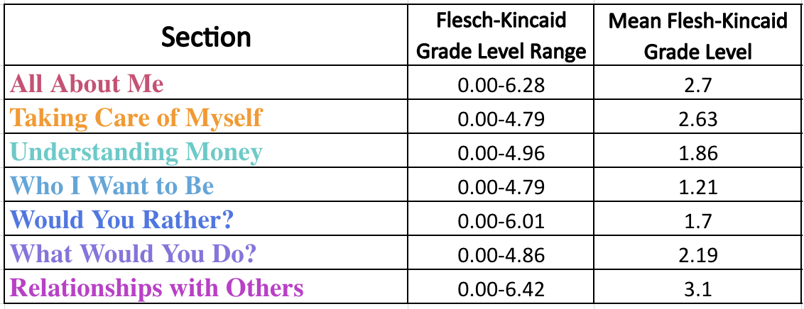
Bell ringers can be utilized to help students transition as they enter class, as part of a daily or weekly routine, as discussion prompts, and as exit tickets at the end of class.
Slides can be used in sequential order or customized for your classroom. (Example: If you only teach math, you may choose to only use the "Understanding Money" section)
Note: The Flesch-Kincaid Grade Level can be found within the notes under each slide. The reading level range is 0 to 6.42 with the mean at 2.08.
Early
Transition
Bell Ringers Tips & Tricks

Slide 5
All About Me

Slide 6
All About Me
Name three words that describe you.
Notes:
Flesch-Kincaid Grade Level: 2.4

Slide 7
All About Me
Name three things you like about yourself.
Notes:
Flesch-Kincaid Grade Level: 2.8

Slide 8
All About Me
Name two things that make you feel happy.
Notes:
Flesch-Kincaid Grade Level: 3.2

Slide 9
All About Me
What is a nice thing someone has said about you?
Notes:
Flesch-Kincaid Grade Level: 3.65

Slide 10
All About Me
Name three things you like about school.
Notes:
Flesch-Kincaid Grade Level: 2.8

Slide 11
All About Me
Name three things you do NOT like about school.
Notes:
Flesch-Kincaid Grade Level: 3.6

Slide 12
All About Me
Name two things you are good at doing while at school.
Notes:
Flesch-Kincaid Grade Level: 4.4

Slide 13
All About Me
Name two things you would like to get better at in school.
Notes:
Flesch-Kincaid Grade Level: 4.8

Slide 14
All About Me
Name two tests that you have taken at school.
What is something that could help you take tests?
Notes:
Flesch-Kincaid Grade Level: 3.6 & 2.34

Slide 15
All About Me
Name two things you are good at doing while at home.
Notes:
Flesch-Kincaid Grade Level: 1.57

Slide 16
All About Me
Name two things you would like to get better at doing at home.
Notes:
Flesch-Kincaid Grade Level: 3.1

Slide 17
All About Me
Name two things you like to do with your free time.
Why do you like to do them?
Notes:
Flesch-Kincaid Grade Level: 0.5 & 0

Slide 18
All About Me
Name two things you do not like doing with your free time.
Why don't you like them?
Notes:
Flesch-Kincaid Grade Level: 1.87 & 0

Slide 19
All About Me
Name three things you need help with while at school.
Notes:
Flesch-Kincaid Grade Level: 0.11

Slide 20
All About Me
Name three things you need help with while at home.
Notes:
Flesch-Kincaid Grade Level: 0.11

Slide 21
All About Me
What does it look like when you ask someone for help?
Notes:
Flesch-Kincaid Grade Level: 2.65

Slide 22
All About Me
How do you overcome hard things?
Who do you get support from?
Notes:
Flesch-Kincaid Grade Level: 2.48 & 0.52

Slide 23
All About Me
How do you feel when you have to do something hard?
Notes:
Flesch-Kincaid Grade Level: 2.65

Slide 24
All About Me
What does it mean to be independent?
What is something you can do by yourself?
Notes:
Flesch-Kincaid Grade Level: 4 & 3.76

Slide 25
All About Me
What does it mean to be responsible?
What are two things you take care of?
Notes:
Flesch-Kincaid Grade Level: 4 & 0

Slide 26
All About Me
What does it look like when you are patient or wait your turn?
Notes:
Flesch-Kincaid Grade Level: 2.19

Slide 27
All About Me
What does it look like when you are following the classroom rules?
Notes:
Flesch-Kincaid Grade Level: 3.84

Slide 28
All About Me
What does it mean to have a disability?
Notes:
Flesch-Kincaid Grade Level: 5.23

Slide 29
All About Me
Name one person you know that has a disability.
(It could be someone famous!)
Notes:
Flesch-Kincaid Grade Level: 6.28 & 5.24

Slide 30
Taking Care of Myself

Slide 31
Taking Care of Myself
Name two healthy choices you make in the morning at home.
Notes:
Flesch-Kincaid Grade Level: 2.65

Slide 32
Taking Care of Myself
What is your morning routine before school?
Notes:
Flesch-Kincaid Grade Level: 4

Slide 33
Taking Care of Myself
Name two healthy choices you make at school.
Notes:
Flesch-Kincaid Grade Level: 2.28

Slide 34
Taking Care of Myself
Name two healthy choices you make in the evening at home.
Notes:
Flesch-Kincaid Grade Level: 4.79

Slide 35
Taking Care of Myself
What is your routine at night before you go to bed?
Notes:
Flesch-Kincaid Grade Level: 2.65

Slide 36
Taking Care of Myself
Compare your mornings on a school day and on the weekend.
Notes:
Flesch-Kincaid Grade Level: 3.72

Slide 37
Taking Care of Myself
Compare your nights on a school day and on the weekend.
Notes:
Flesch-Kincaid Grade Level: 2.65

Slide 38
Taking Care of Myself
What does your routine look like during the summer or school breaks?
Notes:
Flesch-Kincaid Grade Level: 3.84

Slide 39
Taking Care of Myself
Name three things you do to stay healthy.
Notes:
Flesch-Kincaid Grade Level: 0.81

Slide 40
Taking Care of Myself
Name three things you like to do to exercise.
Notes:
Flesch-Kincaid Grade Level: 2.34

Slide 41
Taking Care of Myself
Name three things you can do to help you feel clean.
Notes:
Flesch-Kincaid Grade Level: 0.5

Slide 42
Taking Care of Myself
Name two things you do to help you feel rested.
Notes:
Flesch-Kincaid Grade Level: 1.29

Slide 43
Understanding Money

Slide 44
Understanding Money
Name one reason that you should learn about money.
Notes:
Flesch-Kincaid Grade Level: 3.65

Slide 45
Understanding Money
Name three different ways you can pay for something.
Notes:
Flesch-Kincaid Grade Level: 4.96

Slide 46
Understanding Money
Compare dollar bills (cash) and coins.
Notes:
Flesch-Kincaid Grade Level: 2.48

Slide 47
Understanding Money
Compare dollar bills (cash) and credit cards.
Notes:
Flesch-Kincaid Grade Level: 4.0

Slide 48
Understanding Money
Compare paying with cash and paying with a card.
Notes:
Flesch-Kincaid Grade Level: 3.65

Slide 49
Understanding Money
Compare using gift cards and credit cards.
Notes:
Flesch-Kincaid Grade Level: 4.0

Slide 50
Understanding Money
Name three things that people do with their money.
Notes:
Flesch-Kincaid Grade Level: 3.65

Slide 51
Understanding Money
Name three ways you can keep your money safe.
Notes:
Flesch-Kincaid Grade Level: 1.03

Slide 52
Understanding Money
What does it mean to save your money?
Notes:
Flesch-Kincaid Grade Level: 0.81

Slide 53
Understanding Money
Name three things you would save up your money for.
Notes:
Flesch-Kincaid Grade Level: 1.29

Slide 54
Understanding Money
Name three ways you could earn money.
Would you need help?
Notes:
Flesch-Kincaid Grade Level: 0.63 & 0

Slide 55
Understanding Money
When you earn money at
a job, will you save
or spend it?
Why?
Notes:
Flesch-Kincaid Grade Level: 2.19 & 0

Slide 56
Understanding Money
Compare buying things you want and things you need.
Notes:
Flesch-Kincaid Grade Level: 2.34

Slide 57
Understanding Money
Name three things you need that you can buy.
Notes:
Flesch-Kincaid Grade Level: 0

Slide 58
Understanding Money
Name three things you want that you can buy.
Notes:
Flesch-Kincaid Grade Level: 0

Slide 59
Understanding Money
Look up the price of two toys or games you want.
Which one costs more?
Notes:
Flesch-Kincaid Grade Level: 0.5 & 0

Slide 60
Understanding Money
Look up the price of two meals you may order at a restaurant.
Which one costs less?
Notes:
Flesch-Kincaid Grade Level: 4 & 0

Slide 61
Who I Want to Be

Slide 62
Who I Want to Be
Who is your role model?
Why?
Notes:
Flesch-Kincaid Grade Level: 0.52 & 0

Slide 63
Who I Want to Be
Name three things you might do for fun in middle school.
Notes:
Flesch-Kincaid Grade Level: 1.57

Slide 64
Who I Want to Be
Name three classes you want to take in middle school.
Notes:
Flesch-Kincaid Grade Level: 2.47

Slide 65
Who I Want to Be
Name three things you want to do for fun in high school.
Notes:
Flesch-Kincaid Grade Level: 2.86

Slide 66
Who I Want to Be
Name three classes you want to take in high school.
Notes:
Flesch-Kincaid Grade Level: 1.29

Slide 67
Who I Want to Be
Name two things you are looking forward to when you grow up.
Notes:
Flesch-Kincaid Grade Level: 4.79

Slide 68
Who I Want to Be
Name two things that worry you about growing up.
Notes:
Flesch-Kincaid Grade Level: 3.65

Slide 69
Who I Want to Be
What job do you want when you grow up?
Why?
Notes:
Flesch-Kincaid Grade Level: 0 & 0

Slide 70
Who I Want to Be
Do you want to go to college when you grow up? Why?
Notes:
Flesch-Kincaid Grade Level: 1.57 & 0

Slide 71
Who I Want to Be
Where do you want to live when you grow up?
Why?
Notes:
Flesch-Kincaid Grade Level: 0.11 & 0

Slide 72
Who I Want to Be
Who do you want to live with when you grow up?
Why?
Notes:
Flesch-Kincaid Grade Level: 0.5 & 0

Slide 73
Would You Rather?

Slide 74
Would You Rather?
Would you rather learn about reading or math?
Why?
Notes:
Flesch-Kincaid Grade Level: 3.76 & 0

Slide 75
Would You Rather?
Would you rather learn about science or history?
Why?
Notes:
Flesch-Kincaid Grade Level: 5.23 & 0

Slide 76
Would You Rather?
Would you rather go to music or PE?
Why?
Notes:
Flesch-Kincaid Grade Level: 2.28 & 0

Slide 77
Would You Rather?
Would you rather go to art or STEAM/STEM?
Why?
Notes:
Flesch-Kincaid Grade Level: 1.03 & 0

Slide 78
Would You Rather?
Would you rather do class work by yourself or in a group?
Why?
Notes:
Flesch-Kincaid Grade Level: 2.86 & 0

Slide 79
Would You Rather?
Would you rather do class work on the computer or on paper?
Why?
Notes:
Flesch-Kincaid Grade Level: 4.82 & 0

Slide 80
Would You Rather?
Would you rather take a test or write about what you have learned?
Why?
Notes:
Flesch-Kincaid Grade Level: 3.1 & 0

Slide 81
Would You Rather?
Would you rather get help from your classmates or help your classmates?
Why?
Notes:
Flesch-Kincaid Grade Level: 3.84 & 0

Slide 82
Would You Rather?
Would you rather work when it’s quiet or loud?
Why?
Notes:
Flesch-Kincaid Grade Level: 1.03 & 0

Slide 83
Would You Rather?
Would you rather work weekdays or weekends?
Why?
Notes:
Flesch-Kincaid Grade Level: 4 & 0

Slide 84
Would You Rather?
Would you rather work during the day or night?
Why?
Notes:
Flesch-Kincaid Grade Level: 2.34 & 0

Slide 85
Would You Rather?
Would you rather work an easy job or a hard job?
Why?
Notes:
Flesch-Kincaid Grade Level: 2.65 & 0

Slide 86
Would You Rather?
Would you rather dress up for work or wear a uniform?
Why?
Notes:
Flesch-Kincaid Grade Level: 3.72 & 0

Slide 87
Would You Rather?
Would you rather sit down, stand up, or move around at your job?
Why?
Notes:
Flesch-Kincaid Grade Level: 3.1 & 0

Slide 88
Would You Rather?
Would you rather do physical work or thinking work?
Why?
Notes:
Flesch-Kincaid Grade Level: 4.96 & 0

Slide 89
Would You Rather?
Would you rather work with people or work with things?
Why?
Notes:
Flesch-Kincaid Grade Level: 3.65 & 0

Slide 90
Would You Rather?
Would you rather work inside or outside?
Why?
Notes:
Flesch-Kincaid Grade Level: 4 & 0

Slide 91
Would You Rather?
Would you rather work by yourself or with others?
Why?
Notes:
Flesch-Kincaid Grade Level: 3.65 & 0

Slide 92
Would You Rather?
Would you rather own your own business or work for someone else?
Why?
Notes:
Flesch-Kincaid Grade Level: 5.81 & 0

Slide 93
Would You Rather?
Would you rather be a teacher or a dentist?
Why?
Notes:
Flesch-Kincaid Grade Level: 3.65 & 0

Slide 94
Would You Rather?
Would you rather be an artist or an athlete?
Why?
Notes:
Flesch-Kincaid Grade Level: 3.65 & 0

Slide 95
Would You Rather?
Would you rather be a farmer or a banker?
Why?
Notes:
Flesch-Kincaid Grade Level: 3.65 & 0

Slide 96
Would You Rather?
Would you rather be a firefighter or a vet?
Why?
Notes:
Flesch-Kincaid Grade Level: 4.96 & 0

Slide 97
Would You Rather?
Would you rather be a doctor or a police officer?
Why?
Notes:
Flesch-Kincaid Grade Level: 6.01 & 0

Slide 98
Would You Rather?
Would you rather live alone or with others?
Why?
Notes:
Flesch-Kincaid Grade Level: 3.76 & 0

Slide 99
Would You Rather?
Would you rather live in an apartment or a house?
Why?
Notes:
Flesch-Kincaid Grade Level: 3.65 & 0

Slide 100
Would You Rather?
Would you rather live in a big city or a small town?
Why?
Notes:
Flesch-Kincaid Grade Level: 2.86 & 0

Slide 101
Would You Rather?
Would you rather have a big pet or a small pet?
Why?
Notes:
Flesch-Kincaid Grade Level: 1.57 & 0

Slide 102
Would You Rather?
Would you rather have an inside pet or an outside pet?
Why?
Notes:
Flesch-Kincaid Grade Level: 3.72 & 0

Slide 103
Would You Rather?
Would you rather have a pet bird or a pet fish?
Why?
Notes:
Flesch-Kincaid Grade Level: 1.57 & 0

Slide 104
Would You Rather?
Would you rather have a pet cat or a pet dog?
Why?
Notes:
Flesch-Kincaid Grade Level: 1.57 & 0

Slide 105
Would You Rather?
Would you rather cook dinner or wash the dishes?
Why?
Notes:
Flesch-Kincaid Grade Level: 3.65 & 0

Slide 106
Would You Rather?
Would you rather clean the kitchen or the bathroom?
Why?
Notes:
Flesch-Kincaid Grade Level: 3.65 & 0

Slide 107
Would You Rather?
Would you rather do the laundry or take out the trash?
Why?
Notes:
Flesch-Kincaid Grade Level: 2.65 & 0

Slide 108
Would You Rather?
Would you rather sweep the floor or vacuum the carpet?
Why?
Notes:
Flesch-Kincaid Grade Level: 3.65 & 0

Slide 109
Would You Rather?
Would you rather watch a movie or read a book?
Why?
Notes:
Flesch-Kincaid Grade Level: 2.47 & 0

Slide 110
Would You Rather?
Would you rather play a sport or play an instrument?
Why?
Notes:
Flesch-Kincaid Grade Level: 3.65 & 0

Slide 111
Would You Rather?
Would you rather ride your bike or go swimming?
Why?
Notes:
Flesch-Kincaid Grade Level: 2.34 & 0

Slide 112
Would You Rather?
Would you rather sleep in or stay up late?
Why?
Notes:
Flesch-Kincaid Grade Level: 1.03 & 0

Slide 113
Would You Rather?
Would you rather visit the beach or the mountains?
Why?
Notes:
Flesch-Kincaid Grade Level: 3.65 & 0

Slide 114
Would You Rather?
Would you rather play outside or inside?
Why?
Notes:
Flesch-Kincaid Grade Level: 4 & 0

Slide 115
Would You Rather?
Would you rather play video games or board/card games?
Why?
Notes:
Flesch-Kincaid Grade Level: 3.65 & 0

Slide 116
What Would You Do? Scenarios

Slide 117
What Would You Do?
If you were having a party, who would you invite?
Why?
Notes:
Flesch-Kincaid Grade Level: 3.65 & 0

Slide 118
What Would You Do?
If you were having a party, what would your theme be?
Why?
Notes:
Flesch-Kincaid Grade Level: 2.65 & 0

Slide 119
What Would You Do?
If you were having a party, what fun things would you do?
Why?
Notes:
Flesch-Kincaid Grade Level: 2.86 & 0

Slide 120
What Would You Do?
If you were having a party, what would you eat?
Why?
Notes:
Flesch-Kincaid Grade Level: 2.47 & 0

Slide 121
What Would You Do?
What would you do if there was a substitute teacher?
Notes:
Flesch-Kincaid Grade Level: 3.65

Slide 122
What Would You Do?
What would you do if you did the first steps of your classwork but forgot what to do next?
Notes:
Flesch-Kincaid Grade Level: 4.86

Slide 123
What Would You Do?
What would you do if you forgot your homework at home?
Notes:
Flesch-Kincaid Grade Level: 3.72

Slide 124
What Would You Do?
What would you do during a tornado drill?
Notes:
Flesch-Kincaid Grade Level: 3.76

Slide 125
What Would You Do?
What would you do during a fire drill?
Notes:
Flesch-Kincaid Grade Level: 0.81

Slide 126
What Would You Do?
What would you do if there is a new student in class?
Notes:
Flesch-Kincaid Grade Level: 1.87

Slide 127
What Would You Do?
What would you do if your friend is being bullied?
Notes:
Flesch-Kincaid Grade Level: 2.47

Slide 128
What Would You Do?
What would you do if you are being bullied?
Notes:
Flesch-Kincaid Grade Level: 2.34

Slide 129
What Would You Do?
If you forgot how to do something, what would you do?
Notes:
Flesch-Kincaid Grade Level: 3.72

Slide 130
What Would You Do?
If someone is hurt or needs help, what would you do?
Notes:
Flesch-Kincaid Grade Level: 2.65

Slide 131
What Would You Do?
What would you do if a stranger tried to talk to you?
Notes:
Flesch-Kincaid Grade Level: 1.87

Slide 132
What Would You Do?
What would you do if you felt unsafe?
Notes:
Flesch-Kincaid Grade Level: 0.81

Slide 133
What Would You Do?
What would you do if you got lost?
Notes:
Flesch-Kincaid Grade Level: 0

Slide 134
What Would You Do?
What would you do if you heard it was going to rain today?
Notes:
Flesch-Kincaid Grade Level: 3.1

Slide 135
What Would You Do?
What would you do if you heard it was going to snow today?
Notes:
Flesch-Kincaid Grade Level: 3.1

Slide 136
Relationships with Others

Slide 137
Relationships with Others
Name three important people in your life.
Why are they important?
Notes:
Flesch-Kincaid Grade Level: 5.68 & 3.67

Slide 138
Relationships with Others
Name three things you want your friends to know about you.
Notes:
Flesch-Kincaid Grade Level: 1.57

Slide 139
Relationships with Others
Compare good and bad friendships.
Notes:
Flesch-Kincaid Grade Level: 2.88

Slide 140
Relationships with Others
What does it mean to be a good friend?
Notes:
Flesch-Kincaid Grade Level: 0

Slide 141
Relationships with Others
Name three ways you are a good friend to someone else.
Notes:
Flesch-Kincaid Grade Level: 2.65

Slide 142
Relationships with Others
Name three things you want your teachers to know about you.
Notes:
Flesch-Kincaid Grade Level: 2.65

Slide 143
Relationships with Others
Name three people at school you can ask for help.
Notes:
Flesch-Kincaid Grade Level: 2.47

Slide 144
Relationships with Others
What can your teacher do to help you when you take tests?
Notes:
Flesch-Kincaid Grade Level: 1.87

Slide 145
Relationships with Others
What can your teacher do to help you when you need help on a math problem?
Notes:
Flesch-Kincaid Grade Level: 3.93

Slide 146
Relationships with Others
What can your teacher do to help you when you don’t know how to spell a word?
Notes:
Flesch-Kincaid Grade Level: 3.72

Slide 147
Relationships with Others
Name three community helpers in your life.
Notes:
Flesch-Kincaid Grade Level: 5.68

Slide 148
Relationships with Others
How do community helpers help you?
Notes:
Flesch-Kincaid Grade Level: 6.42

Slide 149
Relationships with Others
Who is in your family?
Notes:
Flesch-Kincaid Grade Level: 2.88

Slide 150
Relationships with Others
What does it mean to be a good family member?
Notes:
Flesch-Kincaid Grade Level: 3.65

Slide 151
Relationships with Others
Name three ways you are a good family member.
Notes:
Flesch-Kincaid Grade Level: 3.65

Slide 152
Relationships with Others
Name three things you want your family to know about you.
Notes:
Flesch-Kincaid Grade Level: 3.72

Slide 153
Relationships with Others
Name someone at home you can ask for help.
Notes:
Flesch-Kincaid Grade Level: 2.34

Slide 154
Relationships with Others
How does your family help you?
Notes:
Flesch-Kincaid Grade Level: 2.48

Slide 155
Relationships with Others
Name three things your family helps you with.
Notes:
Flesch-Kincaid Grade Level: 2.28

Slide 156
Relationships with Others
Name one person in your life that you look up to.
What words describe the person you look up to?
Notes:
Flesch-Kincaid Grade Level: 1.57 & 2.34

Slide 157
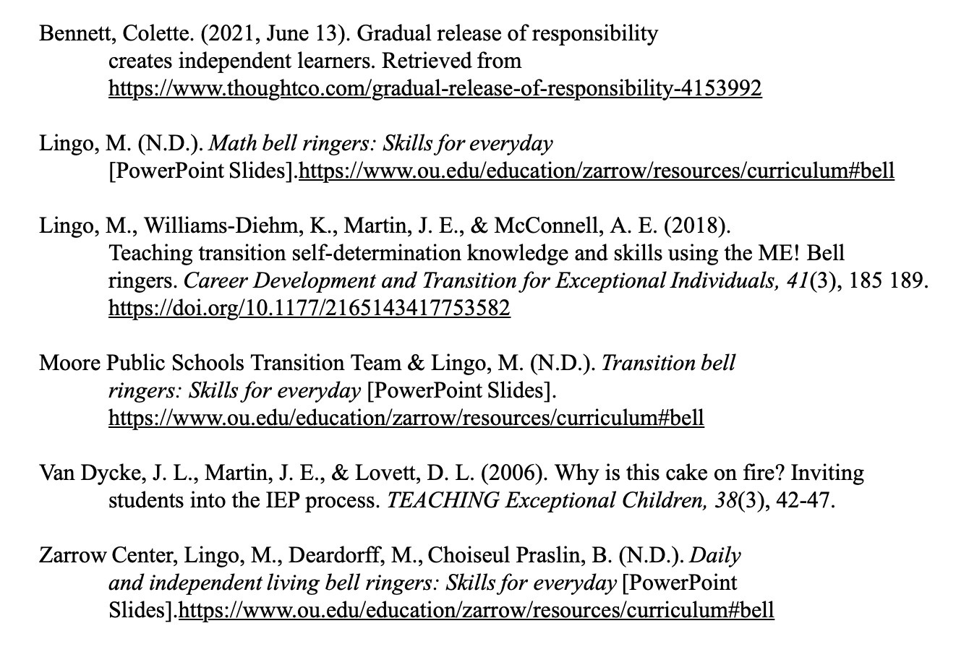
References

