Slide 1
“Strolling through the Match” March 12, 2021

Slide 2
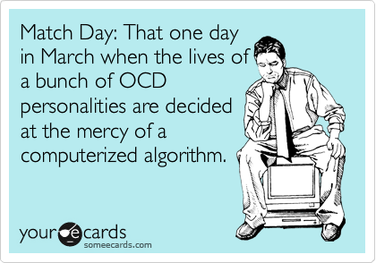

Slide 3
2020 Match Data
Will I match?
Most likely!
18,108 U.S. Seniors matched in 2020, out of 19,326 active applicants
93.7% success rate (historic range of 92-95%)
95.6% of couples were matched-highest ever

Slide 4
2020 Match Data
Will I be able to go where I want?
Probably!
71.1% of U.S. seniors got their first, second or third ranked program (49.2% got their 1st!)
Only 17.6% got >fourth rank

Slide 5
2020 Match Data
Top 5 Specialties for US Seniors
Internal Medicine, categorical (19.3%)
Pediatrics, categorical (9.6%)
Emergency Medicine (9.5)
Family Medicine (8.5)
Internal Medicine, prelim (7.3)
Psychiatry (6.3%) Surgery (5.7%)

Slide 6
2020 Match Data
Top 5 Specialties for OU Seniors
Internal Medicine - categorical(18.9%)
Family Medicine (17.0%)
Pediatrics - categorical(12.6%)
General Surgery (12.6%)
Anesthesia (8.2%)
Psychiatry (4.4%) OB/GYN (4.4%)

Slide 7
2020 Match Data
SCM Match - Class of 2020
Internal Medicine – 11 (42.3%)
Pediatrics – 4 (15.4%)
Psychiatry – 4 (15.4%)
General Surgery – 2(7.6%)
Family Medicine – 1 (3.8%)
IM Prelim/Ophthalmology – 1(3.8%)
IM Prelim/Dermatology– 1(3.8)
Anesthesia – 1(3.8)
Pathology– 1(3.8)
(OB/GYN and EM – 0)

Slide 8
2020 Match Data
SCM Match - Class of 2020
Locations:
13 – Oklahoma (8 Tulsa, 3 OKC, 2 IM Prelims - 1 Tul ,1 OKC)
2 – Colorado
1 each – AL, AZ, CT, FL, IL, KS, MA, MN, MO, NC, TN, UT, VA
2009 to 2020 Match Results are available for your review!

Slide 9
Our Outcomes: The Match

Slide 11
The Application Process
Residency Application Programs:
NRMP – National Residency Match Program
Military Match* – early match (December)
AUA Match* – Urology, early match (January)
San Francisco Match* - Ophthalmology and Plastic Surgery, early match (January)
(*Students also register in the NRMP for prelim spots or Plan B)

Slide 12
What is the NRMP?
The NRMP is a private, not-for-profit corporation established in 1952 to provide a uniform date of appointment to positions in graduate medical education (GME) in the United States.
The NRMP provides a uniform system by which residency candidates simultaneously “match” to first and second-year postgraduate training positions accredited by the ACGME.

Slide 13
NRMP – The Rules
Any program participating in the Main Residency Match is required to place all residency positions in The Match.
Exceptions:
Rural Scholars Programs
Family Medicine Accelerated Programs
Post-SOAP positions
Off-cycle appointments
Few other unusual circumstances

Slide 14
NRMP – Couples Match
Any two individuals can link (‘couple’) their rank order lists.
Each individual of a couple must enroll individually in the Match and indicate in the R3® system that they want to participate in Match as a couple.
Each half of the couple must then send a couple’s request to your partner via the R3 system and they must accept – there is an additional fee
Each partner creates a list of their preferred residency programs.
Both participants’ lists are coordinated to form pairs of choices for the matching algorithm considers.
The couple will match to the most preferred pair of programs on the rank order lists where each partner has been offered a position. Each partner may have up to 300 ranks on their individual rank order lists.

Slide 15
Application System for the NRMP
ERAS – Electronic Residency Application Service
Introduced by American Association of Medical Colleges in 1995 to automate residency application process
Service uses internet to transmit residency and fellowship applications, letters of recommendation, dean’s letters, transcripts, etc. to residency and fellowship program directors

Slide 16
Advantages of ERAS
Saves TIME
Allows you to complete one application and send it to all programs
ERAS is very “user friendly” – very similar to AMCAS
ERAS offers flexibility
Can customize your applications with different personal statements, letters of reference, etc.

Slide 17
How ERAS Works
There are 4 components:
MyERAS – applicant’s Web application
DWS – Dean’s Office workstation
PDWS – Program Director’s workstation
ERAS Post Office

Slide 18
Application Process Checklist
Visit SCM Guide to the Match Website and review the content!
Prepare a Curriculum Vitae – Writing Center, Career specific mentor, Assoc. Dean, etc..
Write a personal statement – OUHSC Writing Center, OU-Tulsa Student Affairs, Career Specific Mentor, Assoc. Dean
Request letters of reference
Practice Interviewing – OU-Tulsa Student Affairs offers practice interviews, Career specific mentors
Complete MSPE Survey Form and submit by June 1st
Meet with Associate Dean regarding Medical School Performance Evaluation (MPSE) “Dean’s Letter”
Decide which programs you wish to apply to – AMA and AAMC resources

Slide 19
ERAS Process Checklist
Get your ERAS token for accessing MyERAS
Go to website www.aamc.org/eras and complete your applications
Dean’s office will send MSPE letter and transcripts.
You must submit names and information for Letter of Recommendation (LoR) writers. LoR writer uploads letters directly to portal.
Applicant Documents Tracking System (ADTS) will use email to acknowledge documents that are downloaded by programs.
CHECK YOUR EMAIL OFTEN!

Slide 20
Completing your Applications
Choose the programs you are applying to – Follow all instructions as to what is needed in regard to LoRs
Assign a Personal Statement and LoRs (up to 4) to each program’s application – you may individualize per program!
Make sure to request your NBME transcripts – all scores to date will be on that transcript
Dean’s office will upload MSPE letter and transcripts
Wait for interviews offers – there is a sweet spot of being able to rank around 15 programs that gives you your highest chance to match in almost every specialty
CHECK YOUR EMAIL OFTEN!

Slide 21
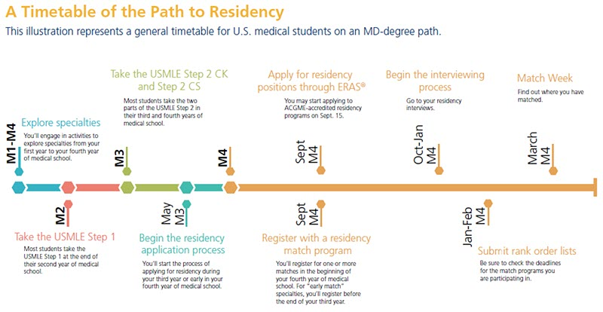
General Residency Application Time Line
From the AAMC’s Roadmap to Residency
*A more detailed timeline is available on the SCM Guide to Match AAMC and ERAS Websites
https://www.ou.edu/tulsa/community_medicine/currrent-students/current-students/guidetothematch/important-dates-
Notes:
Move to solid colored slide

Slide 22
Success in the Match
Do not overestimate yourself - look at the characteristics of individuals who successfully match.
Do not underestimate yourself - talk to people who can objectively assess your competitiveness.
Do not list programs where you feel you will be unhappy – decide if it’s better to be unmatched than to match where you don’t want to go.
The order is crucial! – rank by your preference, not by your perceived competitiveness for the program.
Don’t make your list too short – the more competitive your specialty, the longer your list needs to be (which translates to apply to more programs!)

Slide 23
Away Rotations
Policy # 405 – Updated 7/2020
Limited to 4 electives in a single department – SubIs, department sponsored Specials Studies and Research courses are NOT included in this number
Limited to 3 Away rotations
2021 Coalition for Physician Accountability Guidance:
Limited to 1 IN-PERSON away rotation, to begin no earlier that 8/1/21
Applications open 4/15/21
Programs to begin processing applications 5/1/21
You may do an additional 2 VIRTUAL away rotations
Do I need to do an away rotation?
Depends on your goals!

Slide 24
Important Links
ERAS – Electronic Residency Application System
https://apps.aamc.org/myeras-web/#/landing
NRMP – National Residency Match Program
https://www.nrmp.org/
VSLO – Visiting Student Learning Opportunities
https://students-residents.aamc.org/attending-medical-school/article/visiting-student-learning-opportunities/
VSAS – Visiting Student Application System – access through VSLO page, use your AAMC UN and PW

Slide 25
Program Director’s Role
Program Director’s evaluate your application through ERAS
Issue invitations to students they wish to interview
Make a rank list for their residency program

Slide 26
2018 NRMP Program Director Survey
USMLE Step 1 and Step 2-CK scores open the residency doors, but it is the interview that lands you the residency.
The top factors in Offering interviews to applicants
USMLE Step 1/Comlex Level 1 scores
Letters of Recommendation
MSPE ‘Dean’s’ letters
Step 2 CK / Comlex Level 2 scores
Personal statement

Slide 27
2018 NRMP Program Director Survey
USMLE Step 1 and Step 2-CK scores open the residency doors, but it is the interview that lands you the residency.
The top factors in ranking applicants
Interactions with faculty during interview and visit
Interpersonal skills
Interactions with housestaff during interview and visit
Feedback from current residents
USMLE/COMLEX Step 1 score

Slide 28
Dean’s Office/Student Services Role
MSPE dean’s letter and transcripts to programs’ “mailboxes”
Offer advice, support, and nagging
We want you to succeed and match with the residency program that is right for you!

Slide 29
What if I don’t match?
SOAP - Supplemental Offer and Acceptance Program
Unmatched applicants apply for unfilled residency positions through ERAS.
Unmatched students will be notified on Monday of Match week and a list of unfilled programs is released.
Students apply to preferred unfilled programs via ERAS.
Programs will conduct phone or zoom interviews with applicants Tuesday and Wednesday morning.
Wednesday afternoon through Thursday, several rounds of offers from programs to candidates occur – interviews may continue to occur.
DO NOT USE SOAP AS A BACK UP PLAN!

Slide 30
Choosing a Residency Program
Things to consider:
What were your original goals
Size of the program
Large academic program vs community based
Competitiveness of the program
Geographic location
Opportunities for fellowship exposure
Opportunities for doing procedures
Family and relationship considerations

Slide 31
NRMP Resources
DATA REPORTS:
Results and Data: 2020 Main Residency Match (PDF, 128 pages) This report contains statistical tables and graphs for the Main Residency Match®and lists by state and sponsoring institution every participating program, the number of positions offered, and the number filled.
2020 Match Results by State, Specialty, and Applicant Type (PDF, 17 pages) This report includes the numbers of positions offered and filled by state, specialty, and applicant type for the 2020 Main Residency Match.
Program Results, 2016-2020 (PDF, 176 pages) This report includes the numbers of positions offered and filled for all programs participating in the Main Residency Match between 2016 and 2020.
Impact of Length of Rank Order List on Match Results 2002-2020 Main Residency Match (PDF, 5 pages)

Slide 32
NRMP Resources
Research reports:
Charting Outcomes in the Match: Senior Students of U.S. MD Medical Schools – Characteristics of U.S. MD Seniors Who Matched to Their Preferred Specialty in the 2020 Main Residency Match (2nd edition) (PDF, 215 pages) Report documents how applicant qualifications affect match success, including USMLE Step 1 and Step 2 CK scores, number of research experiences, publications, and work and volunteer experiences.
Interactive Charting Outcomes in the Match: Updated with 2020 data, this tool is intended to assist Match applicants in determining their goodness of fit for specialties. Built using data visualization software, it draws from the same data sources as the NRMP’s publication Charting Outcomes in the Match.

Slide 33
NRMP Resources
SURVEY REPORTS:
Results of the 2020 NRMP Program Director Survey (PDF, 172 pages) This report examines the factors program directors use to select applicants to interview and rank. Data are reported for 22 specialties and the transitional year in the Main Residency Match.
Results of the 2019 NRMP Applicant Survey (PDF, 181 pages) This report presents the results of selected items from the 2019 NRMP Applicant Survey. The report documents factors that applicants weigh in selecting programs (1) at which to interview and (2) to rank in the Main Residency Match.

Slide 34
AMA Resources
FREIDA:
All residencies and fellowships accredited by the Accreditation Council for Graduate Medical Education are searchable on FREIDA
All programs have an Overview, which includes contact information, accredited length, start dates, participating institutions, and a map of training locations
Programs with an Expanded listing include application information, USMLE/COMLEX scores, program faculty and trainee data, work/call schedule, and other educational and employee information that will help you determine the best program for your training.
Search by specialty and state, or narrow your search with additional optional filters
Compare key program features with the Comparison list.

Slide 35
AAMC Resources
AAMC - Careers in Medicine:
descriptions of and data for more than 120 U.S. M.D. and D.O. specialties, including
competitiveness data including USMLE and COMLEX scores
prerequisites and length of training for ACGME- and AOA-accredited residency and fellowship programs
salary and lifestyle information
patient profiles
advice for successfully navigating the U.S. residency application and match process
career self-assessments to help connect you to your preferred specialties
a database of all active ACGME-accredited residency and fellowship programs

Slide 36
SCM Resources
SCM Departmental Career Specific Mentors:
Emergency Medicine – Emily Fisher
Family Medicine – Jason Deck
Internal Medicine – Oliver Cerqueira
Med/Peds – Will Butron
OB/GYN – Monica Henning
Pediatrics – Matt Tandy
Psychiatry – Andrew Liew
Surgery – Peter Nelson
OKC Departmental Mentors – See database in Hippocrates

Slide 37
SCM Resources
Guide to the Match
http://www.ou.edu/tulsa/community_medicine/md-program-scm-track/current-students/guidetothematch

Slide 38
What will this cost me?
MS4 Estimated Costs

Slide 39
ou.edu/communitymedicine.com

