Slide 1
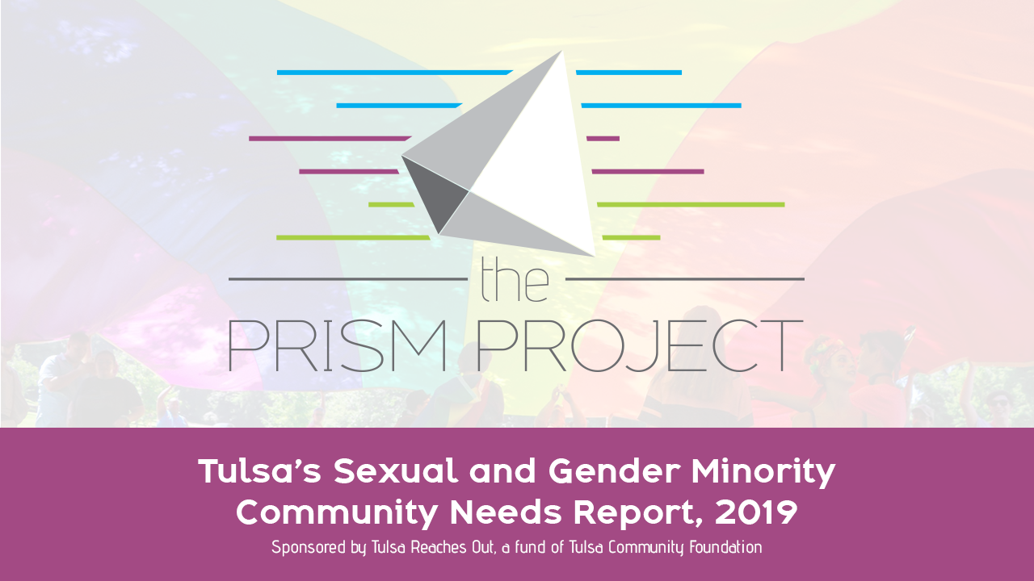

Slide 2
TABLE OF CONTENTS
About the Report
Sample Characteristics
Sexual Identity
Summary of Findings
Family & community
Mental health and trauma
Physical health and healthcare access
SGM youth report challenges
Workplace experiences
Priorities & Recommendations

Slide 3
ABOUT THE REPORT

Slide 4
About the Report
The title of this report, The Prism Project, is meant to convey two things:
First, this report is the product of extensive input from members of the SGM community in the Tulsa region, and it is meant to shine a light on the issues and project a variety of solutions on the other side.
Second, we chose the word “project” because it implies the work is not done. Rather, this serves as one more step forward in contributing to an ongoing conversation.
Notes:
- The title of this report, The Prism Project, is meant to convey two things.
- First, this report is the product of extensive input from members of the Sexual and Gender Minority (SGM) community in the Tulsa region, and like a prism, its purpose is to shine a light on the issues and project a variety of solutions on the other side.
(Sexual Gender Minority: A broad and inclusive umbrella term that includes any person who is non-cisgender and/or non-heterosexual. This term sometimes includes romantic orientations (GRSM).
- Second, we chose the word “project” because it implies the work is not done. Rather, this serves as one more step forward in contributing to an ongoing conversation that will lead to better results for members of our SGM community.
- A data-based understanding of a group within our society allows service providers, policy makers, businesses, faith communities and others to make informed decisions in addressing the needs and challenges of the group and the individuals within the group.

Slide 5
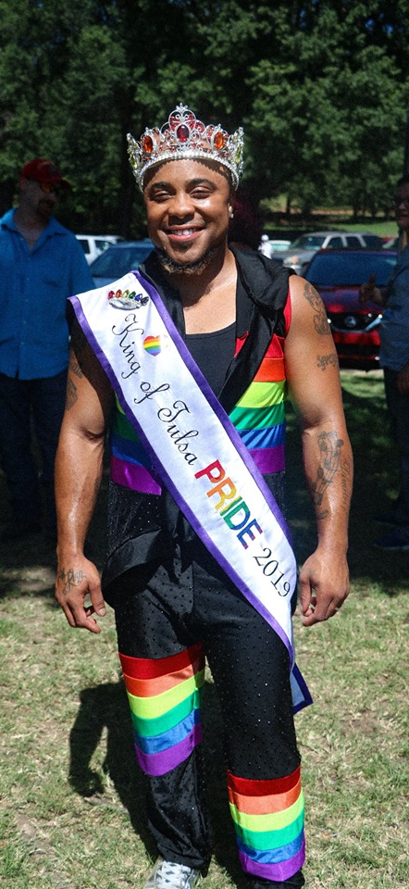
About the Report
The first LGBT Needs Assessment was commissioned in 2004 by Tulsa Reaches Out (TRO)
The purpose was to promote access to needed social and health services and to inform the community of the gaps in inclusive policies and practices involving the LGBTQ population
585 completed the 2004 survey or participated in a focus group
Notes:
- The first LGBT Needs Assessment was commissioned in 2004 by Tulsa Reaches Out (TRO), an advisory council within the Tulsa Community Foundation.
- The purpose of the 2004 survey, and the resulting report released in 2005, was to promote access to needed social and health services and to inform the community of the gaps in inclusive policies and practices involving the LGBTQ population.
- 585 LGBTQ persons completed a survey or participated in a focus group.

Slide 6
About the Report
TRO commissioned The Hope Research Center at the University of Oklahoma’s Tulsa Campus for this 2019 Report
Our goals in providing this Report are three-fold:
1. Outreach to community partners
2. Inform advocacy groups
3. Guide policymakers & policy implementers
Notes:
TRO organized a Steering Committee and commissioned The Hope Research Center at the University of Oklahoma’s Tulsa campus to conduct a new survey, analyze the data and issue this 2019 Report.
Our goals in providing this Report are three-fold:
1. Outreach to community partners to inform practice and ensure services are responsive to the needs of the SGM community;
2. Inform advocacy groups working to increase public awareness and support goals that will improve the well-being of members of our SGM community; &
3. Guide policymakers by providing data and analysis on the experiences of our SGM community to inform future policy recommendations and actions.

Slide 7
“We hope readers will consider committing their resources, influence, and networks to come up with creative solutions to the persistent challenges faced by SGM individuals so that we can continue making progress together as one community.”

Slide 8
About the Report
Chan Hellman, University of Oklahoma - Tulsa, Hope Research Center
Eden Nay, University of Oklahoma - Tulsa, Hope Research Center
Stephanie Andrews, Tulsa Public Schools
^{Dr. Laura Arrowsmith}
Brad Church, Williams Companies, Inc.
Michael DuPont, Charles and Lynn Schusterman Family Foundation
Allison Ikley-Freeman, State Senator and counselor
Toby Jenkins, Oklahomans for Equality
Marcia Keesee, Creoks Health Services
Gabe Lowe, Youth Services of Tulsa
Avery Marshall, University of Oklahoma – Tulsa, Office of Diversity & Inclusion
Ben Matthews, Camp Fire Green Country
^{Nancy McDonald}
Rev. Chris Moore, Fellowship Congregational Church UCC
^{Kate Neary, Tulsa CARES}
^{Dennis Neill}
Father Alvaro Nova Ochoa, Comunidad de Esperanza
Heather Palacios, Coretz Family Foundation
Taylor Raye, Youth Services of Tulsa
^{Chris Shoaf, Club Majestic}
Jeremy Simmons, Health Outreach Prevention Education, Inc. (H.O.P.E.)
^{Mark Smalley, Tulsa CARES}
Ben Stewart, George Kaiser Family Foundation
^{Al Triggs}
Jose Vega, Oklahomans for Equality
Alex Wade, Oklahomans for Equality
^{Justice Waidner, ONEOK Inc}
^{Mark Wilson}
Notes:
List of Steering Committee Members

Slide 9
SAMPLE CHARACTERISTICS

Slide 10
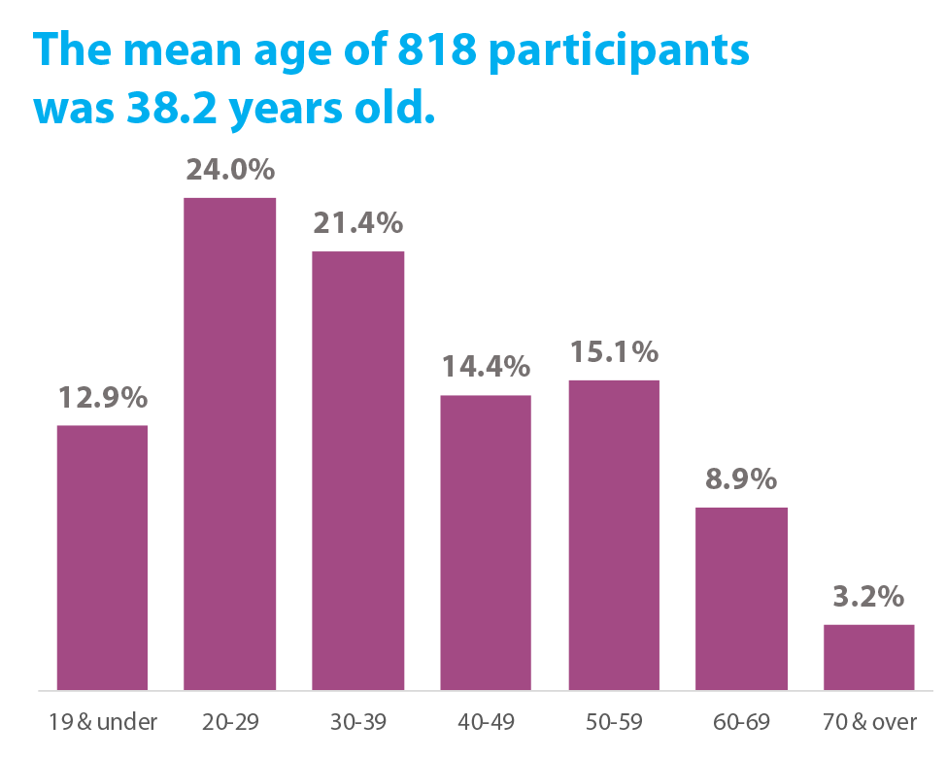
Sample Characteristics
Final sample consisted of 818 participants
Mean age was 38.2 years old
Majority (71.9%) identified as white-only as their race or ethnicity
Notes:
- The final sample consisted of 818 participants
- The mean age was 38.2 years old
- The majority (88.3%) selected either white-only or white in addition to another selection as part of their race or ethnicity.
- Table 1 shows the full results.

Slide 11
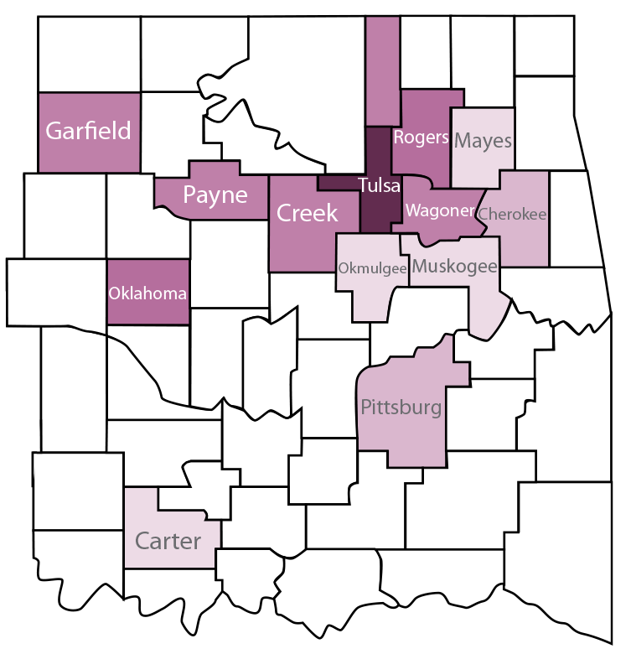
Sample Characteristics
82.1% live within the Tulsa Metropolitan Statistical Area (TMSA)
Mean number of others living in the household was 1.7
Nearly all (97.9%) respondents reported English being spoken in the home, whether English alone or in addition to another language
Notes:
- 82.1% of respondents report living within the Tulsa Metropolitan Statistical Area (TMSA)
- The mean number of others living in the household was 1.7
- Nearly all (97.9%) respondents reported English being spoken in the home, whether English alone or in addition to another language.
- Table 2 shows the full results.

Slide 12
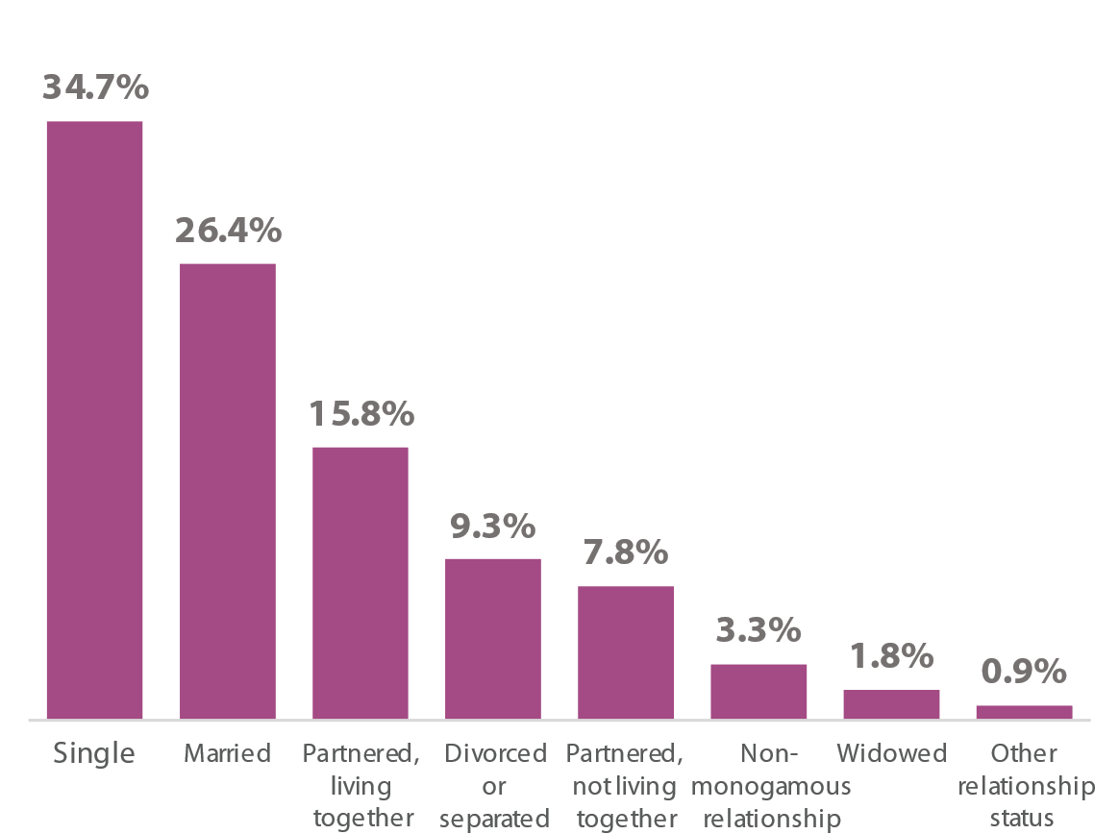
Sample Characteristics
Relationship status of respondents

Slide 13
Sample Characteristics
Annual household income for participants and TMSA appear
proportionately similar with only minor
differences between groups.
Notes:
Table 3 shows the comparisons for annual household income between study participants and the overall TMSA. Groups appear proportionately similar with only minor differences between groups.

Slide 14
SEXUAL IDENTITY

Slide 15
Sexual Identity
92.1% of participants were categorized as sexual minorities
21.9% were categorized as gender minorities
78.1% of respondents reported being cisgender
10.6% reported being transgender
9.8% reported being nonbinary
1.5% gender minorities were left uncategorized
Notes:
Sexual minorities: A broad category including all persons who are not straight or heterosexual.
Gender minorities: A broad category including all persons who are not cisgender.
Cisgender: A person whose gender identity corresponds with their sex assigned at birth. For example, a cisgender man is someone who was both assigned male at birth and currently identifies as a man.
Transgender: An umbrella term used to describe a person whose gender identity does not correspond with their sex assigned at birth.
Nonbinary: An umbrella term used to describe any person who does not identify within the binary of “man” or “woman,” including gender identities such as gender nonbinary, genderqueer, genderfluid, and others.

Slide 16
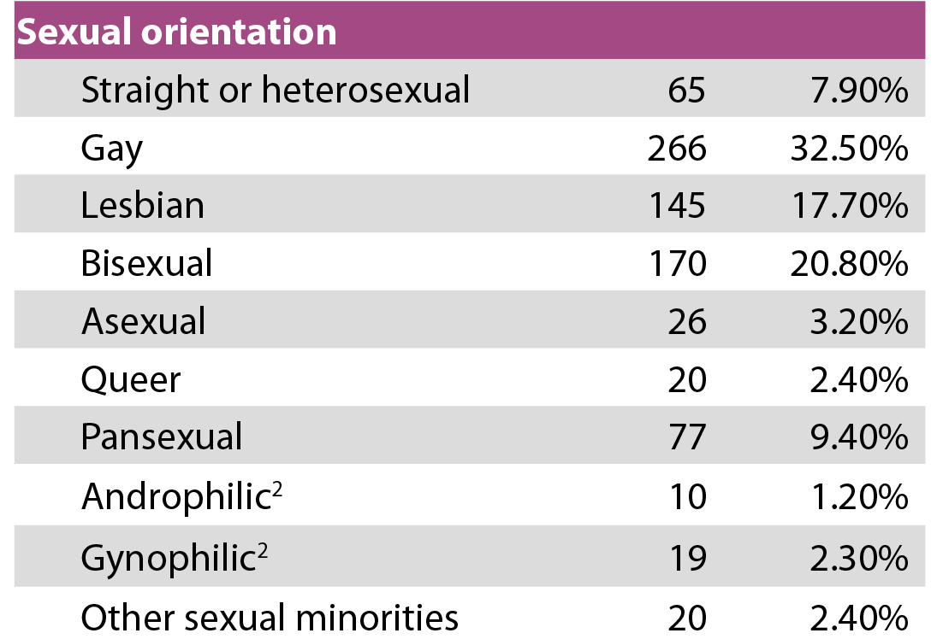
Sexual Identity

Slide 17
SUMMARY OF FINDINGS

Slide 18
SUMMARY OF FINDINGS: Family & Community

Slide 19
Family & Community
Adults are reporting high levels of hope (84.8%) and civic engagement (71.3%)
Many are living with others and in relationships
Nearly 4 in 5 are living with at least one other person
Over half are in a relationship

Slide 20
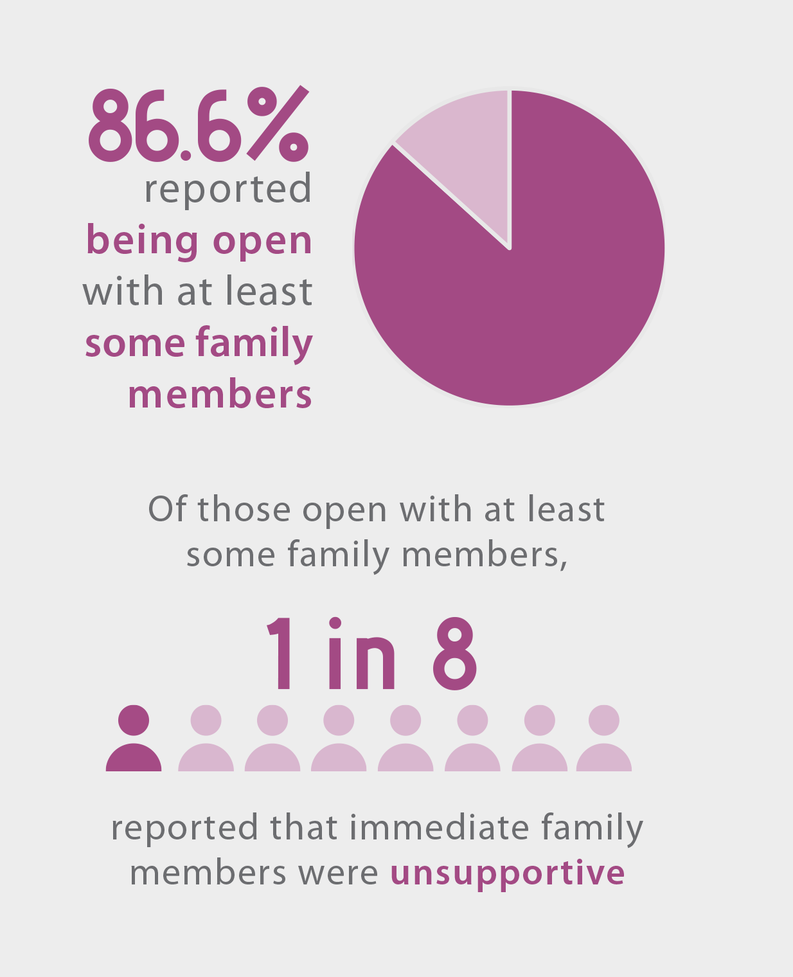
Family & Community
Many are reporting generally positive experiences with family
Over half of respondents reported none of the listed negative experiences with family
2/3 of respondents reported at least one of the listed positive experiences with family
Notes:
- Many are reporting generally positive experiences with family.
Over half of respondents reported none of the listed negative experiences with family.
For participants under 20, 61.2% reported none of the listed negative experiences with family.
Two-thirds of respondents reported at least one of the listed positive experiences with family.
For participants 19 and younger, three out of four reported at least one such positive experience.
- 86.6% reported being open with at least some family members, and about one in eight reported that immediate family members were unsupportive.

Slide 21
Family & Community
Many respondents are accessing agencies, programs, and services in the community
Many are reporting few instances of the listed negative experiences with law enforcement
5 out of 6 participants who interacted with law enforcement in the past 3 years reported none of the listed negative experiences
Notes:
- Many respondents are accessing agencies, programs, and services in the community.
- 55.6% of adults are accessing Oklahomans for Equality and 58.7% of youth are accessing Gender and Sexuality Alliances.
- Many are reporting few instances of the listed negative experiences with law enforcement.
- Five out of six participants who interacted with law enforcement in the past three years reported none of the listed negative experiences.

Slide 22
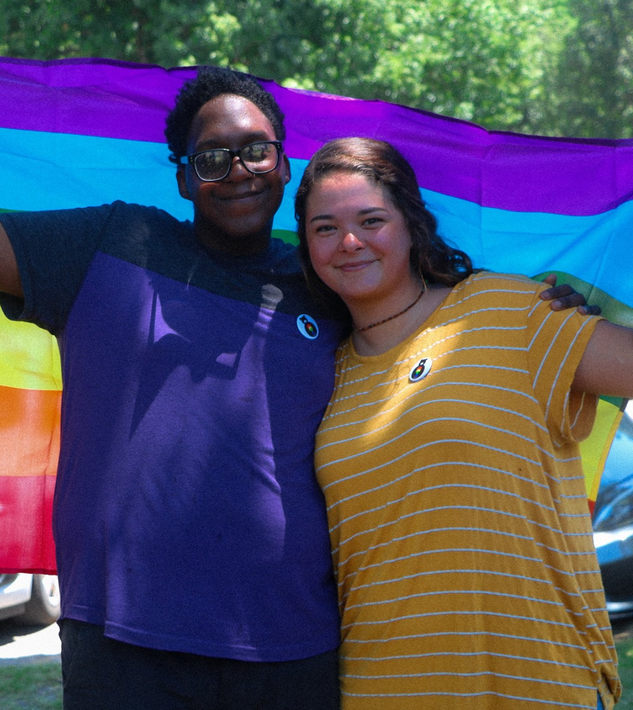
Family & Community
Those who have been involved in spiritual or religious communities in the past three years are more open about their SGM identity with their communities
And SGM individuals are more likely to remain involved in their spiritual and religious communities in the past three years if they have had a more SGM-affirming experience

Slide 23
Family & Community
58% of those who have been involved within the past 3 years are open with members and leaders in their spiritual and religious communities
Of adults who reported being open with at least some members, just 10% reported that members were unsupportive
Those who report being white or identifying as Christian report a more SGM-affirming experience
Notes:
58% of those who have been involved within the past three years are open with members and leaders in their spiritual and religious communities
just one-third of participants who had been previously involved in such communities, but not within the past three years, reported having been open.
- Of adults who reported being open with at least some members, just 10% reported that members were unsupportive.
- Those who report being white or identifying as Christian report a more SGM-affirming experience than those who identify as non-white or those who do not currently identify as Christian.

Slide 24
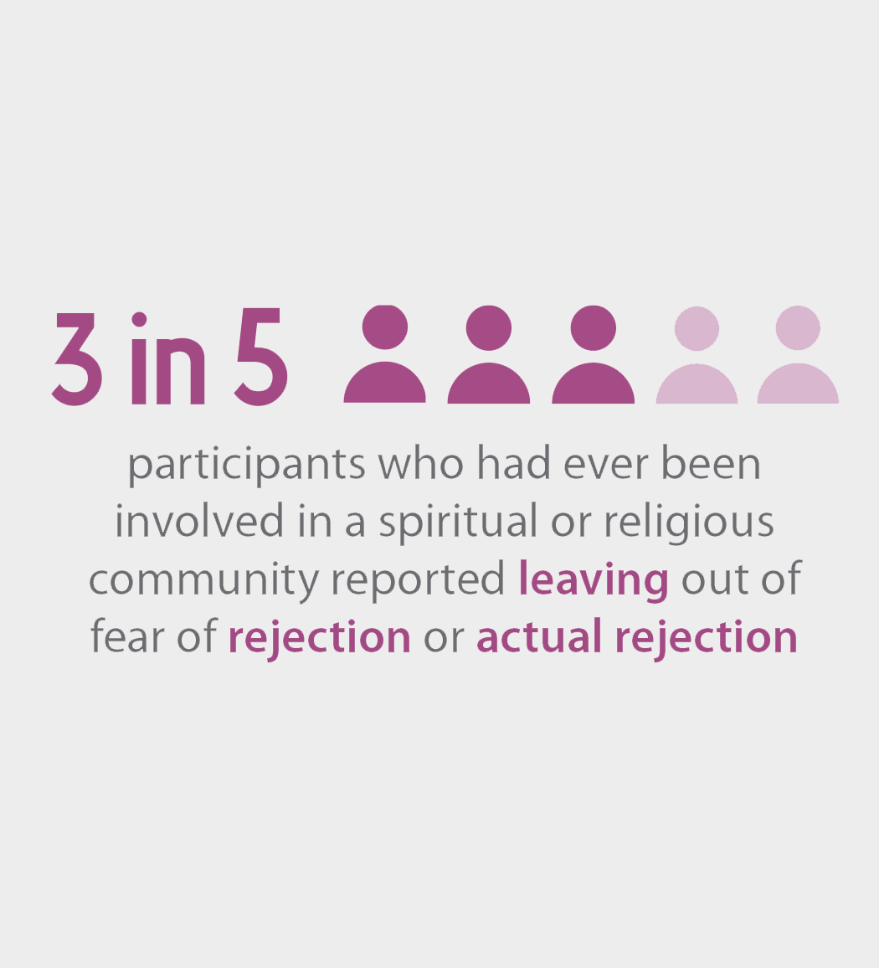
Family & Community
A high percentage of respondents reported leaving their spiritual or religious communities, driven by fear of rejection or actual rejection by their communities
Half of respondents had been involved in such communities but not in the past 3 years
Notes:
- A high percentage of respondents reported leaving their spiritual or religious communities, driven by fear of rejection or actual rejection by their communities.
- Half of respondents had been involved in such communities but not in the past three years. Nearly three in five participants who had ever been involved in such communities reported leaving out of fear of rejection or actual rejection.

Slide 25
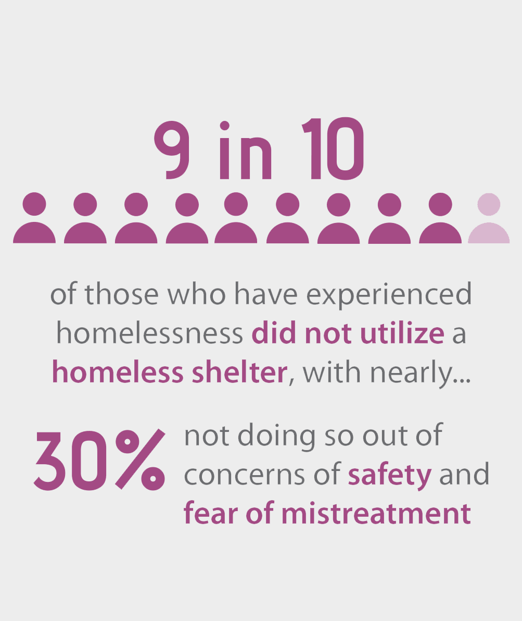
Family & Community
Several respondents have experienced homelessness, yet have not utilized shelters
1 in 8 have experienced homelessness in their lifetimes
Of those who have stayed at a shelter, over 1/3 reported negative experiences as an SGM person
Notes:
- Several respondents have experienced homelessness, yet have not utilized shelters.
One in eight have experienced homelessness in their lifetimes, and
just under 5% within the past three years.
- Of those who have experienced homelessness, nearly 9 in 10 did not utilize a homeless shelter—with nearly 30% not doing so out of concerns of safety and fear of mistreatment.
- Of those who have stayed at a shelter, over one-third reported negative experiences as an SGM person.

Slide 26
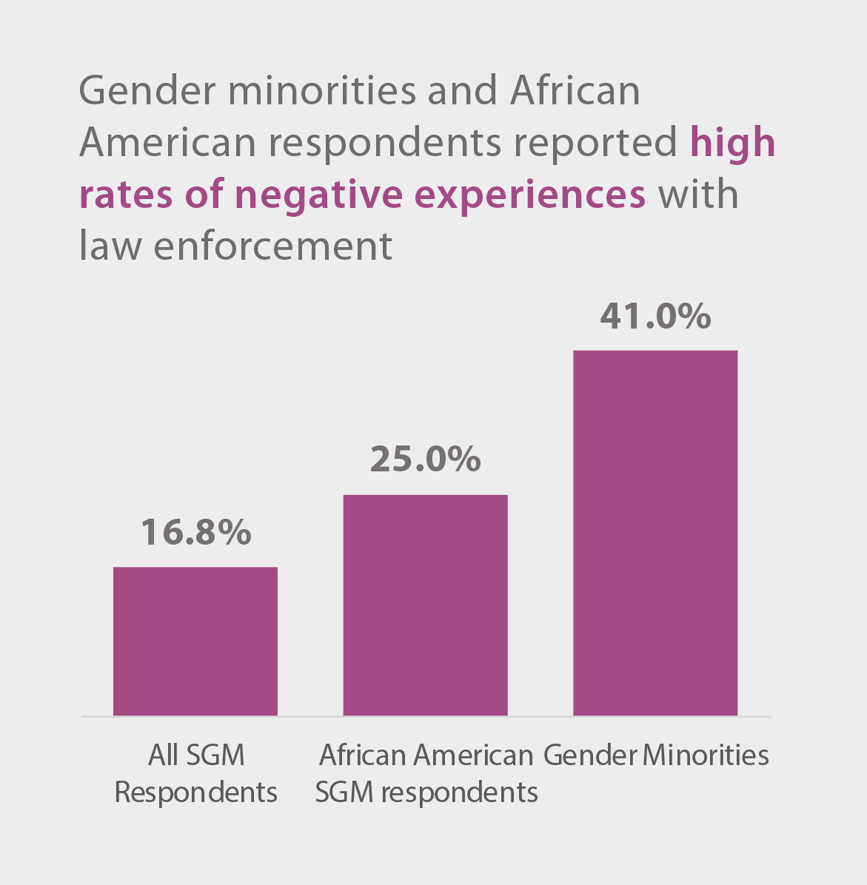
Family & Community
Gender minorities and Black/African American respondents reported high rates of negative experiences with law enforcement
Notes:
- Gender minorities and black/African-American respondents reported high rates of negative experiences with law enforcement.
- 41% of gender minorities and 25% of black/African-American SGM respondents reported at least one of the listed negative experiences, compared to 16.8% of all SGM respondents—the most common experience being verbal harassment.

Slide 27
SUMMARY OF FINDINGS: Mental Health & Trauma

Slide 28
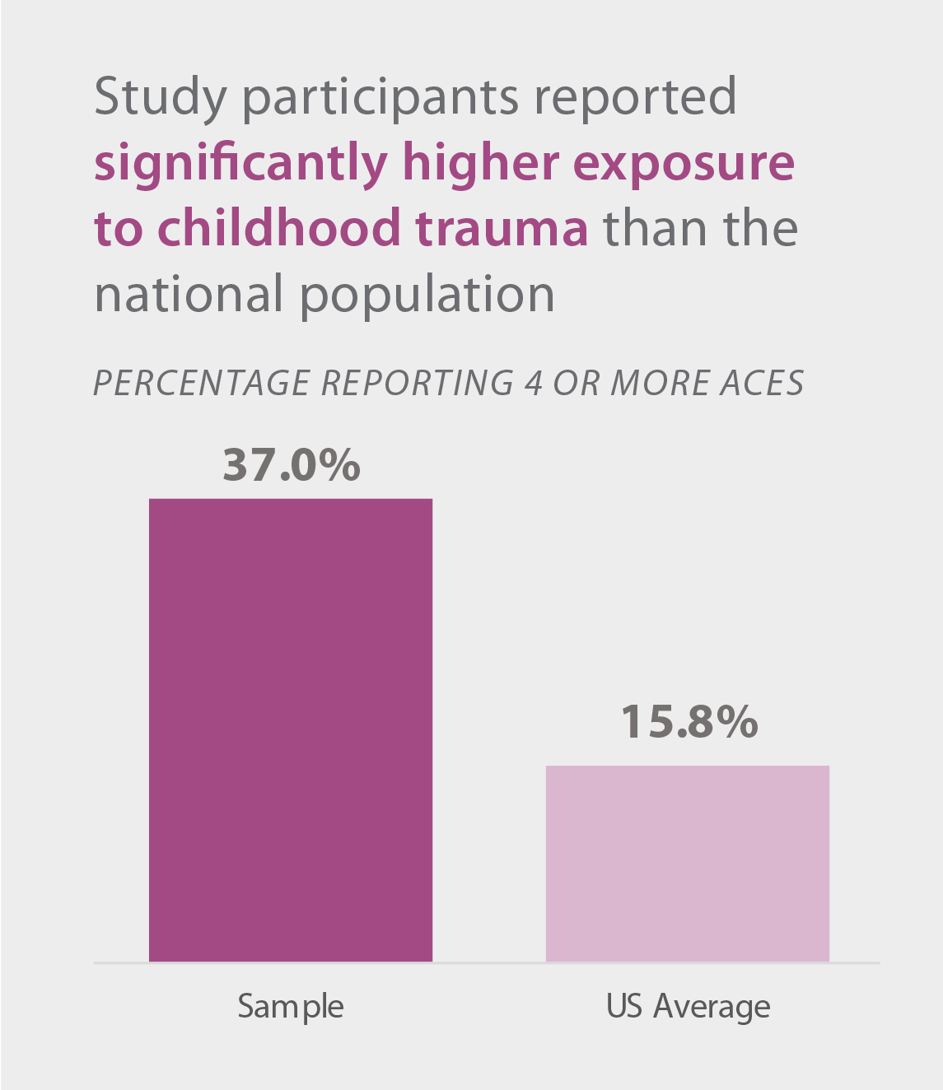
Mental Health & Trauma
Nearly 2/3 reported 2 or more Adverse Childhood Experiences (ACEs)—much higher than the national rate of 38%
37% reported 4 or more ACEs, compared to 15.8% nationally
Notes:
Participants reported significantly higher exposure to childhood trauma than the national population.
- Nearly two-thirds reported two or more Adverse Childhood Experiences (ACEs)—much higher than the national rate of 38%.
- 37% reported four or more ACEs, compared to 15.8% nationally

Slide 29
Mental Health & Trauma
In comparison with the overall populations of both Oklahoma and the U.S., the study’s sample reports higher ACE scores, reflecting greater exposure to childhood trauma in the home.

Slide 30
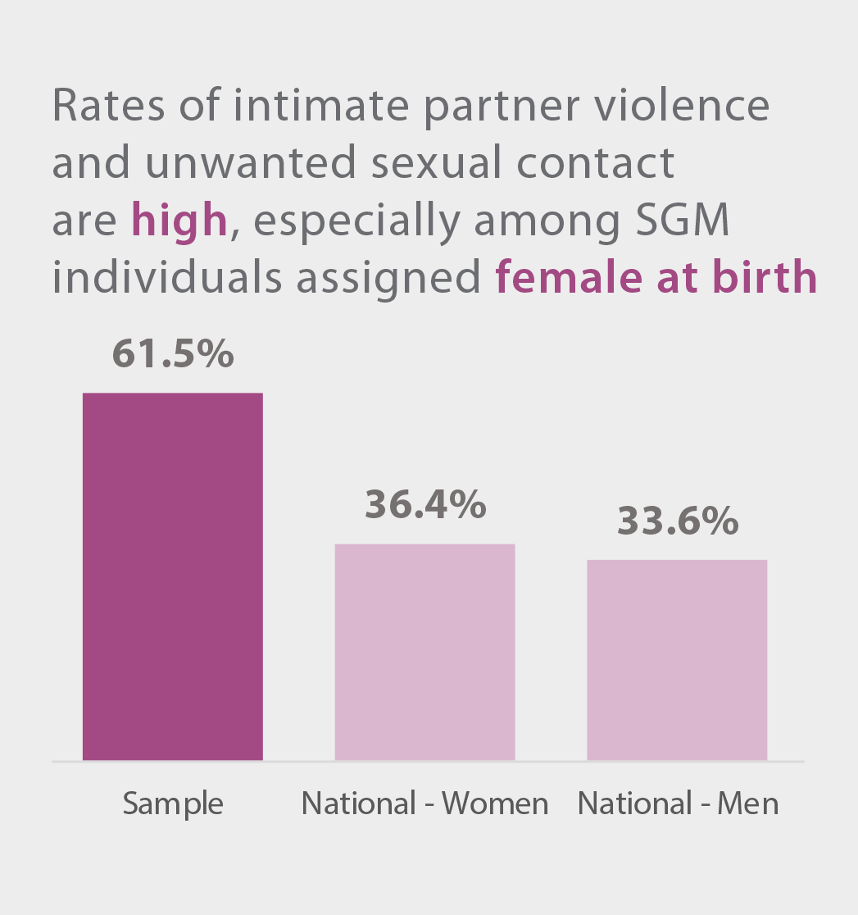
Mental Health & Trauma
42.1% of individuals assigned female at birth reported at least one instance of IPV before their 18th birthday, compared with 25.8% nationally
Half reported ever experiencing unwanted sexual contact
Nearly 2/3 of SGM individuals assigned female at birth experienced unwanted sexual contact, 25 percentage points higher than the general female population
Notes:
Rates of intimate partner violence (IPV) and unwanted sexual contact are high, especially among SGM individuals assigned female at birth.
- 61.5% of respondents reported experiencing at least one instance of IPV, nearly twice the rate among the general population nationally. 24% of respondents reported exposure to four or more items. 42.1% of individuals assigned female at birth reported at least one instance of IPV before their 18th birthday, compared with 25.8% of females in national estimates.
- Half of SGM respondents reported ever experiencing unwanted sexual contact. Nearly two-thirds of SGM individuals assigned female at birth experienced unwanted sexual contact, 18 percentage points higher than the general female population.

Slide 31
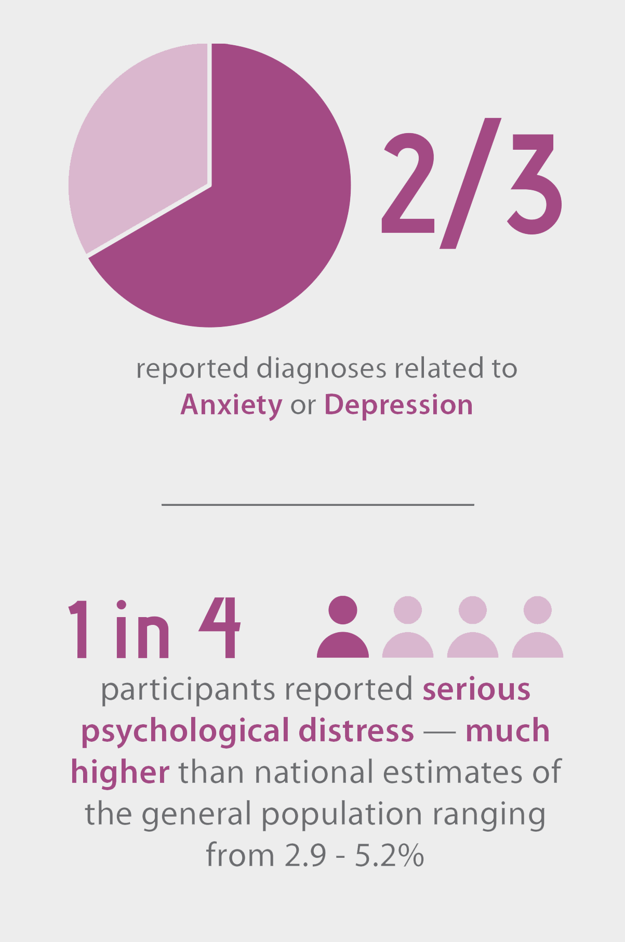
Mental Health & Trauma
Mental health diagnoses and serious psychological distress are prevalent among SGM respondents, especially among youth and gender minority individuals
The rate of those experiencing anxiety is 15% higher than in the 2005 study
39.2% of gender minorities reported serious psychological distress
24.5% of sexual minorities reported serious psychological distress
Notes:
Mental health diagnoses and serious psychological distress are prevalent among SGM respondents, especially among youth and gender minority individuals.
- Two-thirds reported diagnoses related to anxiety or depression. The rate of those experiencing anxiety is 15 percentage points higher than the rate reported in TRO’s 2005 study (47.9% vs. 32.6%).
- In the present study, youth reported experiencing anxiety and depression 11 percentage points higher than adults.
- One in four SGM participants reported serious psychological distress—much higher than national estimates of the general population ranging from 2.9-5.2%.
- 39.2% of gender minorities 18 and older scored above the threshold for serious psychological distress, compared to 19.8% of cisgender participants.
- 24.5% of sexual minorities 18 and older scored above the threshold for serious psychological distress, compared to 14.8% of straight/heterosexual participants.

Slide 32
Mental Health & Trauma
SGM youth reported higher rates of
serious psychological distress
Notes:
- 62.9% of individuals ages 19 and under scored above the threshold, compared with 37.1% of those over the age 19 (see Table 27 for more information on age differences).
- Youth reported experiencing anxiety and depression 11% higher than adults.

Slide 33
Mental Health & Trauma
Despite such high rates of mental health diagnoses and psychological distress, just over 1 in 4 adult participants report currently seeing a mental health professional
Of those who have ever discussed their SGM identity with a professional, nearly 20% reported that the professional attempted to change their sexual orientation or gender identity
Notes:
- Despite such high rates of mental health diagnoses and psychological distress, just over one in four adult participants report currently seeing a mental health professional.
- Of those who have ever discussed their SGM identity with a professional, nearly 20% reported that the professional attempted to change their sexual orientation or gender identity.

Slide 34
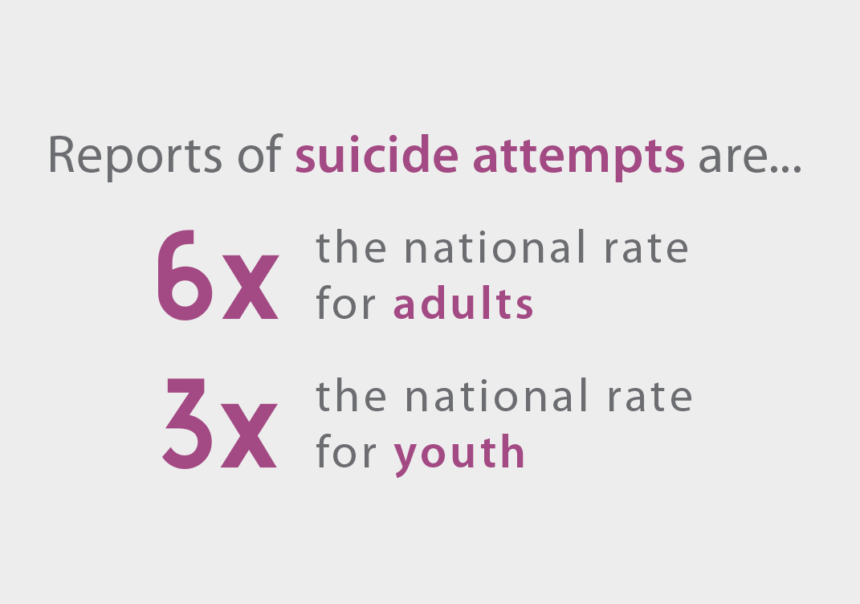
Mental Health & Trauma
Suicidality is strikingly high among the study’s sample, especially among youth
Notes:
Suicidality is strikingly higher among the study’s sample, especially among youth.
- 21.6% of adults (five times the national average) and 59.1% of youth (three times the national average) reported suicidal ideation.
- 3.8% of adults (six times the national average) and 21.5% of youth (three times the national average) reported having attempted suicide.

Slide 35
Mental Health & Trauma
Compared to national estimates, participants age 18 and older report strikingly higher rates of suicidality

Slide 36
Mental Health & Trauma
Participants age 18 and younger also report high rates of suicidality compared to national estimates

Slide 37
SUMMARY OF FINDINGS: Physical Health & Health Care

Slide 38
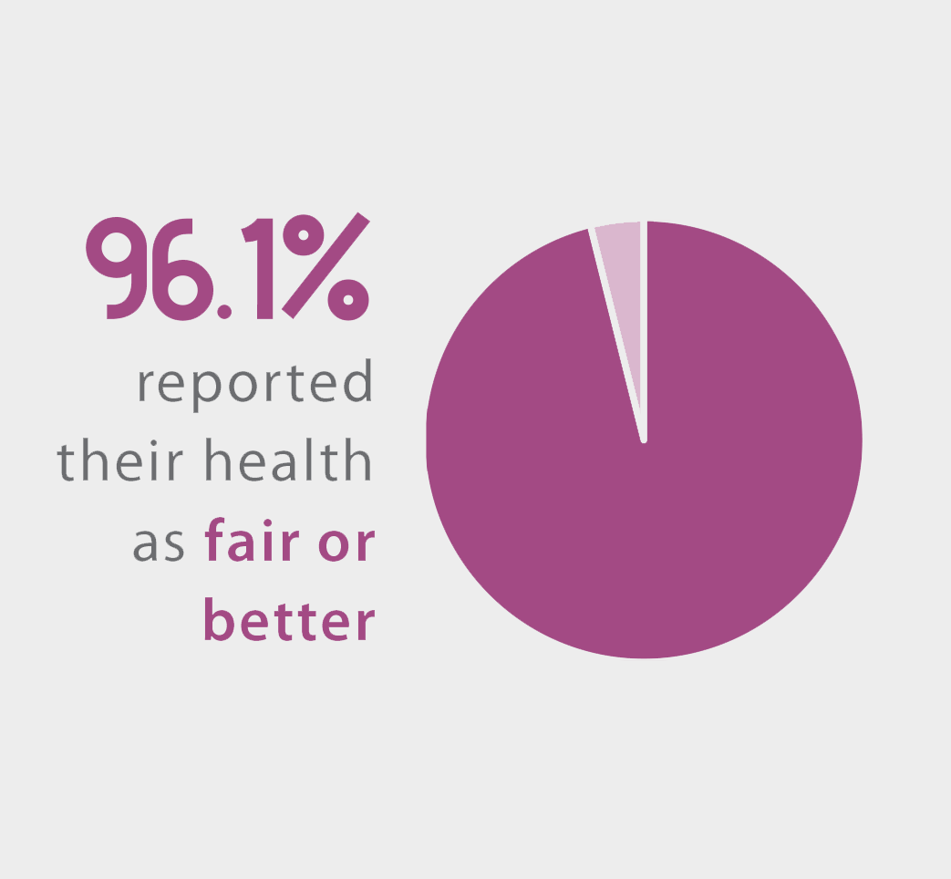
Physical Health & Health Care
Most reported at least a decent quality of health and have health insurance
94.1% reported being HIV negative
Nearly 90% of all respondents who reported living with HIV also reported receiving health care related to HIV within the past 12 months
Notes:
Most reported at least a decent quality of health and have health insurance.
96.1% reported their health as fair or better. Three in four reported good or better.
- 94.1% reported being HIV negative, including nearly 99% of respondents under 30. Nearly 90% of all respondents who reported living with HIV also reported receiving health care related to HIV within the past 12 months.

Slide 39
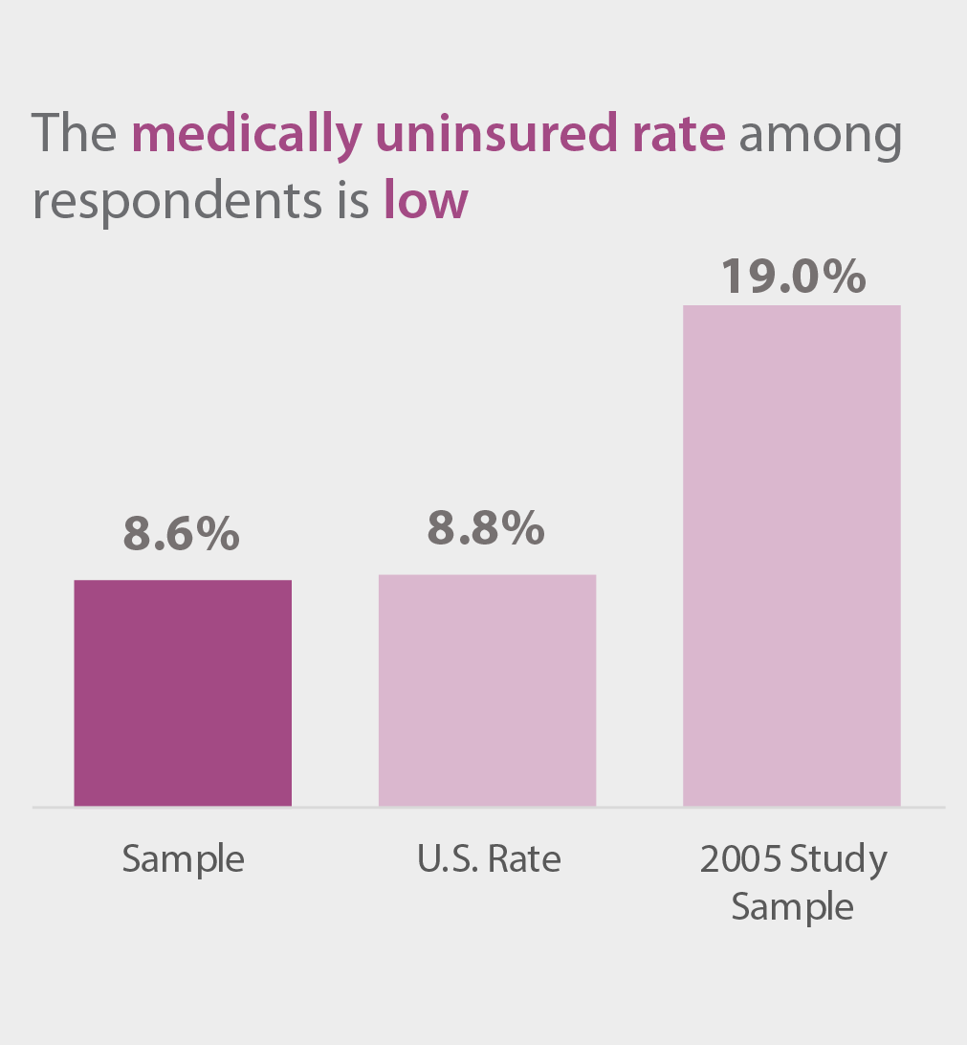
Physical Health & Health Care
The medically uninsured rate among respondents is low (8.6%) and comparable to the national rate (8.8%)
The rate reported in this study is 10.4% lower than the rate reported in the 2005 study
Notes:
Most reported at least a decent quality of health and have health insurance.
96.1% reported their health as fair or better. Three in four reported good or better.
- 94.1% reported being HIV negative, including nearly 99% of respondents under 30. Nearly 90% of all respondents who reported living with HIV also reported receiving health care related to HIV within the past 12 months.
- The medically uninsured rate among respondents is low (8.6%) and comparable to the national rate (8.8%). The rate reported in this study is 10.4 percentage points lower than the rate reported in the 2005 study.

Slide 40
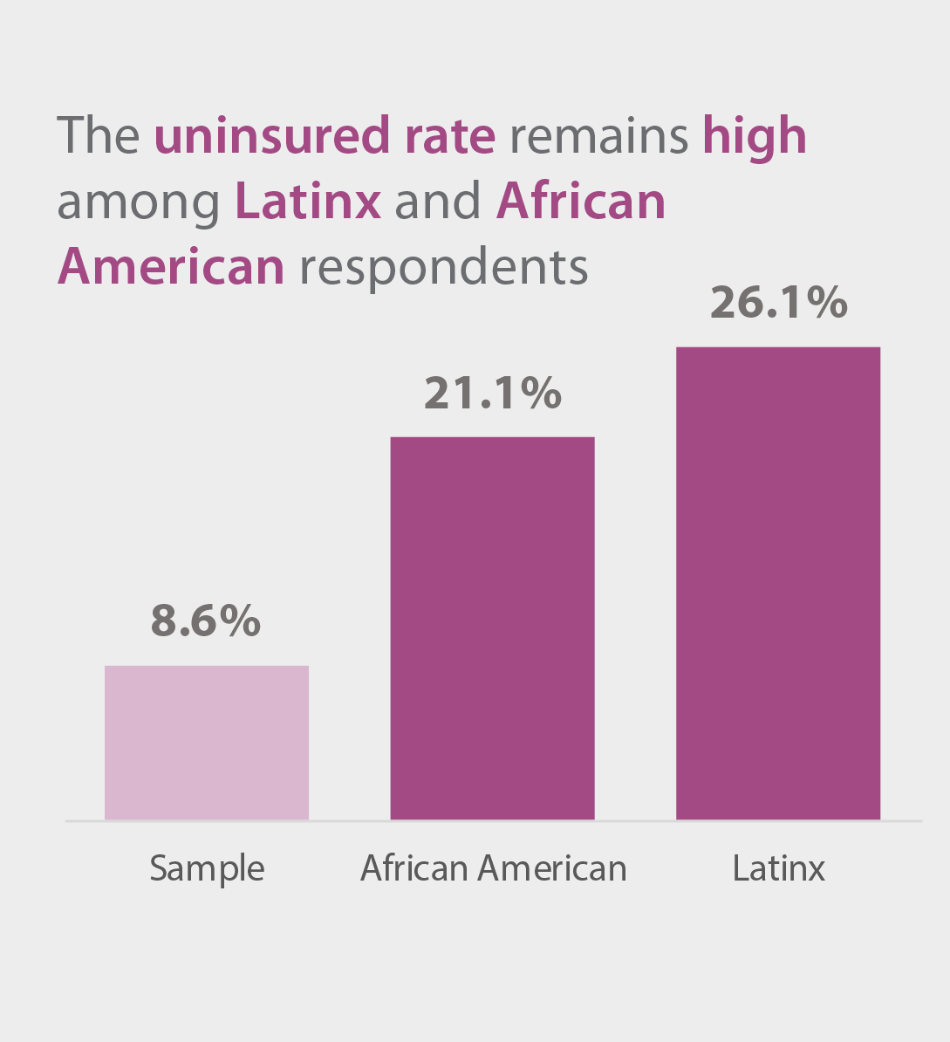
Physical Health & Health Care
There are concerns with respect to the physical health of SGM respondents and access to healthcare
1/3 reported having a serious health issue, including nearly 70% of respondents aged 70 and over
Notes:
- There are concerns with respect to the physical health of SGM respondents and access to healthcare.
- One-third reported having a serious health issue, including nearly 70% of respondents aged 70 and over.
- Although the overall medically uninsured rate is low in this sample (8.6%), the rate remains high among Latinx (26.1%) and black/African-American (21.1%) respondents.

Slide 41
Physical Health & Health Care
1 in 4 report not having a primary care provider, including 34.8% of Latinx and 30% of American Indian respondents
Of those without a primary care provider, 27.8% report they do not seek healthcare because they can’t afford it
Nearly 2/3 reported at least one of the listed negative experiences with their health care provider in the past 3 years
Notes:
- One in four report not having a primary care provider, including 34.8% of Latinx and 30% of American Indian respondents. Of those without a primary care provider, 27.8% report they do not seek healthcare because they can’t afford it.
- Nearly two-thirds of SGM participants reported at least one of the listed negative experiences with their health care provider in the past three years.

Slide 42
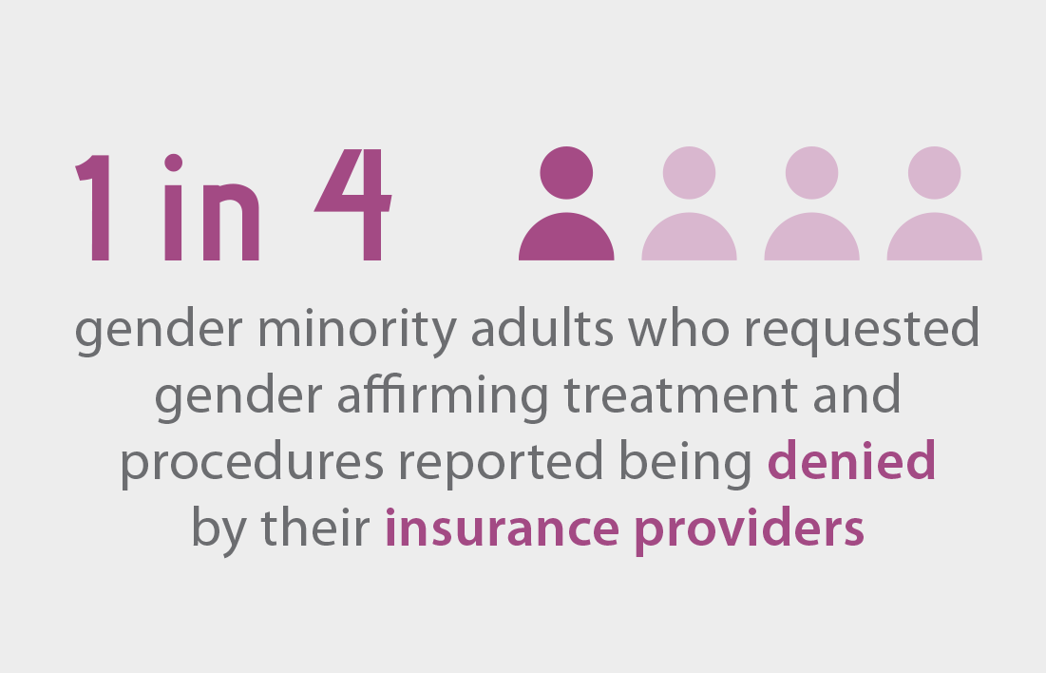
Physical Health & Health Care

Slide 43
SUMMARY OF FINDINGS: SGM Youth Report Challenges

Slide 44
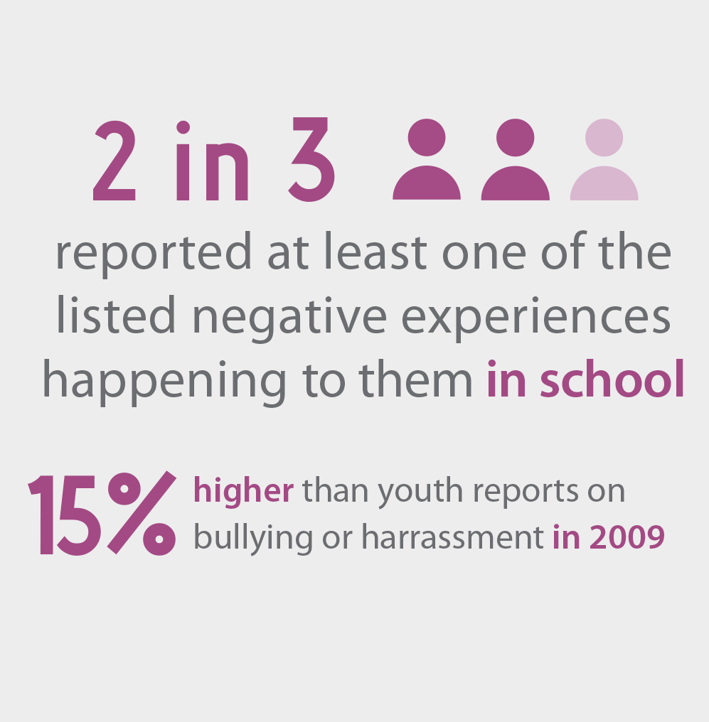
SGM Youth Report Challenges
Negative experiences are common for SGM youth
Outside of any specific social group, 3 in 5 youth reported experiencing teasing, bullying or intimidation
Notes:
- Negative experiences are common.
- Nearly two-thirds reported at least one of the listed negative experiences happening to them in school—15 percentage points higher than the percentage of youth who reported bullying or harassment at school in 2009.
- Outside of any specific social group, three in five youth reported experiencing teasing, bullying or intimidation.

Slide 45
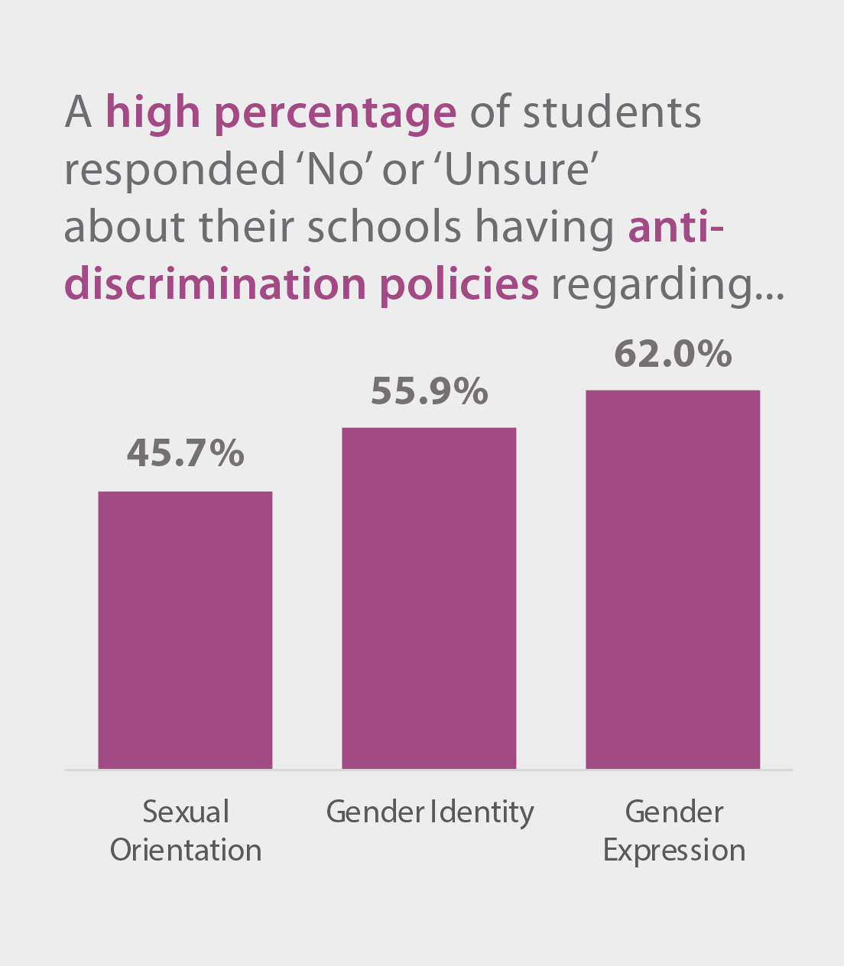
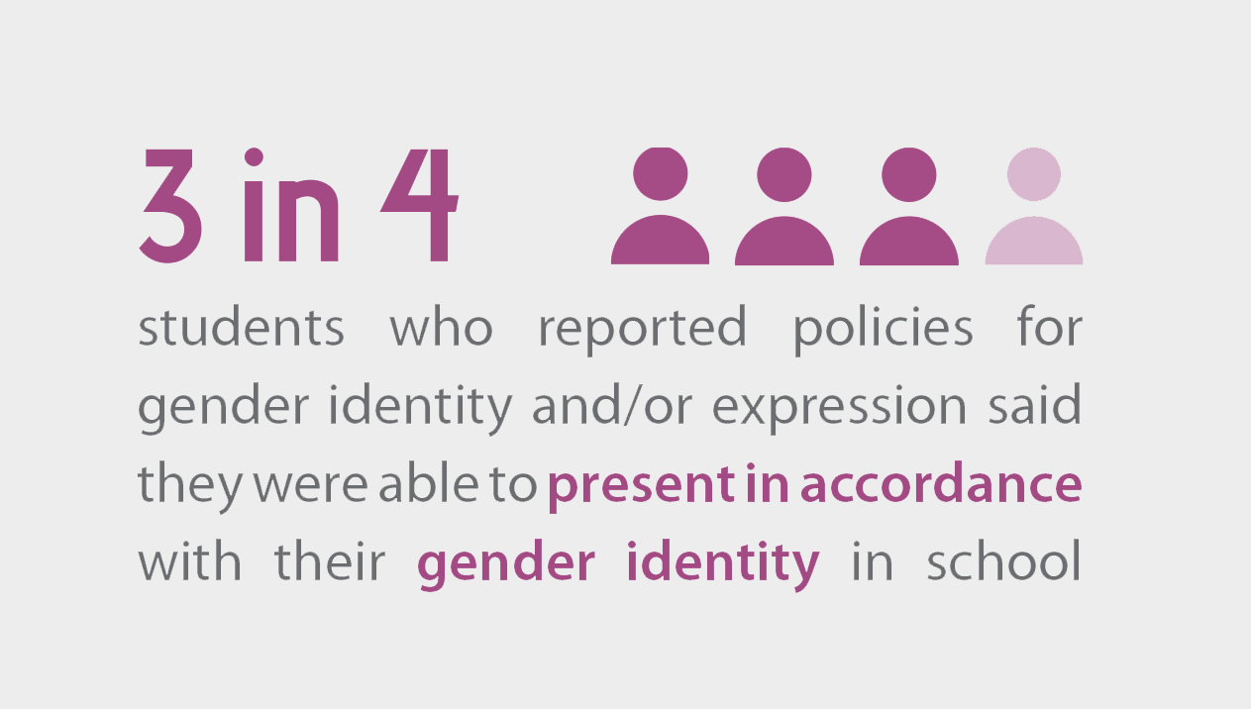
SGM Youth Report Challenges
There is room for improvement among school districts to adopt anti-discrimination policies policies and ensure that students are aware of them
Notes:
- A high percentage of participants reported that their schools do not have, or that they are unaware of, antidiscrimination policies regarding sexual orientation, gender identity, or gender expression—indicating that there is room for improvement among districts to adopt such policies and ensure that students are aware of them.

Slide 46
SGM Youth Report Challenges
Youth participants reported relatively high rates of substance use
30% reported using tobacco products
28% reported marijuana use without a prescription within the past month
nearly 1 in 4 reported having used illicit drugs in their lifetime
Notes:
Youth participants reported relatively high rates of substance use.
30% reported using tobacco products,
28% reported marijuana use without a prescription within the past month, and
- nearly one in four reported having used illicit drugs in their lifetime.

Slide 47
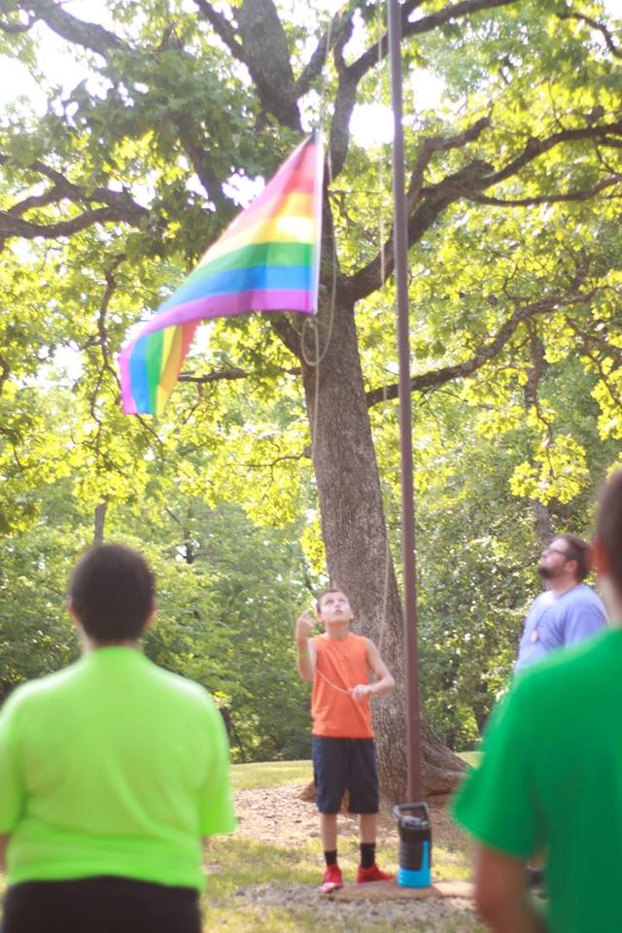
SGM Youth Report Challenges
Youth reported significantly lower levels than adults on measures of wellbeing, including:
hope
flourishing
social support
civic engagement
Notes:
- Regarding the four measures of wellbeing used in this study—hope, flourishing, social support and civic engagement—youth reported significantly lower levels than adults.

Slide 48
SUMMARY OF FINDINGS: Workplace Experiences

Slide 49
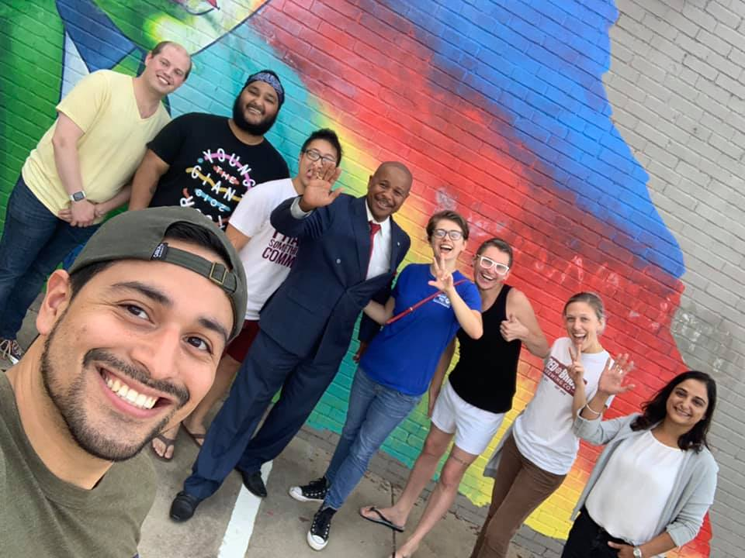
Workplace Experiences
Many are employed and making contributions to the economy
Nearly 4 in 5 participants 18 and older reported full-time employment, part-time employment, or being self-employed
Notes:
- Many are employed and making contributions to the economy.
- Nearly four in five participants 18 and older reported full-time employment, part-time employment, or being self-employed.

Slide 50
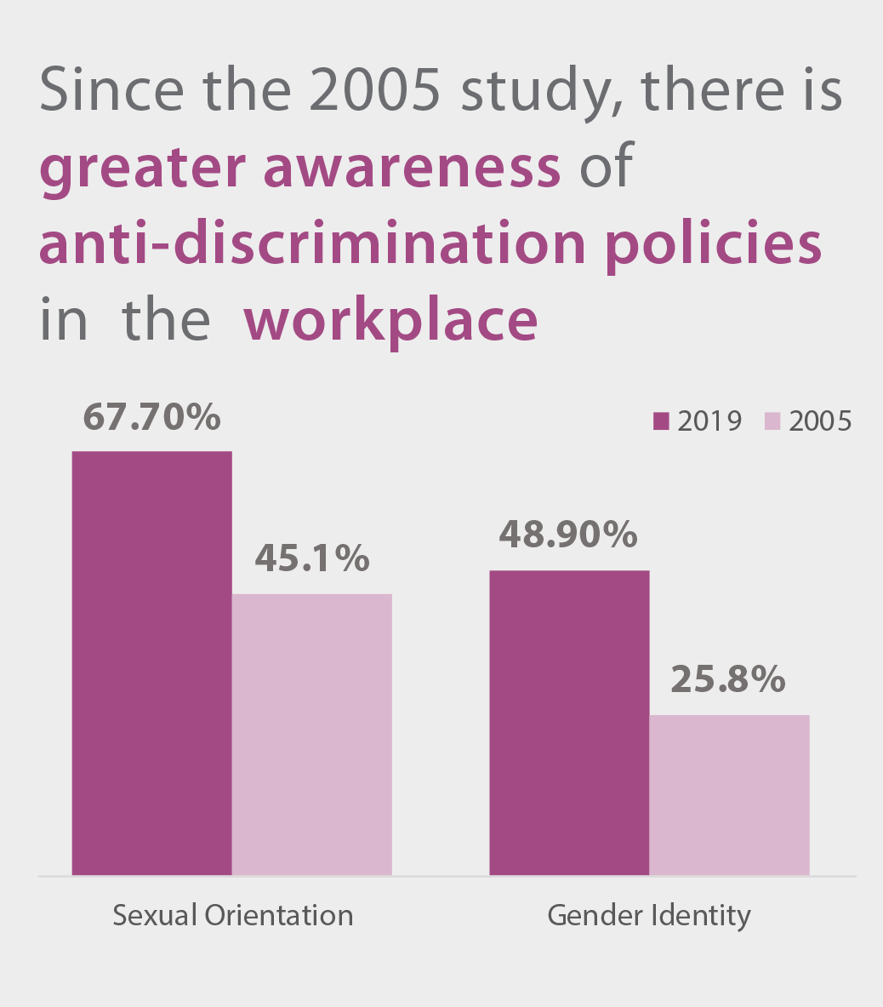
Workplace Experiences
Over 2/3 reported awareness of their employers’ antidiscrimination policy regarding sexual orientation— an increase of 22.6%
Nearly half reported awareness of their employers’ anti-discrimination policy regarding gender identity— an increase of 23.1%
Notes:
- Of those who are employed, there is greater awareness of anti-discrimination policies in their workplace, compared to TRO’s previous study conducted in 2005.
- Over two-thirds reported awareness of their employers’ antidiscrimination policy regarding sexual orientation—an increase of 22.6 percentage points over the rate reported in 2005.
- Nearly half reported awareness of their employers’ antidiscrimination policy regarding gender identity—an increase of 23.1 percentage points over the rate reported in 2005.

Slide 51
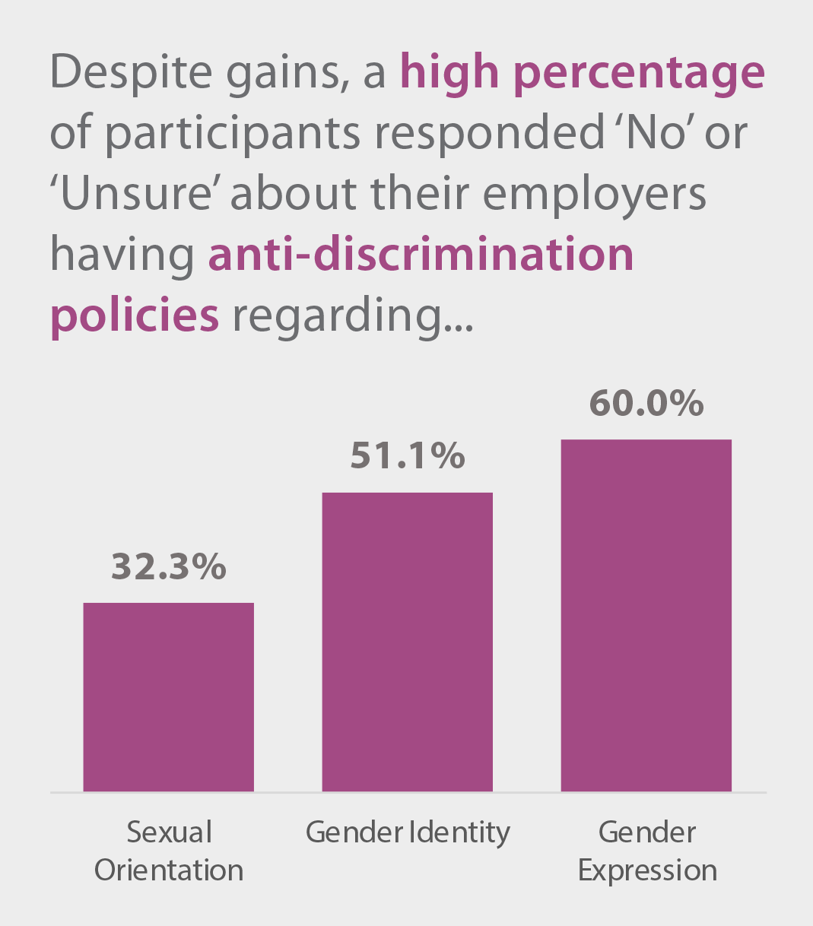
Workplace Experiences
Despite gains over the past 15 years, a high percentage reported that their employers do not have, or that they are unaware of, antidiscrimination policies
Notes:
Despite gains over the past 15 years, a high percentage of participants reported that their employers do not have, or that they are unaware of, antidiscrimination policies regarding sexual orientation, gender identity, or gender expression
indicating that there is room for improvement among employers to adopt such policies and ensure that employees are aware of them.

Slide 52
Workplace Experiences
High rates of SGM employees have taken actions in the past three years to avoid discrimination in the workplace
13.7% quit their job
42.6% had to stay in the closet
These rates are higher among those who did not report that their workplaces had all three antidiscrimination policies
Notes:
High rates of SGM employees have taken actions in the past three years to avoid discrimination in the workplace.
- 13.7% quit their job and
- 42.6% had to stay in the closet.
-These rates are higher among those who did not report that their workplaces had all three antidiscrimination policies.

Slide 53
Workplace Experiences
Of participants who said their employers had antidiscrimination policies in place, a lower rate reported that they have taken actions to avoid discrimination—such as:
feeling as though they had to quit their job (6.3% vs. 12.0%)
feeling as though they had to stay in the closet (26.1% vs. 44.7%)
Notes:
Of participants who said their employers had antidiscrimination policies in place regarding sexual orientation, gender identity, and gender expression, a lower rate reported that they have taken actions to avoid discrimination—such as
- feeling as though they had to quit their job (6.3% vs. 12.0% among those who did not say their workplaces had all three policies) and
- feeling as though they had to stay in the closet (26.1% vs. 44.7% among those who did not say their workplaces had all three policies).

Slide 54
Priorities & Recommendations

Slide 55
Regarding the most important services needed for SGM individuals:
Youth indicated preferences for
• mental health and counseling services
• public awareness about LGBTQ+ issues
• programs for LGBTQ+ youth
• sexual health education
Adults indicated preferences for
• mental health and counseling services
• advocacy at the state legislature
• physical and medical health services
• public awareness about LGBTQ+ issues

Slide 56
Recommendations
For Educators
Implement pre-service training in regional colleges of education to build competencies among future educators in working with and supporting LGBTQ youth.
Ensure that emergency-certified educators receive training in working and supporting LGBTQ youth early in their employment.
Hold staff training on understanding the basics of working with and supporting LGBTQ youth.
Implement visible LGBTQ-affirming signs and messaging in school buildings and identify staff in each building who are willing to be visible allies of LGBTQ students
Adopt and implement LGBTQ-affirming, evidence-based social-emotional learning, bullying prevention, and medically accurate sex education programming in schools.
Connect families to resources that will help them support their children in “coming out” as an LGBTQ person, such as Oklahomans for Equality, Youth Services of Tulsa, and PFLAG.
Adopt anti-discrimination policies covering sexual orientation, gender identity, and gender expression and regularly communicate those policies to all staff, teachers, and students.
Embed Hope-building practices into all touch-points with youth and families.
Provide students and families with a general resource guide listing LGBTQ youth-supporting agencies and services.
Notes:
Of participants who said their employers had antidiscrimination policies in place regarding sexual orientation, gender identity, and gender expression, a lower rate reported that they have taken actions to avoid discrimination—such as
- feeling as though they had to quit their job (6.3% vs. 12.0% among those who did not say their workplaces had all three policies) and
- feeling as though they had to stay in the closet (26.1% vs. 44.7% among those who did not say their workplaces had all three policies).

Slide 57
Recommendations
For Youth-serving Agencies
Adopt goals, accountability measures, and action plans regarding program services provided to LGBTQ youth.
Hold staff training on understanding the basics of working with and supporting LGBTQ youth and families.
Implement visible LGBTQ-affirming signs and messaging in facilities.
Connect parents to resources that will help them support their children in “coming out” as an LGBTQ person, such as Oklahomans for Equality, Youth Services of Tulsa, and PFLAG.
Adopt anti-discrimination policies covering sexual orientation, gender identity, and gender expression and regularly communicate those policies to all staff and clients.
Embed Hope-building practices into all touch-points with youth and families.
Provide youth and families with a general resource guide listing LGBTQ-supporting agencies and services.
Notes:
Of participants who said their employers had antidiscrimination policies in place regarding sexual orientation, gender identity, and gender expression, a lower rate reported that they have taken actions to avoid discrimination—such as
- feeling as though they had to quit their job (6.3% vs. 12.0% among those who did not say their workplaces had all three policies) and
- feeling as though they had to stay in the closet (26.1% vs. 44.7% among those who did not say their workplaces had all three policies).

Slide 58
Recommendations
For Funders
Require that grantees adopt anti-discrimination policies covering sexual orientation, gender identity, and gender expression.
Request that grantees set goals, identify outcome measures, and collect data through application and reporting processes regarding program services provided to LGBTQ individuals.
Fund the development and delivery of training for agencies and professionals working with and supporting LGBTQ youth and families.
Fund community programs and initiatives that explicitly seek to improve the experiences and outcomes of LGBTQ individuals, as described in the Prism Project Report.
Notes:
Of participants who said their employers had antidiscrimination policies in place regarding sexual orientation, gender identity, and gender expression, a lower rate reported that they have taken actions to avoid discrimination—such as
- feeling as though they had to quit their job (6.3% vs. 12.0% among those who did not say their workplaces had all three policies) and
- feeling as though they had to stay in the closet (26.1% vs. 44.7% among those who did not say their workplaces had all three policies).

Slide 59
Recommendations
For Employers
Hold training for all managerial positions on understanding the basics of building an LGBTQ-affirming workplace culture.
Adopt anti-discrimination policies covering sexual orientation, gender identity, and gender expression and regularly communicate those policies to all employees.
Implement visible LGBTQ-affirming signs and messaging in the workplace.
Connect employees to resources that will help them support their children in “coming out” as an LGBTQ person, such as Oklahomans for Equality, Youth Services of Tulsa, and PFLAG.
Provide employees with a general resource guide listing LGBTQ-supporting agencies and services (available through Oklahomans for Equality).
Notes:
Of participants who said their employers had antidiscrimination policies in place regarding sexual orientation, gender identity, and gender expression, a lower rate reported that they have taken actions to avoid discrimination—such as
- feeling as though they had to quit their job (6.3% vs. 12.0% among those who did not say their workplaces had all three policies) and
- feeling as though they had to stay in the closet (26.1% vs. 44.7% among those who did not say their workplaces had all three policies).

Slide 60
Recommendations
For Healthcare and Mental Health Professionals
Participate in the ongoing efforts of Oklahomans for Equality to establish a directory of culturally responsive mental health and medical professionals.
Implement pre-service training in regional schools of medicine, social work, counseling and other healthcare and mental health preparation programs to build competencies among future practitioners in working with and supporting LGBTQ youth and adults.
Provide culturally competent and affirming care to LGBTQ youth and adults.
Hold staff training on understanding the basics of working with LGBTQ youth and adults.
Implement visible LGBTQ-affirming signs and messaging in hospitals and healthcare facilities.
Connect parents to resources that will help them support their children in “coming out” as an LGBTQ person, such as Oklahomans for Equality, Youth Services of Tulsa, and PFLAG.
Adopt anti-discrimination policies covering sexual orientation, gender identity, and gender expression and regularly communicate those policies to all staff and patients.
Provide patients with a general resource guide listing LGBTQ-supporting agencies and services.
Notes:
Of participants who said their employers had antidiscrimination policies in place regarding sexual orientation, gender identity, and gender expression, a lower rate reported that they have taken actions to avoid discrimination—such as
- feeling as though they had to quit their job (6.3% vs. 12.0% among those who did not say their workplaces had all three policies) and
- feeling as though they had to stay in the closet (26.1% vs. 44.7% among those who did not say their workplaces had all three policies).

Slide 61
Recommendations
For Faith-based Institutions
Establish a definition and process in line with accepted standards for determining the institution’s commitment as an open and affirming community.
Assist Oklahomans for Equality in maintaining a directory of open and affirming faith-based institutions.
Hold training for staff on understanding the basics of working with and supporting LGBTQ youth and families.
Implement visible LGBTQ-affirming signs and messaging in facilities.
Connect parents to resources that will help them support their children in “coming out” as an LGBTQ person, such as Oklahomans for Equality, Youth Services of Tulsa, and PFLAG.
Adopt anti-discrimination policies covering sexual orientation, gender identity, and gender expression and regularly communicate those policies to all constituents.
Provide constituents with a general resource guide listing LGBTQ-supporting agencies and services.
Notes:
Of participants who said their employers had antidiscrimination policies in place regarding sexual orientation, gender identity, and gender expression, a lower rate reported that they have taken actions to avoid discrimination—such as
- feeling as though they had to quit their job (6.3% vs. 12.0% among those who did not say their workplaces had all three policies) and
- feeling as though they had to stay in the closet (26.1% vs. 44.7% among those who did not say their workplaces had all three policies).

Slide 62
Recommendations
For Law Enforcement
Implement pre-service officer training to build competencies among future practitioners in working with LGBTQ youth and adults.
Hold training for officers on understanding the basics of working with LGBTQ individuals.
Adopt anti-discrimination policies covering sexual orientation, gender identity, and gender expression and regularly communicate those policies to all constituents.
Notes:
Of participants who said their employers had antidiscrimination policies in place regarding sexual orientation, gender identity, and gender expression, a lower rate reported that they have taken actions to avoid discrimination—such as
- feeling as though they had to quit their job (6.3% vs. 12.0% among those who did not say their workplaces had all three policies) and
- feeling as though they had to stay in the closet (26.1% vs. 44.7% among those who did not say their workplaces had all three policies).

Slide 63
Recommendations
For Policymakers and Policy Implementers
Require the creation of a plan to recruit more LGBTQ-friendly foster homes.
Require the inclusion of an SGM identifying question on existing statewide survey instruments such as the State Department of Mental Health’s Oklahoma Prevention Needs Assessment.
Adopt anti-discrimination policies covering sexual orientation, gender identity, and gender expression and regularly communicate those policies to all constituents.
Adopt policies supporting the implementation of trauma-informed and Hope-building practices across all government agencies.
Fund the development and delivery of training for agencies and professionals working with and supporting LGBTQ youth and families.
Conduct and audit of current practices and needs across all state agencies that affirm or deter identifying as an LGBTQ person.
State Licensing Boards should require culturally competent and affirming curricula in all professional training programs.
Notes:
Of participants who said their employers had antidiscrimination policies in place regarding sexual orientation, gender identity, and gender expression, a lower rate reported that they have taken actions to avoid discrimination—such as
- feeling as though they had to quit their job (6.3% vs. 12.0% among those who did not say their workplaces had all three policies) and
- feeling as though they had to stay in the closet (26.1% vs. 44.7% among those who did not say their workplaces had all three policies).

Slide 64
This Report and supporting documents are housed at the following link: link.ou.edu/tulsa-lgbtq
If you have questions, comments or concerns about the Report or request additional data analysis or other support not available on the website, please contact Dennis Neill at 918.808.1010 or dneillok@mac.com
Suggested Citation
Nay, E.D.E. (2019). The Prism Project: Tulsa’s sexual and gender minority needs report, 2019. Tulsa, OK: Tulsa Reaches Out, Hope Research Center. Retrieved from link.ou.edu/tulsa-lgbtq

