Slide 2
“A multi-step journey to better understand where your idea fits in the marketplace…and how to advance it…”
Presents
iPath: Innovation Pathway
Now done in 3 Phases:
A multi-week ideation process (I)
A self-paced planning platform (II)
An in-person workshop (III)
For more information go to
https://www.ou.edu/oicp/ipath
iPath will help you:
Articulate the value of your business proposition
View your discovery through a market lens
Prepare to go to the market
Who Should Apply:
Any OU, OUHSC founder (faculty, staff or student) or OMRF Researcher with an idea to test in the market
Apply for Phase I Today at…
Phase I Application

Slide 3
Key Points:
Responsibility for Norman, HSC and Tulsa campuses
Consists of…
Office of Technology Commercialization
Office of Corporate Relations and Economic Development
Office of Venture Development
Strategic approach in support of Lead On strategy and the strategies from…
VPRP Norman
Provost, HSC

Slide 4
Strategic Imperatives
Innovation Volume
Market Pathway
Venture Development
Ensure that the volume of disclosures, patents, trademarks and copyrights are tracking to Tier
Create clear pathways to commercialization that keep the "researcher at the center" of
Install and maintain world-class capabilities in moving university technologies from the bench
1 research institution levels
determinations and ease the process for all participants
to the market - via license, startup or otherwise.
Office of Innovation and Corporate Partnerships

Slide 5
“A multi-step journey to better understand where your idea fits in the marketplace…and how to advance it…”
Presents
iPath: Innovation Pathway
Now done in 3 Phases:
A multi-week ideation process (I)
A self-paced planning platform (II)
An in-person workshop (III)
For more information go to
https://www.ou.edu/oicp/ipath
iPath will help you:
Articulate the value of your business proposition
View your discovery through a market lens
Prepare to go to the market
Who Should Apply:
Any OU, OUHSC founder (faculty, staff or student) or OMRF Researcher with an idea to test in the market
Apply for Phase I Today at…
Phase I Application

Slide 6
“In order to participate in Phase II, a Researcher must have completed the Phase I Objectives…or have participated in and completed a market-driven, commercial application discovery program related to his/her/their innovation.”
iPath
Growth Fund
Growth Fund
Phase I (Market Discovery)
Phase II (Translational Research).

Slide 7
Who Should Apply?
Startups trying to raise capital and scale their business
Inventors trying to figure out their options to commercialize
Researchers looking for the best path forward for their discovery.
Entrepreneurs with an idea to go to market
Founders wanting to meet local and regional investors

Slide 8
What Will You Learn?
Market validation
Customer discovery
Finding the right investors
The components of a pitch
Why investors say no
Presenting your opportunity
Identifying funding needs
What investors look for
Insights from entrepreneurs
Developing your plan
Refining your financials
And much, much more

Slide 9
Program Overview
Schedule By Topic
Phase I: Ideation | Phase II: Business Plan Development | Phase III: Capital Workshop – 2 Days
Ideation with WKI* Weekly Coaching Slack Channel | LivePlan Subscription Slack Channel Coaching Assistance | Preliminary Pitches Mentor Feedback Sessions Investor Readiness Pitch Refinement Live Pitches to Investors
https://wendykennedy.com/
https://www.liveplan.com/

Slide 10
Phase I | Kickoff Call | Date | Time
 | Ideation Call 1 | Date | Time | WKI Modules 1 and 2 (completed for call)
 | Ideation Call 2 | Date | Time | WKI Modules 3 and 4 (completed for call)
 | Ideation Call 3 | Date | Time | WKI Module 5 (completed for call)
 | Ideation Call 4 | Date | Time | WKI Module 6 (completed for call)
 | Ideation Call 5 | Date | Time | WKI Modules 6, 7 & 8 (completed for call)
 | Ideation Call 6 | Date | Time | WKI Module 9 Open Q & A
Phase II | Business Plan Development With Customer Discovery | Self-Paced | Up to 1 Year | LivePlan Subscription with Coaching
Phase III | iPath Workshop Day 1 | Date | Time | The Workings of VC Funds, Corporate Structure, Terms Sheets
 | iPath Workshop Day 2 | Date | Time | Investor Targets, Cap Table, Boards, Pitch Prep, Mastery
 | Evening Event Day 2 | Date | Time | Pitches and Investor Reception

Slide 11
Among the People You Will Meet…
Fellow Founders
Engaged Mentors
OU Innovation and Commercialization Staff
Interested Investors
Entrepreneurial Support Organizations
Experienced Startups
Experienced Licensees
Q: Why isn’t cost mentioned?
A: Because, as an OU or OUHSC inventor, there is no cost to you! And for OUHSC and OMRF researchers, the Presbyterian Health Foundation has covered the cost of the program through a generous grant.

Slide 12
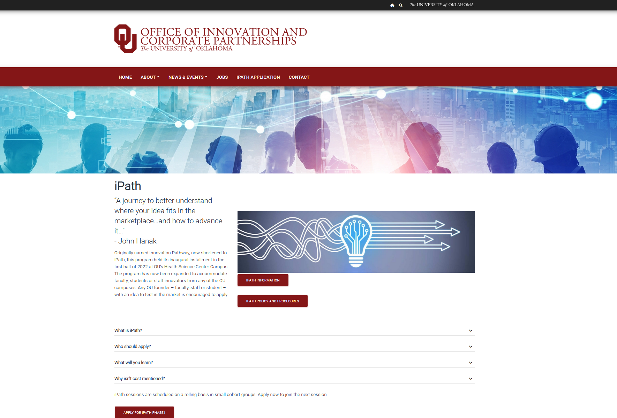

Slide 13
Cohort I
Dr. Vibhudutta Awasthi
Dr. Eric Sherburn
Dr. Evan Floyd
Dr. Hala Chaaban
Dr. Rajani Rai*
Dr. Vishal Chandra*
*representing Dr. Doris Benbrook
Cohort II
Dr. Alberto de Armendi
Dr. Michael Businelle
Ann Gettys
Dr. Anne Kasus-Jacobi
Drs. Kelly Lucas and Sharukh Khajotia
Elijah Robertson and Dr. Suzanne Kimball
Dr. Carol Webb
April 14, 2022
September 7, 2022

Slide 14
Apply for Phase I Today
At
Phase I iPath Application
Due to the popularity of the program, we have decided to take all comers!
We will begin a new cohort every time we get six applicants

Slide 15
Next Lunch and Learn is April 26
New Ventures & Conflict of Interest
Andrew Pollock

