Slide 1
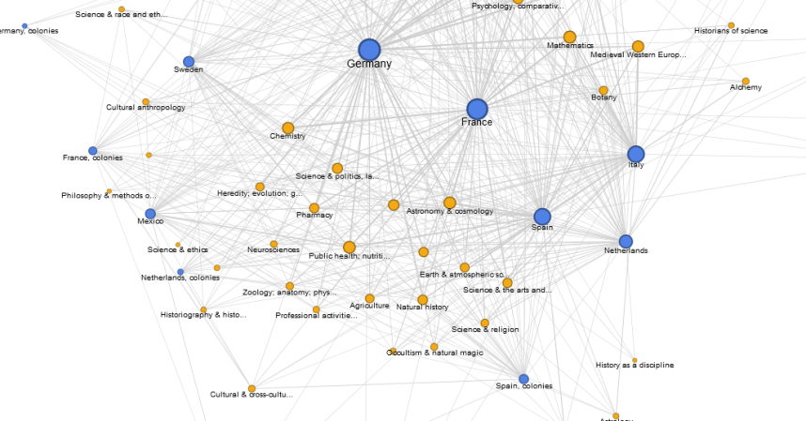
The IsisCB Platform
Digitizing and Refactoring a Large Bibliographic Dataset in History of Science
Stephen P. Weldon, History of Science
Editor, Isis Current Bibliography
Digital Humanities Day, Tuesday, Sept. 15, 9:20-10:50
University of Oklahoma, Zarrrow Hall, Community Room

Slide 2
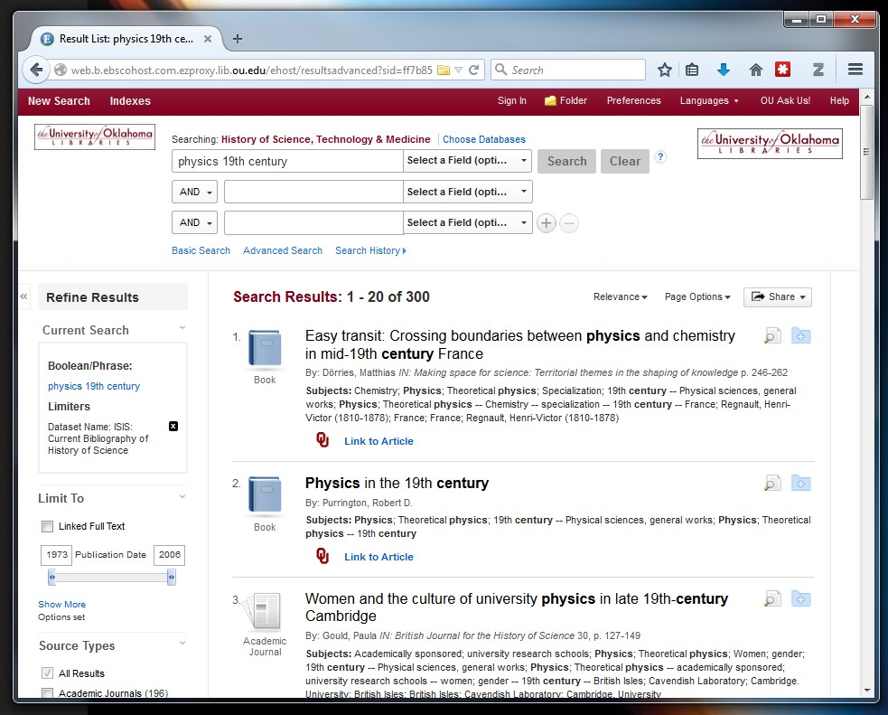
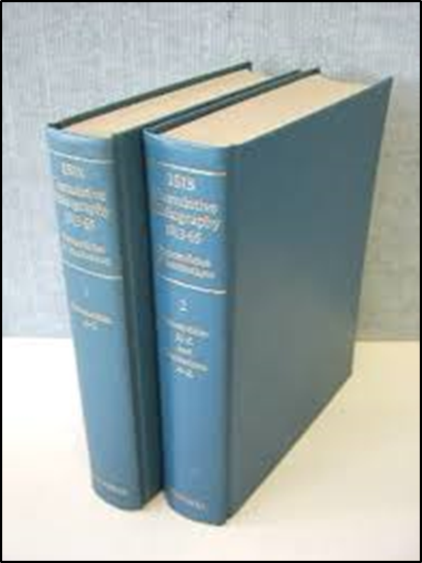
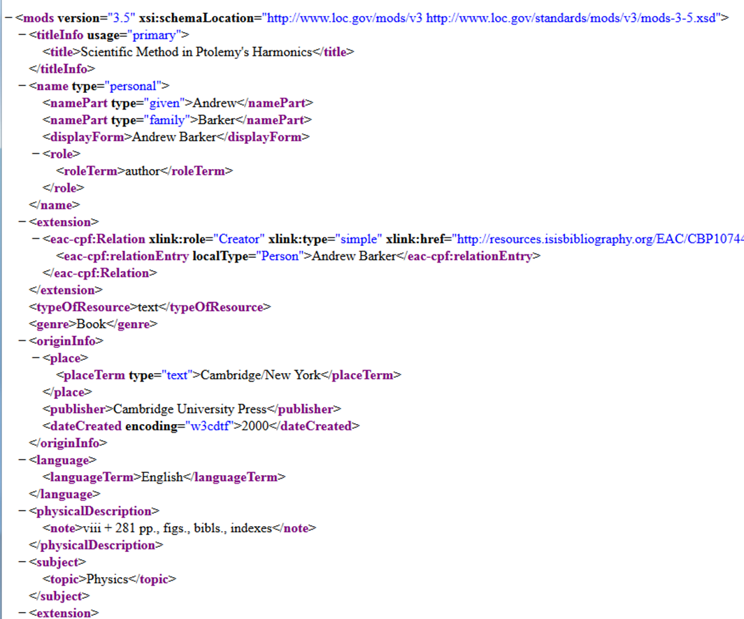
The Development of the Isis Bibliography as a Big Data Resource
The Isis Bibliography was begun in 1913 as a standard bibliographical reference tool.
In the 1990s, the bibliographical data was fed into a database file accessible online.
Now, I am reprocessing the data, and building a new type of robust and sustainable reference tool.

Slide 3
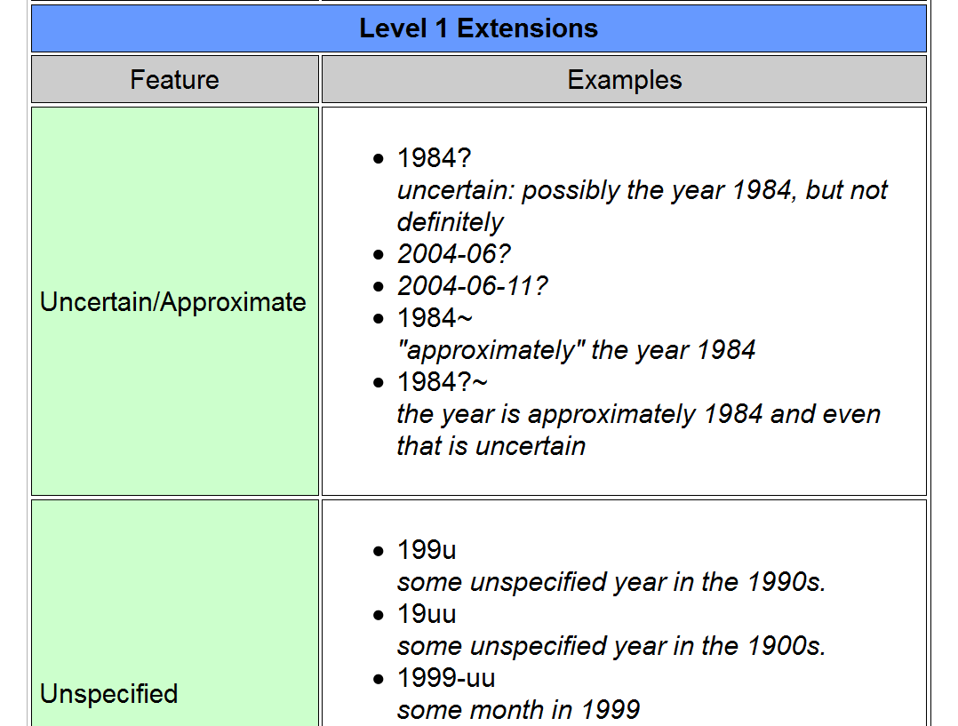
Establishing Standards:
A Critical First Step
MODS 3.5 (bibliographic records) EAC-CPF (authority records) ISO 8601 EDTF (ISO date standards)
Modifying standards: adding internal / external links, adding new record types
The purpose is to create a sustainable foundation for long-term accessibility

Slide 4
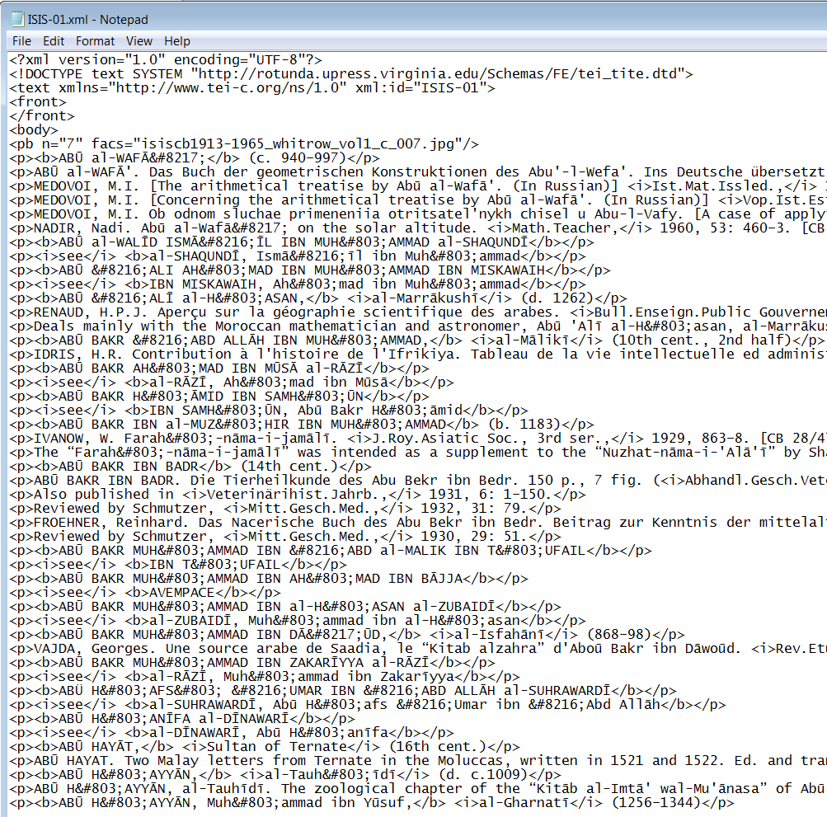
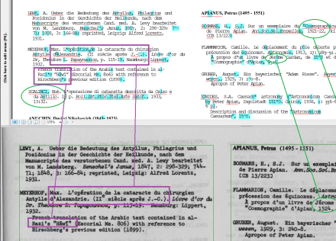
Capturing the Legacy Data:
The Most Time Consuming Aspect of the Project
About 4,700 pages An estimated 130,000 records
Converting flat text to marked, machine-readable data. We attempted OCR, but have turned to human transcription. Parsing will be the next step.
The work is very difficult, but the results will more than double our chronological reach.

Slide 5
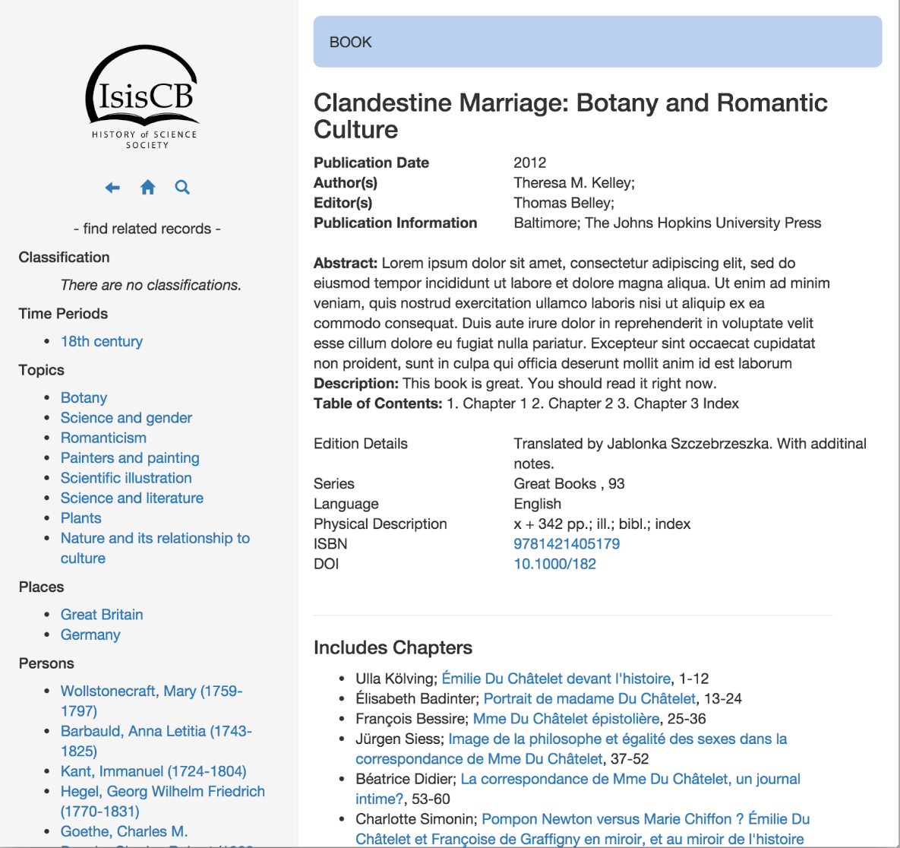
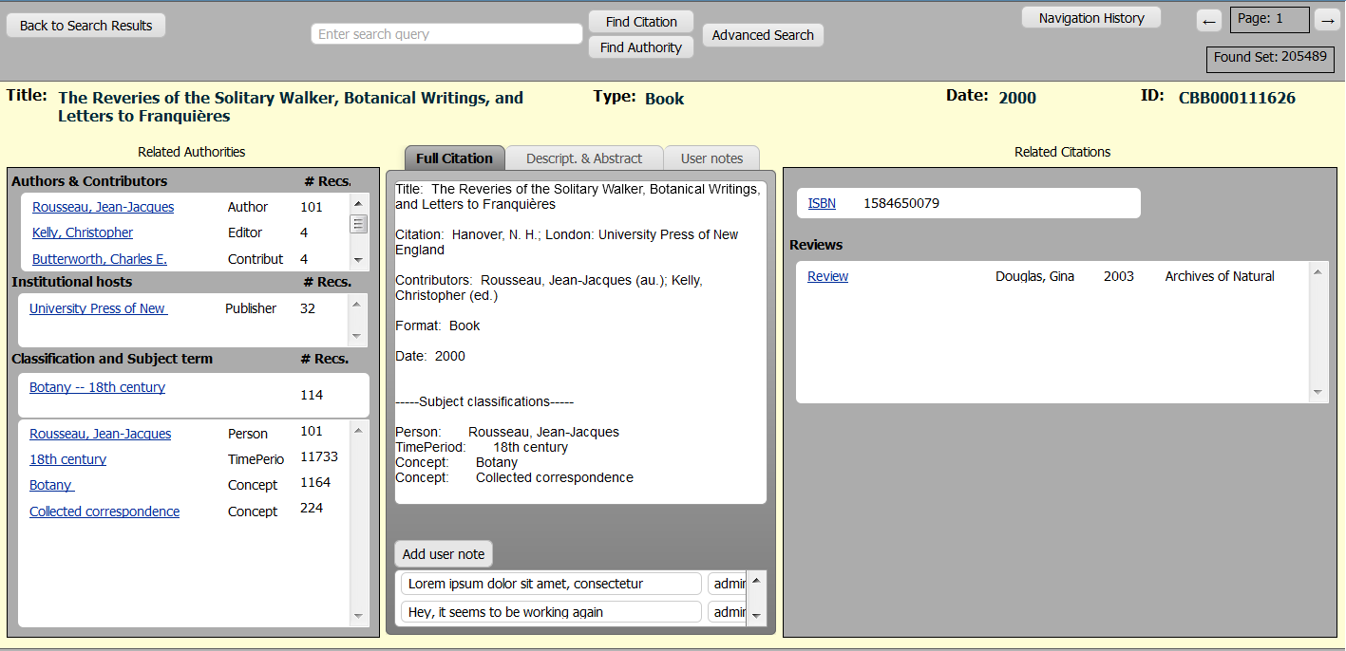
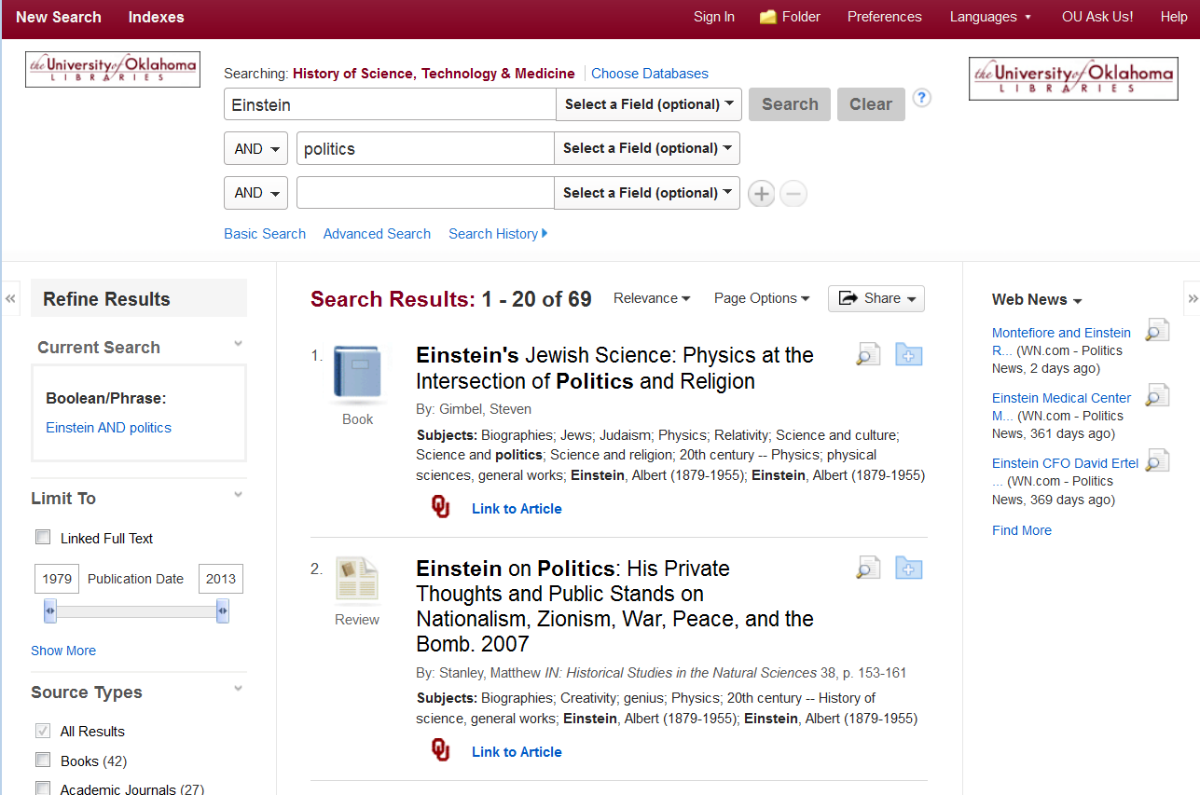
Building the User Interface:
Creating Researcher Diverse Research Capabilities
Understanding what is missing from the current interface.
Refactoring the data to build a more robust network graph.
Enabling features that will add new research capacities.

Slide 6
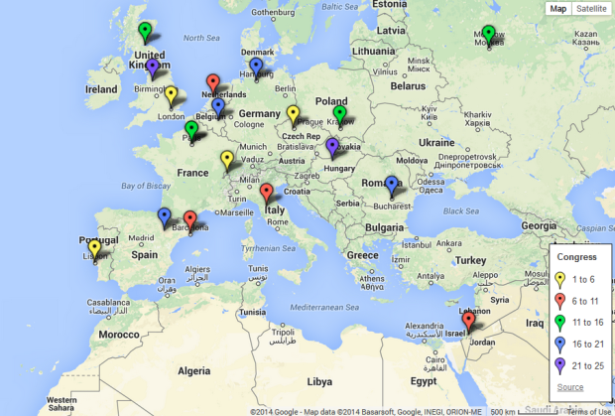
Big Data Discovery
and Big Data Research
Open Linked Data will allow us to interlink our data with other trusted sources.
API Access will make it possible for any researcher to work with our data directly.
Big data visualization and analytics will change the way we think of bibliographic discovery.

Slide 7
The IsisCB Platform
Digitizing and Refactoring a Large Bibliographic Dataset in History of Science
Stephen P. Weldon, History of Science
Editor, Isis Current Bibliography
Digital Humanities Day, Tuesday, Sept. 15, 9:20-10:50
University of Oklahoma, Zarrrow Hall, Community Room
Thank You

