Slide 1
The OU / Exaptive Xap
Exploring New Ways to Categorize, Visualize, and Create Knowledge
David Vishanoff, University of Oklahoma

Slide 2
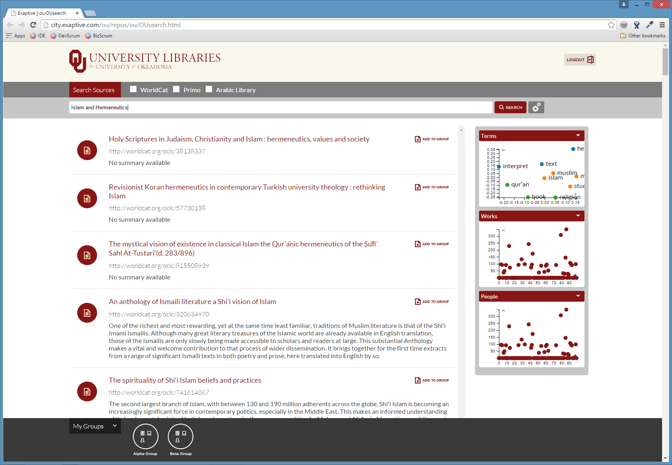

Slide 17
