Slide 1
Digital Humanities @ OU
September 15, 2015

Slide 2
Partners
The Andrew W. Mellon Foundation
Society for Classical Studies
Medieval Academy of America
Renaissance Society of America
The University of Oklahoma

Slide 3
Mission
To publish and curate critical editions of Latin texts, of all types, from all eras, and to facilitate an ongoing scholarly conversation about these texts through open collaboration and annotation
To facilitate the finding and, where openly available and accessible online, the reading of all texts written in Latin

Slide 4
What kinds of questions are we asking?

Slide 5
How do we turn this =>
This is a typical critical edition in Latin. It’s highly encoded with abbreviations and symbols that are intelligible only to scholars with years of training.

Slide 6
… into this =>
This is a snippet of the same text encoded with Extensible Markup Language (XML), a format readable by both humans and machines.

Slide 7
so that we can do this …
This is a storyline visualization of the XML data in the previous slide. It shows how manuscript witnesses to the text agree and disagree at different points.

Slide 8
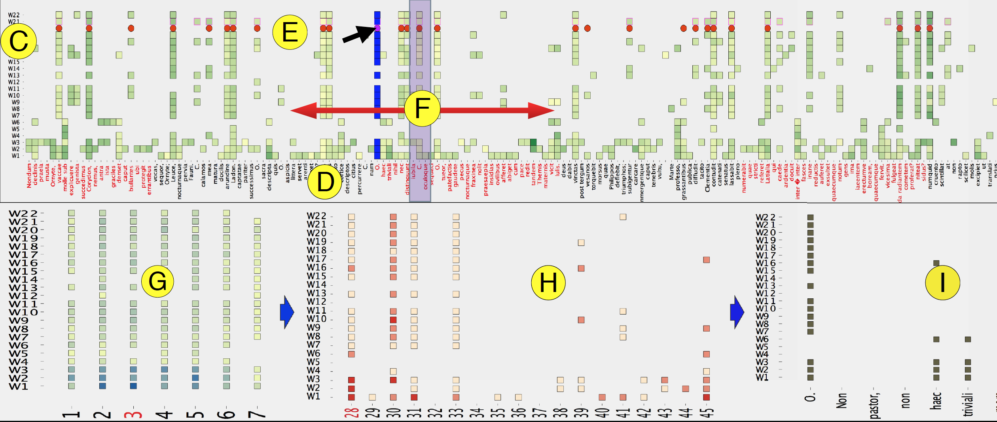
… or this.
This is a pixel-based visualization of the same data.

Slide 9
The Digital Latin Library

Slide 10
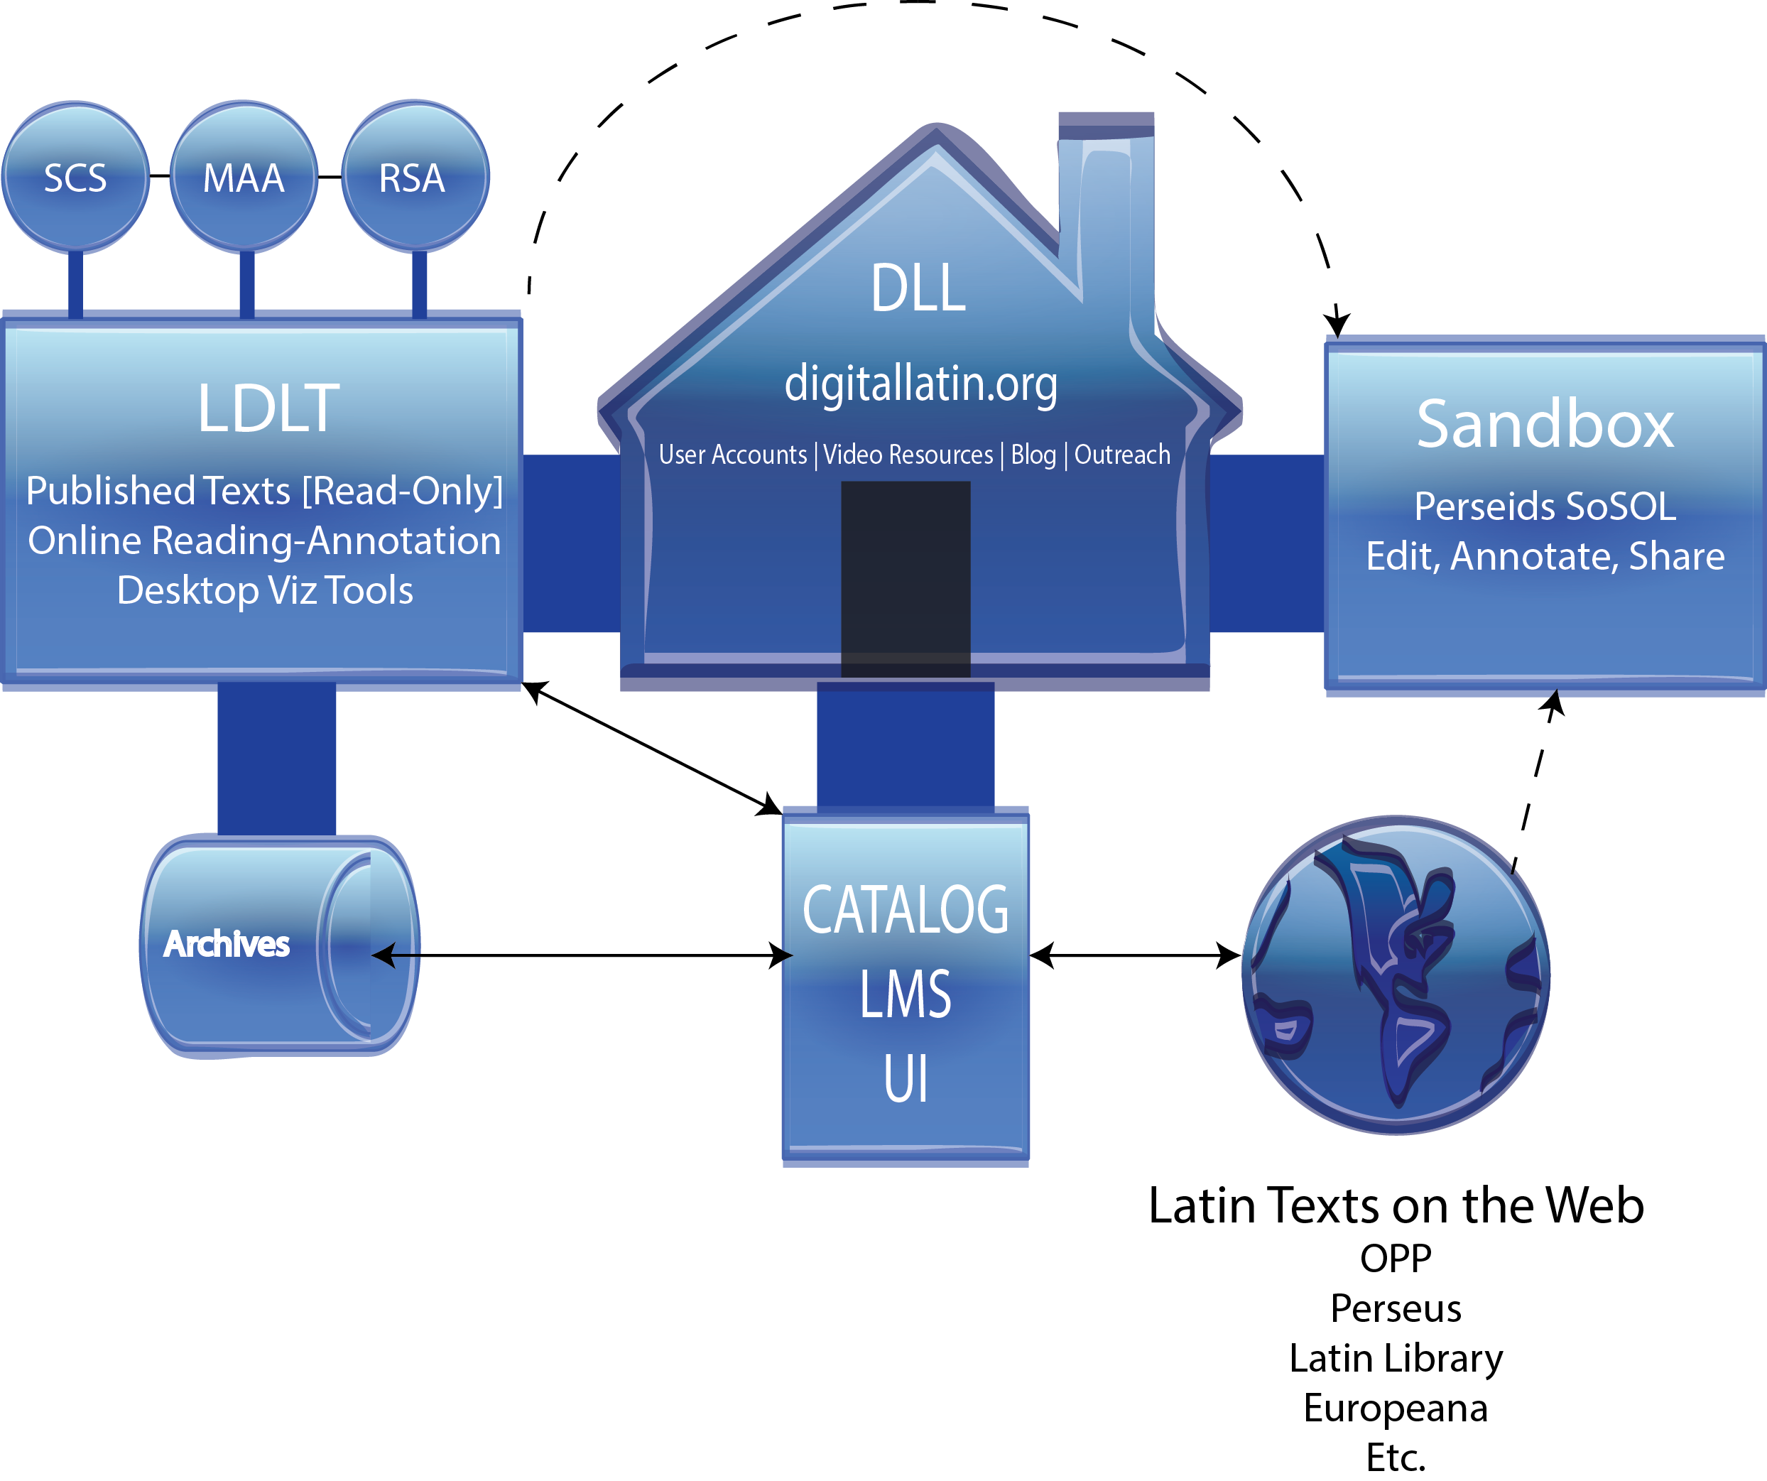

Slide 11
What kinds of tools or methods are you using that are specifically enabled by the digital nature of the project?
Data visualization and analysis
Improvise
TEI XML
Drupal CMS
Islandora

Slide 12
Where in the life cycle is the project and what lessons can you share?
June 2012: AWMF awards a planning grant of $159,000 to the American Philological Association
June 2014: AWMF awards second planning grant of $572,000 to OU
June 2015, AWMF awards two-year implementation grant for $1,000,000 to OU

Slide 13
What assets have been critical and what assets could empower this kind of scholarship at OU in the future?
hobbes.rccc.ou.edu
Digital Scholarship Laboratory
Staff Support
Scrappiness

