Slide 1
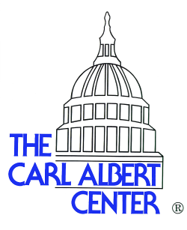
Follow the Water:
Digital Humanities in a Congressional Archive
Cindy Simon Rosenthal

Slide 2
http://www.ou.edu/content/carlalbertcenter.html
Our Mission
The Goals
The Opportunities
The Challenges

Slide 3
The Digital Classroom http://water.cacexplore.org/
Discovery
Text Analysis
Data Mapping
Coding and Data Analysis
Individually Curated Projects
http://water.cacexplore.org/

Slide 4
Research Opportunities http://cacexplore.org/
Develop specialized subject guides
Create powerful datasets
Analyze data
Illuminate social networks
Conduct textual analysis of finding aids

Slide 5
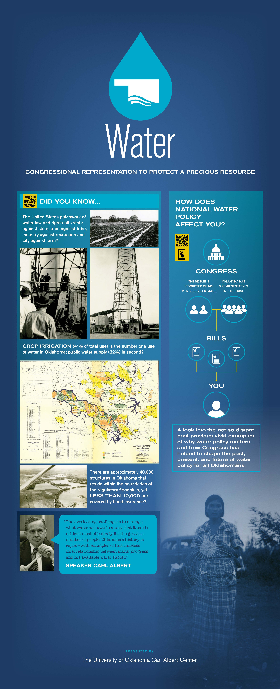
Community Engagement: http://www.ou.edu/content/carlalbertcenter/congressional-collection/exhibits/waterexhibit.html
Community outreach and engagement by creating a “public commons” for interaction.
Digital environment offers new opportunities for a variety of content.
Collaborative opportunities
K-12 Curricular add-ons

Slide 6
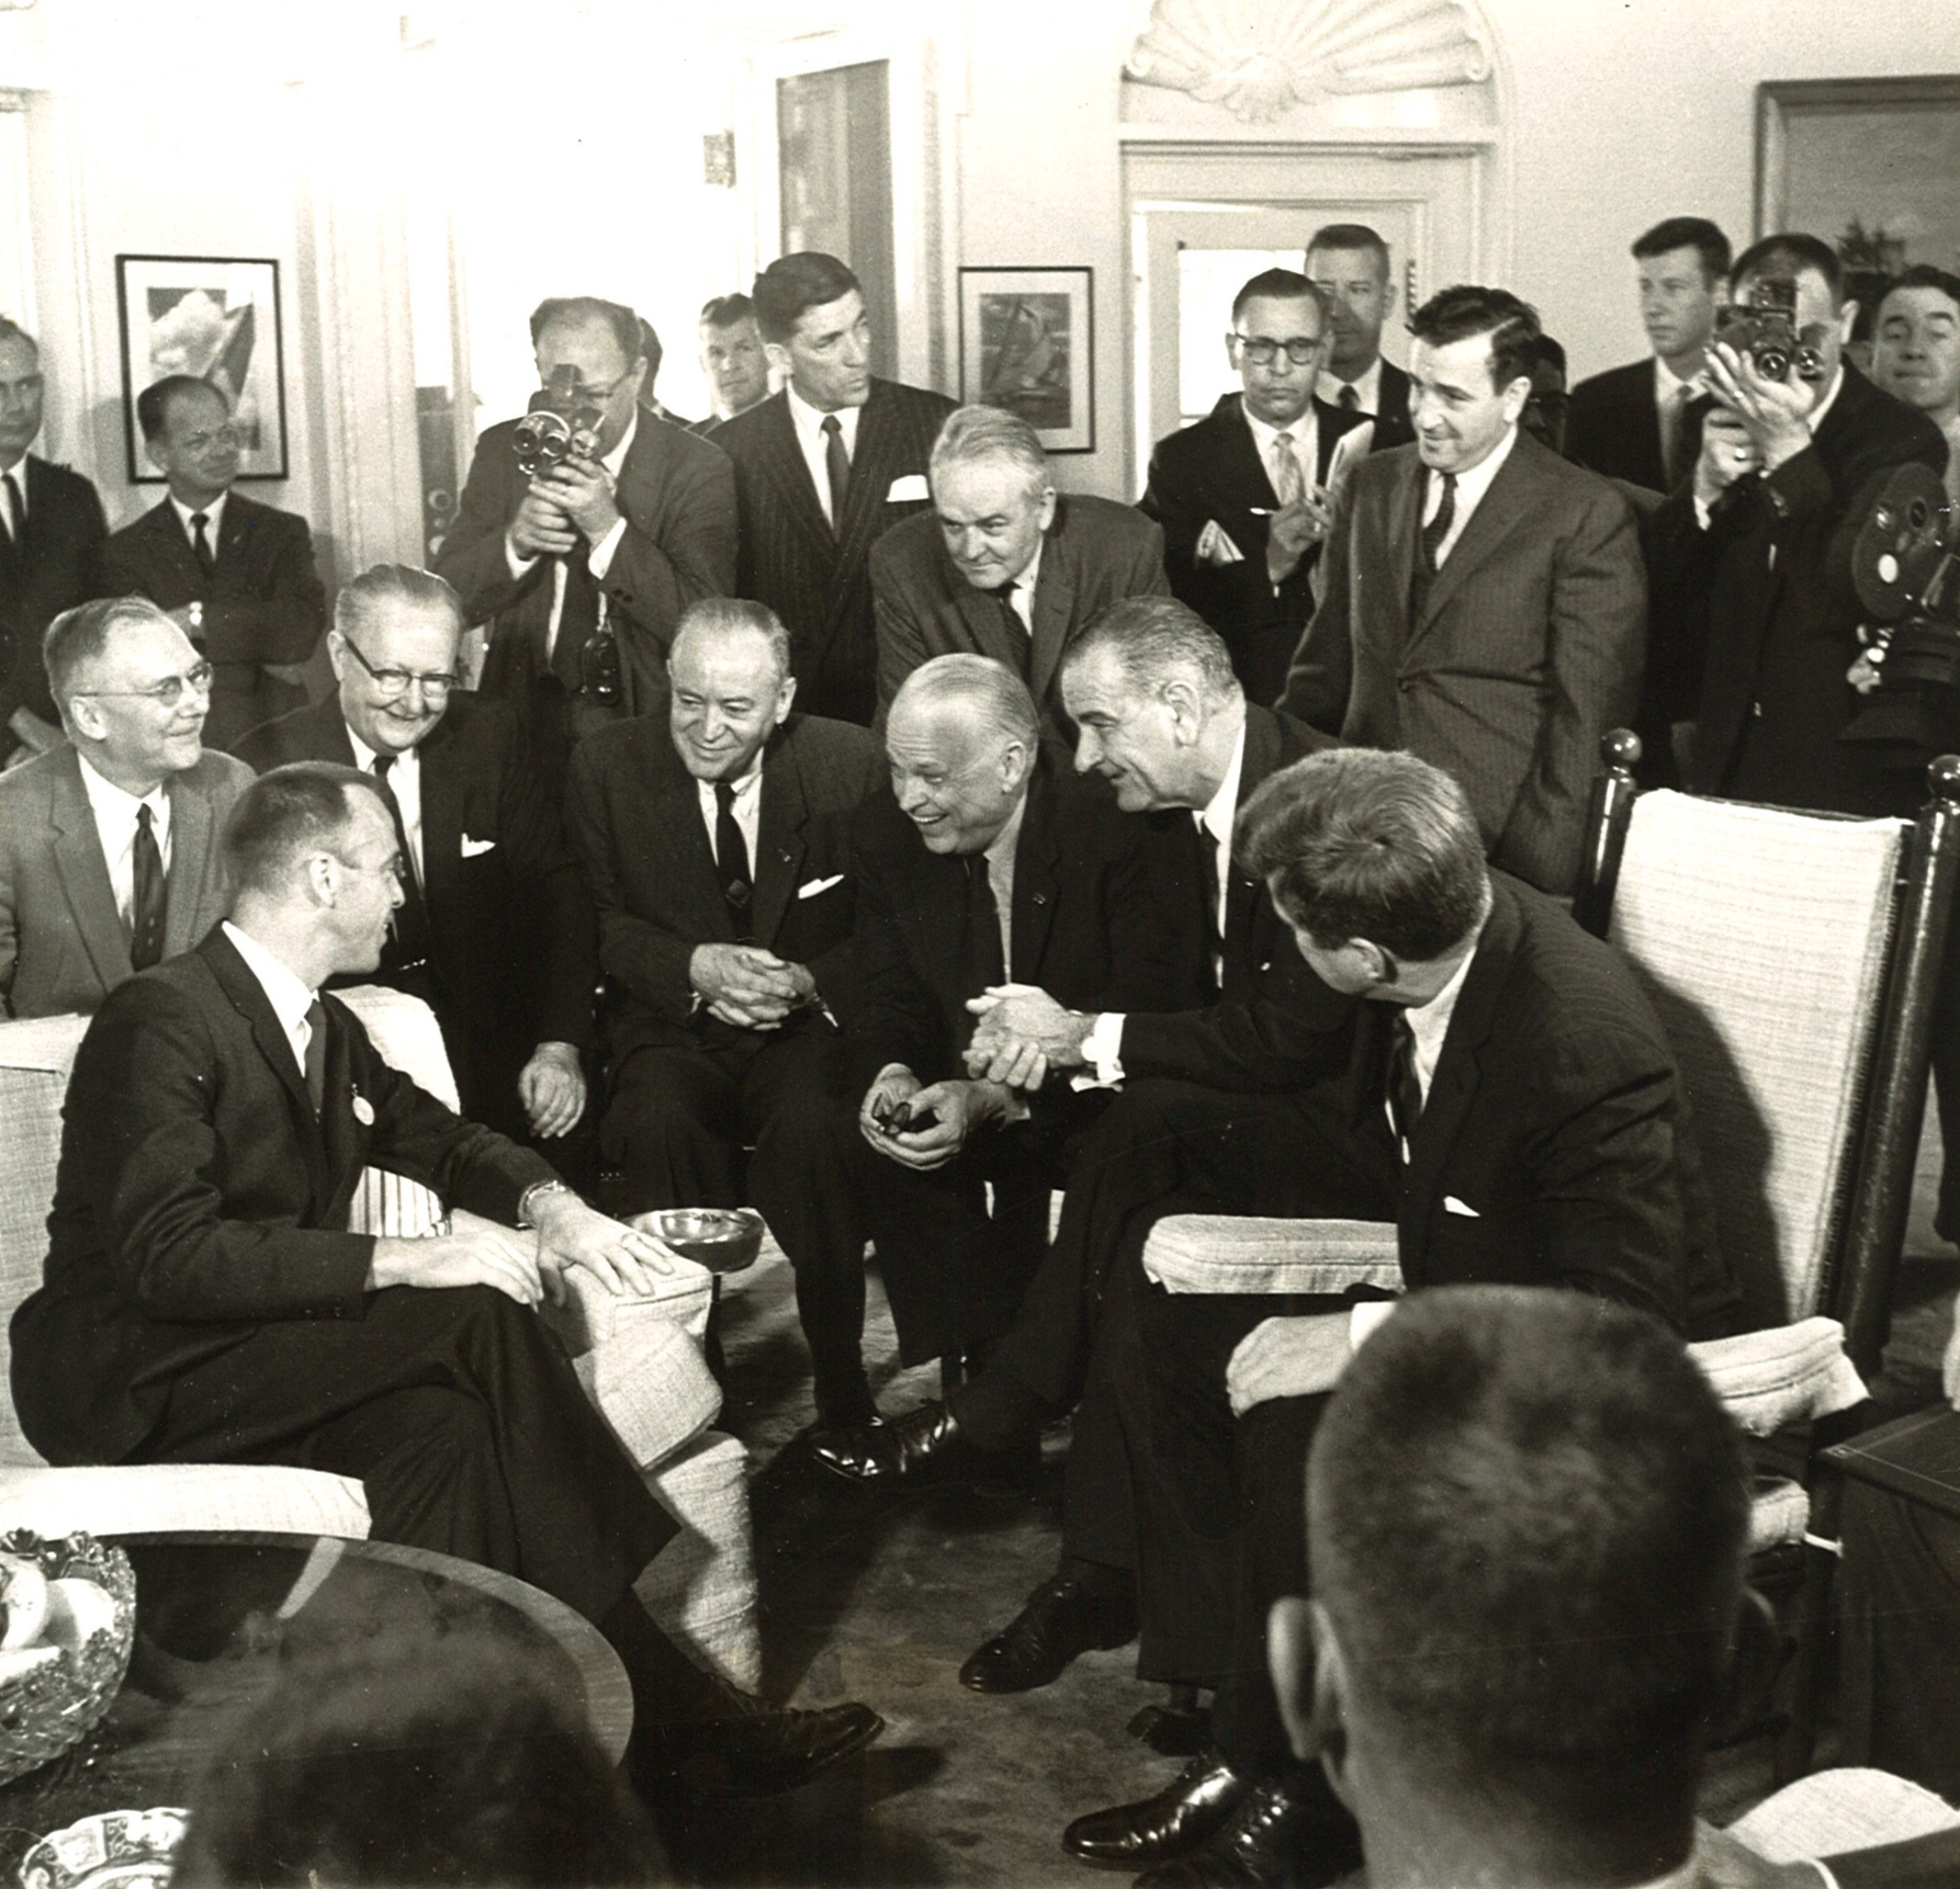
The Sky’s the Limit!
To explore the Center’s contribution to Galileo’s World, see:
ROCKETS' RED GLARE: ROBERT KERR
AND THE SPACE AGE
http://rockets.cacexplore.org/cms/exhibits/show/rockets--red-glare--robert-ker
Direct inquires for additional
information to:
Cindy Simon Rosenthal
Director and Curator
csrosenthal@ou.edu
Nathan Gerth
Assistant Curator & Archivist
gerth@ou.edu

