Slide 1



Constructing your future: Disability awareness
Lesson 4:
Talking About My Disability
Disability Awareness

Slide 2


Talking about
my disability
Disability Awareness

Slide 3

Journal Prompt
How can you talk about your disability so you get the supports you need to be successful?
Disability Awareness

Slide 4
Objectives
Today you will:
  identify visible and invisible disabilities
  define self-disclosure and stigma
  identify when and where you might need to share information about your disability
  discuss strategies for disclosing your disability and requesting accommodations
Disability AWareness

Slide 5
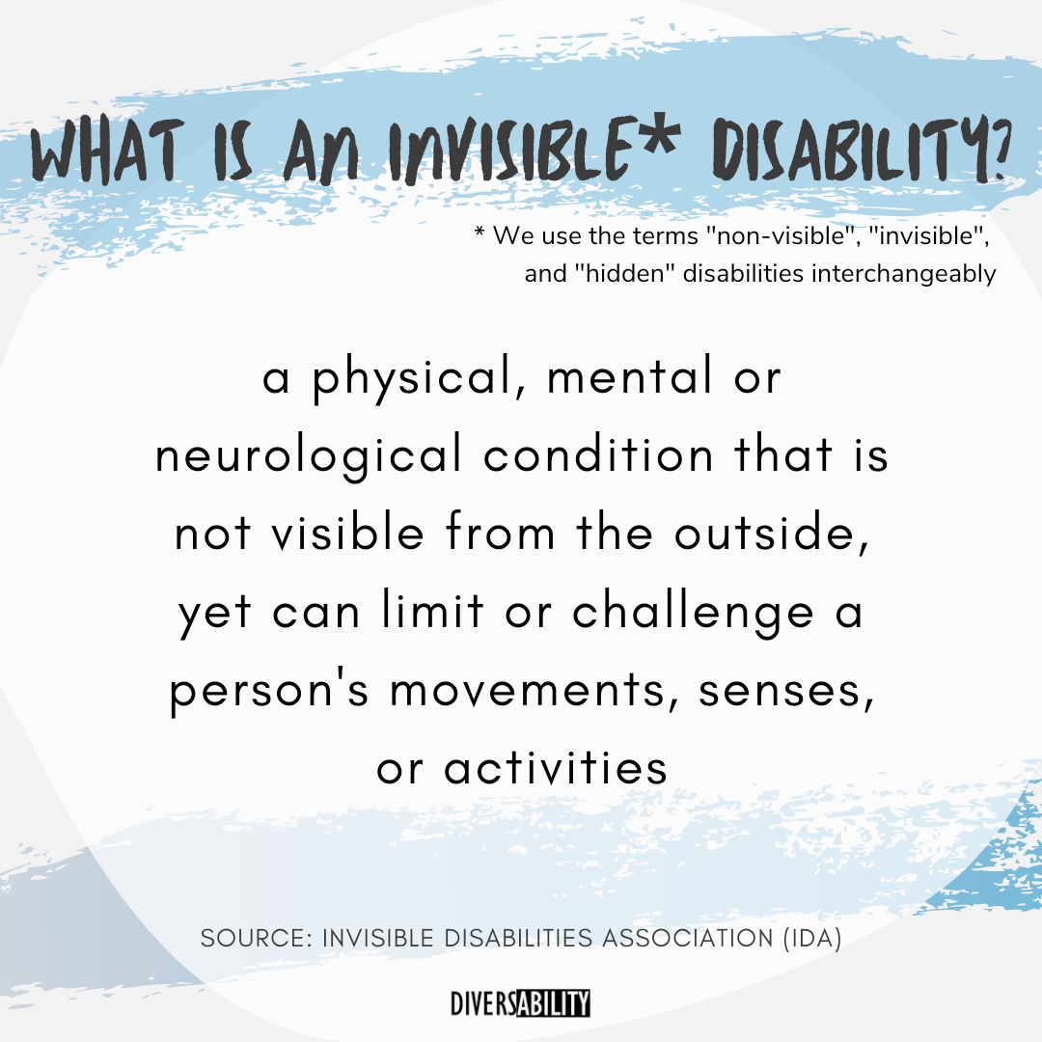
Do these terms make you think of invisible disabilities differently?
non-visible
invisible
hidden
Disability AWareness

Slide 6

Hidden Disabilities
The U.S. Department of Education
says a hidden disability is physical or mental impairment that results in a substantial limitation of one or more major life activities like:
  caring for yourself
  performing manual tasks
  walking
  seeing
  hearing
  speaking
  breathing
  learning
  working
Disability AWareness
US Department of Education

Slide 7
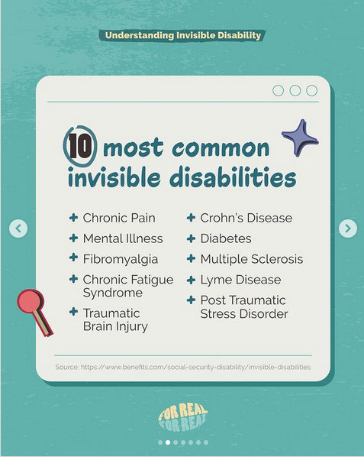



Is your disability visible or invisible?
Disability AWareness
@yougotwatchsg

Slide 8
Talking about my disability
Can you think of a situation that you might need to share information about your disability with someone else?
Disability AWareness

Slide 9
Self-Disclosure
Self-disclosure means intentionally sharing information about yourself and your disability to receive accommodations or supports.
Disability AWareness

Slide 10

Who might need to know about your disability?
  teachers
  employers
  friends
  health care professionals
  police & firemen
Disability AWareness

Slide 11
self-disclosure
When could
self-disclosure be good?
When could it be
difficult?
Disability AWareness

Slide 12
Self-Disclosure
What kind of information do you need to share? How much information do you need to share?
Disability AWareness

Slide 13
What is a stigma?
A stigma is a negative or unfair belief about
someone or something
(like a stereotype)
Disability AWareness

Slide 14

What is a Stigma?
Sometimes people have a stigma about disabilities or a person who has a disability.
Disability AWareness

Slide 15
choosing to talk about your disability
Because of stigmas, some people may not want to talk about their disability.
Sometimes you need to talk to others about your disability to get help, accommodations, and support.
Disability AWareness

Slide 16
choosing to talk about your disability
You can choose who you want to tell about your disability and how much you want to share.
Disability AWareness

Slide 17

Advantages of Self-Disclosure
You can receive:
  accommodations you need to be successful
  some legal protections against discrimination (ADA)
You also increase your:
  self-confidence and self-advocacy skills
  communication with others
Disability AWareness

Slide 18
DisAdvantages of Self-Disclosure
You might:
  get embarrassed
  be asked questions
  be treated differently
  feel excluded
Disability AWareness

Slide 19
Talking about my Disability
What information would you need to share about your disability?
Disability AWareness

Slide 20
Self-Disclosure: Beyond High School
Your teacher, instructor, professor, and/or boss will need to know:
  how your disability affects the way you learn and perform
  what accommodations, supports, and services you need to be successful
You can choose to (not) share additional information about you and your disability.
Disability AWareness

Slide 21

Self-Disclosure: Beyond High School
When you get a job and after you graduate from high school,
it is your responsibility
to disclose your disability and to ask for accommodations and supports you need.
Disability AWareness

Slide 22


Person-first language
It's important to use person-first language when you talk about disabilities.
This means talking about a person before their disability.
Disability AWareness
“He’s a person with autism.”
“He’s an autistic person.”

Slide 23
Talking about my Disability
If you wanted to tell someone about your disability, what would you say?
Disability AWareness

